Slide 1
Alarm System Update based on Apache Kafka
June 2018
Kay Kasemir
Evan Smith

Slide 2
Evolution of CS-Studio
JavaFX
SWT
BOY
Display Builder
Display Builder
Data Browser
Data Browser
Data Browser
PV Tree
PV Tree
PV Tree
Probe
Probe
Probe
PV Table
PV Table
PV Table
Alarms
Alarms
Alarms
Channels
Channels
Channels
Scan
Scan
Scan
… more …
… more …
… more …
Eclipse
Eclipse
Phoebus
Java 8
Java 8
Java 9, 10
Since ~2010: Operational at several sites
Since ~2016: SNS beam lines, planned for ESS
End of 2018 Goal: Some SNS beam lines

Slide 3
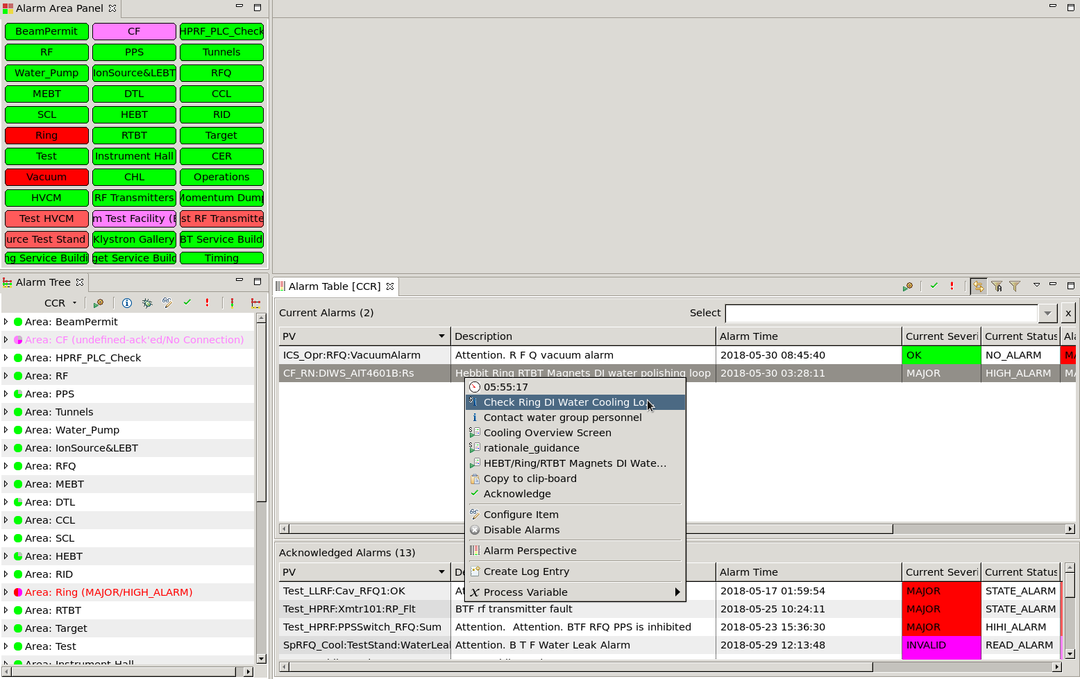
Alarm System
Alarm Server
Monitor PVs
Track alarms, acknowledgement
Alarm UI
Configure (add PVs, guidance, links to displays)
Show current state
Acknowledge alarms
Open guidance, related displays, email, log, ..

Slide 4
Current Architecture
RDB
Configuration
Snapshot of last known state
JMS
Acknowledge requests
State updates
Notification of configuration updates
/Accl/Vacuum: Guidance “…”
/Accl/Vacuum/PV1: Latch, last severity MINOR, time of last change, ..
/Accl/Vacuum/PV1: Acknowledged
/Accl/Vacuum/PV1: Severity now MINOR_ACK
/Accl/Vacuum: Guidance was changed

Slide 5
Alarms: From RDB/JMS to Kafka
/Accl/Vacuum: Guidance “…”
/Accl/Vacuum/PV1: Latch, last severity MINOR, time of last change, ..
Clients need
Config and initial state: RDB
state updates: JMS
/Accl/Vacuum/PV1: Severity now MINOR_ACK
➔ Do all that in Kafka?!
Topic ‘Accelerator’ for configuration
Topic ‘AcceleratorState’ for state
/Accl/Vacuum: {“guidance”: …}
/Accl/Vacuum/PV1: {“latch”:true, …}
/Accl/Vacuum/PV1: {“severity”:”MINOR”, …}
/Accl/Vacuum/PV1: {“severity”:”MINOR_ACK”, …}

Slide 6
Kafka stream for Alarms, ‘AcceleratorState’
From beginning of time, never ending
…
/Accl/Vacuum/PV1: {“severity”:”MINOR”, …}
/Accl/Vacuum/PV1: {“severity”:”MINOR_ACK”, …}
/Accl/RF/PV2: {“severity”:”MINOR”, …}
/Accl/Vacuum/PV1: {“severity”:”OK”, …}
/Accl/RF/PV3: {“severity”:”MAJOR”, …}
Time
/Accl/RF/PV2: {“severity”:”OK”, …}
/Accl/Vacuum/PV1: {“severity”:”MINOR”, …}
/Accl/Vacuum/PV1: {“severity”:”MINOR_ACK”, …}
/Accl/Vacuum/PV1: {“severity”:”OK”, …}
…
Clients tend to only need the most recent state for each item, followed by updates

Slide 7
Kafka Storage of ‘AcceleratorState’…
New ‘segment’, e.g. every 10 seconds..
/Accl/Vacuum/PV1: {“severity”:”MINOR”, …}
/Accl/Vacuum/PV1: {“severity”:”MINOR_ACK”, …}
/Accl/RF/PV2: {“severity”:”MINOR”, …}
/Accl/Vacuum/PV1: {“severity”:”OK”, …}
/Accl/RF/PV3: {“severity”:”MAJOR”, …}
Time
/Accl/RF/PV2: {“severity”:”OK”, …}
/Accl/Vacuum/PV1: {“severity”:”MINOR”, …}
/Accl/Vacuum/PV1: {“severity”:”MINOR_ACK”, …}
/Accl/Vacuum/PV1: {“severity”:”OK”, …}
…
Simply delete older segments?
Then state of PV3 is lost..

Slide 8
‘Compacted’ Kafka ‘AcceleratorState’
Keeping single older segment w/ last value for each item
/Accl/RF/PV2: {“severity”:”MINOR”, …}
/Accl/Vacuum/PV1: {“severity”:”OK”, …}
/Accl/RF/PV3: {“severity”:”MAJOR”, …}
Time
/Accl/RF/PV2: {“severity”:”OK”, …}
/Accl/Vacuum/PV1: {“severity”:”MINOR”, …}
New clients get at least the most recent state for each item, maybe a few more,
followed by updates
/Accl/Vacuum/PV1: {“severity”:”MINOR_ACK”, …}
/Accl/Vacuum/PV1: {“severity”:”OK”, …}
…

Slide 9
Initial Tests
2010 Test (PosgreSQL, JMS)
Load hierarchy with 50000 PVs into RDB
5 minutes
Show config in new Alarm Tree
Nothing shown until all loaded after 30 seconds
Handle Alarm Updates
10 per second
2018 Test (Kafka)
100000 PVs into Kafka
3 seconds
Shows growing tree for 10 seconds
500 per second

Slide 10
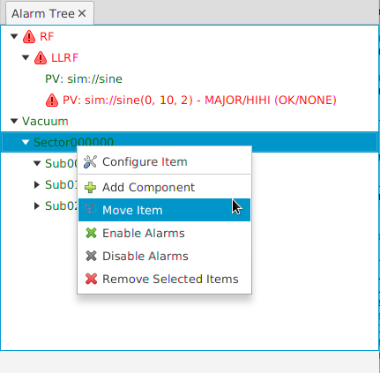
State of Development
Functional
Alarm Server
Import/Export of XML-based configuration
Same format as before
Alarm Tree
Configure, monitor, acknowledge, ..
Alarm Table
Primary operator view of current alarms
Area Panel
For cross-the-room status check
To Do
Annunciator
Authentication for changes

Slide 11
Further Ideas for - based Alarm System
Stream ‘compacted’ alarm topics into
Non-compacted Kafka Topics: Long-term history
RDB, MongoDB, ElasticSearch: Alternate long-term history, existing tools to analyze
For what it’s worth: ESS uses Kafka to stream EPICS PVs & Instrument data,
http://accelconf.web.cern.ch/AccelConf/icalepcs2017/papers/tupha177.pdf

Slide 12
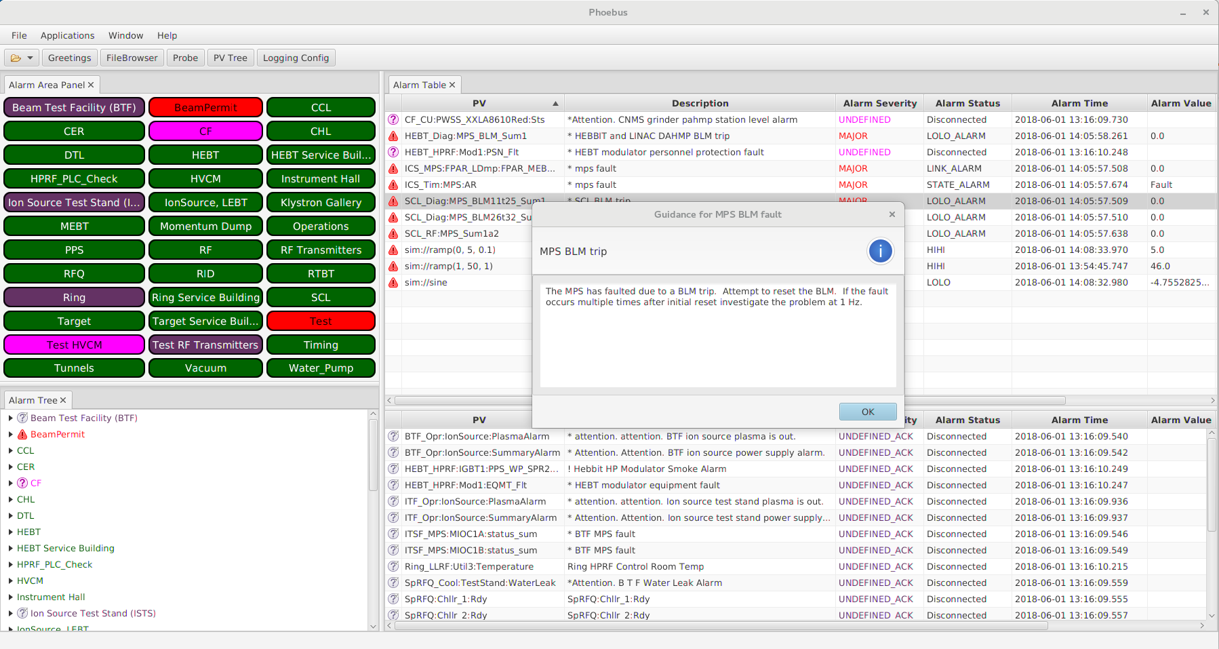
Alarm System Update for Phoebus
RDB & JMS →
Same XML import/export
Similar UI
Performance headroom

Slide 14
Other Changes
Server now ‘maximizes’ severity of all nodes up to root
Used to be in client
Has to be in server to support ‘sevr_pv’
A little more traffic, but
simpler client code
more information for reports, statistics, dashboards

Slide 15
Quirks (not show stoppers)
Deleting and then re-creating a topic to “start over” causes log cleaner to quit. Need to restart Kafka.
“Delete” alarm tree node.. means adding a null entry. New clients often see both messages, i.e. add and soon delete the entry. Full cleanup means starting over: Export data, recreate topic (requires Kafka restart), import data.
/Accl/Vacuum/PV1: {“latch:true, …}
/Accl/Vacuum/PV1: null

