Slide 1
Kegnote Address: EPICS, Brewing, and the Maker Ecosystem
Ryan Pierce

Slide 2
EPICS can control synchrotrons and telescopes. But can it brew beer?
And WHY does someone spend thousands of dollars and hundreds of hours over two four years to build a computer controlled beer brewing system using EPICS?

Slide 3
Because Beer and Physics have a long and distinguished history!
A young Albert Einstein, working for his family’s company Elektrotechnische Fabrik J. Einstein & Cie, installed electricity for Munich’s oldest Oktoberfest beer tent.
Using EPICS to brew beer carries on this noble tradition!

Slide 4
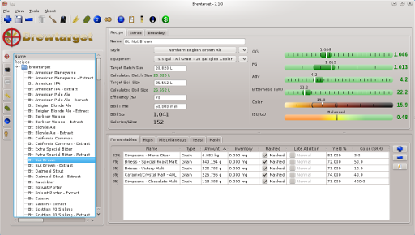
Because Process Control!
Brewing depends on careful process control
Mash temperature and time control enzymes
Goal: Temp. +/- 0.5 F
Accurate water volume
Boil-off rate
Process control makes brewing repeatable
Beer can be “designed” in software
Better recipe development by reducing human error

Slide 5
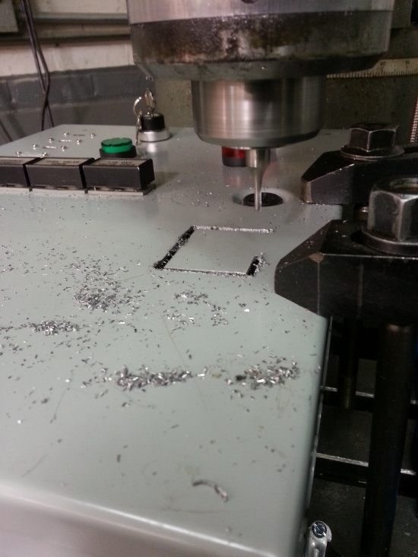
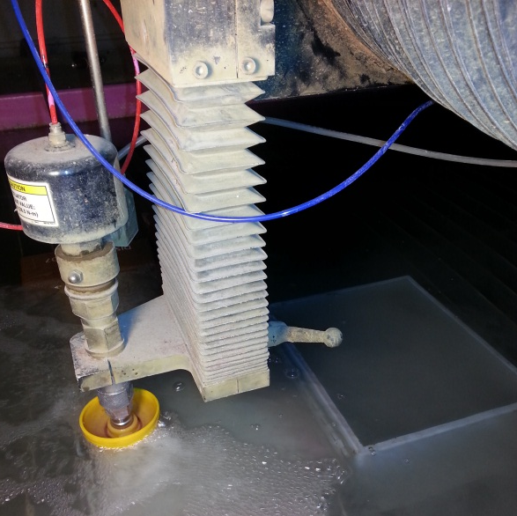
Because Hackerspace!
Hackerspaces / Makerspaces / Fab Labs provide:
Tools (MIG and TIG welders, manual and CNC machining…)
Community (people who like to teach what they know)
Ecosystem of Open Source, Open Hardware
Arduino, Raspberry Pi, BeagleBone
Commercial software that is free to makers:
Fusion 360 (CAD/CAM), Eagle (PCB design)
Encourage the audacious!
I built this project at:
Pumping Station: One (location of brew club, welding, metal fabrication, assembly and testing)
University of Chicago Polsky Center Fab Lab (software)
Analytics Lounge (waterjet)
Lately, a friend’s house

Slide 6
Because EPICS!
EPICS provides much of what I need out of the box
Network protocol, code, and libraries
Tools to construct operator control panels without writing GUI code
Data archiving, web interface
EPICS lets me focus on my hardware interface and control algorithms

Slide 7
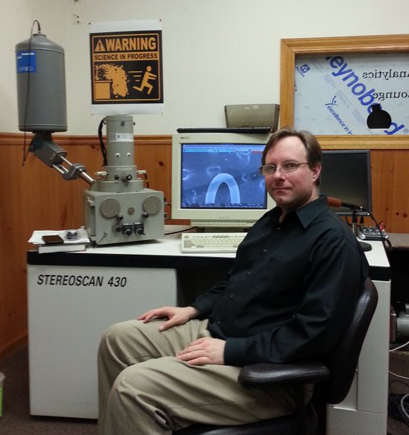
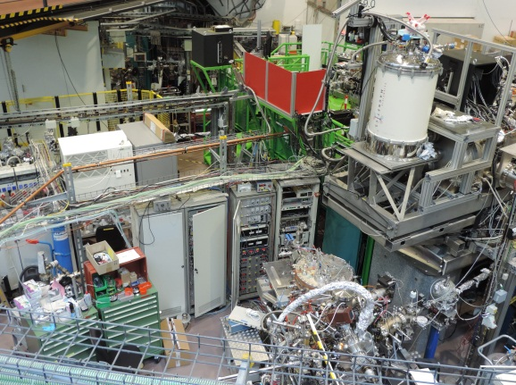
Because Science!
As a kid, I wanted to be a high energy physicist
Lectures and tours at Fermilab, Argonne, working summers at a science museum, intern at CDF
As an adult, I’m still fascinated by science
APS open house in 2012 introduced me to EPICS
EPICS community provided significant help and encouragement with this project and enabled access to BESSY II and BER II in 2015
Presented at 2016 EPICS Conference at ORNL
Analytics Lounge – making science accessible
Scanning electron microscopy and EDX, gamma and alpha spectroscopy, ICP-MS, pXRF
Currently looking for a home for our lab….

Slide 8
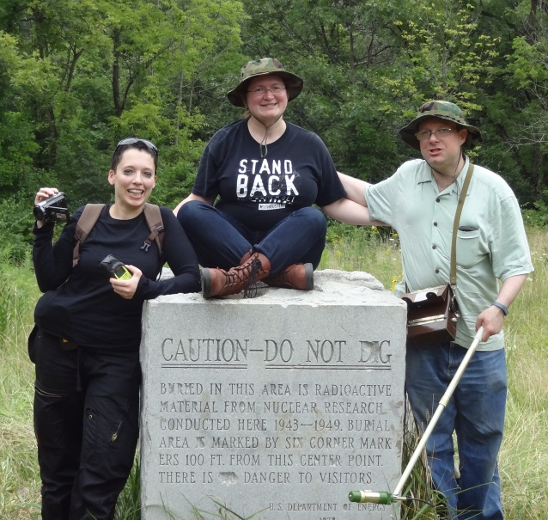
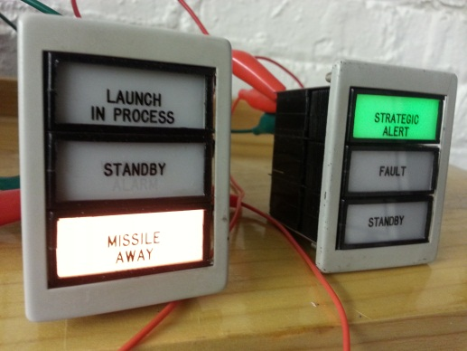
Because Cold War and Nuclear History!
My favorite vacation spots include Chernobyl, Hanford, US and Ukrainian nuclear missile museums
I acquired panel indicator lights from two nuclear missile systems:
Thor IRBM
Minuteman I ICBM
Swords to Plowshares – repurposing nuclear weapons systems parts for Beer!

Slide 9
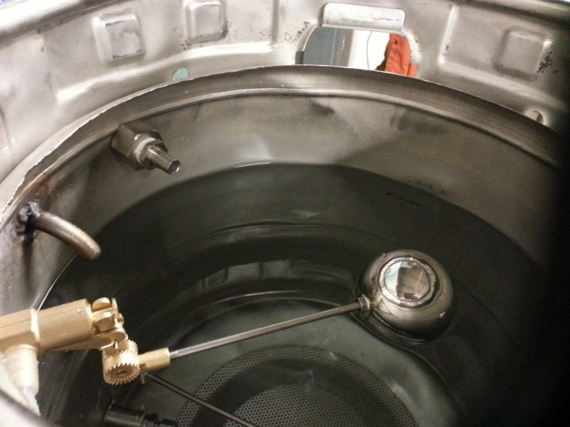
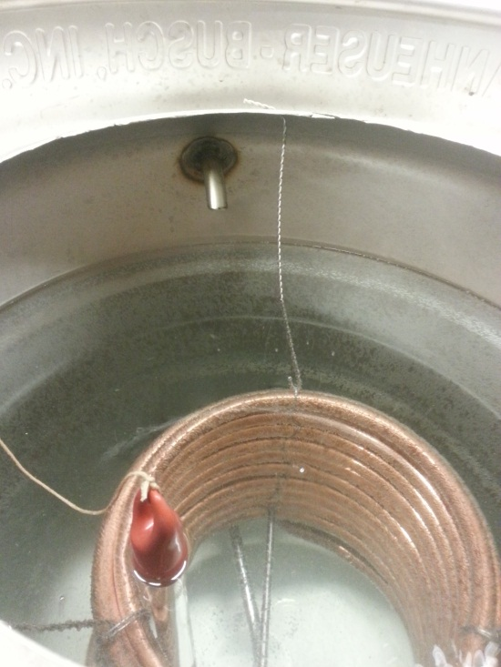
System Overview

Slide 10
EPICS System Design
Raspberry Pi running IOC
StreamDevice & Asyn via USB serial
Arduino Mega
Interfaces to brewing hardware and sensors
Unlike Pi, uses 5 V logic and lots of GPIO and analog pins
Unlike Pi, tight timing (bit banging), hardware interrupts don’t require kernel drivers
Runs code derived from Pete Jemian’s cmd_response
Implements critical control algorithms like firing gas burners without risk of Linux crashing
CSS BOY operator interface
Actuators:
12 VDC actuated ball valves and solenoid valves for fluids
24 VAC propane burner valves / pilot lights (furnace control)
120 VAC pump
Stepper motor (for propane throttle)
Sensors:
Bus of DS18B20 OneWire temperature sensors
Analog pressure sensors for measuring fluid levels
Flow meters producing streams of pulses

Slide 11
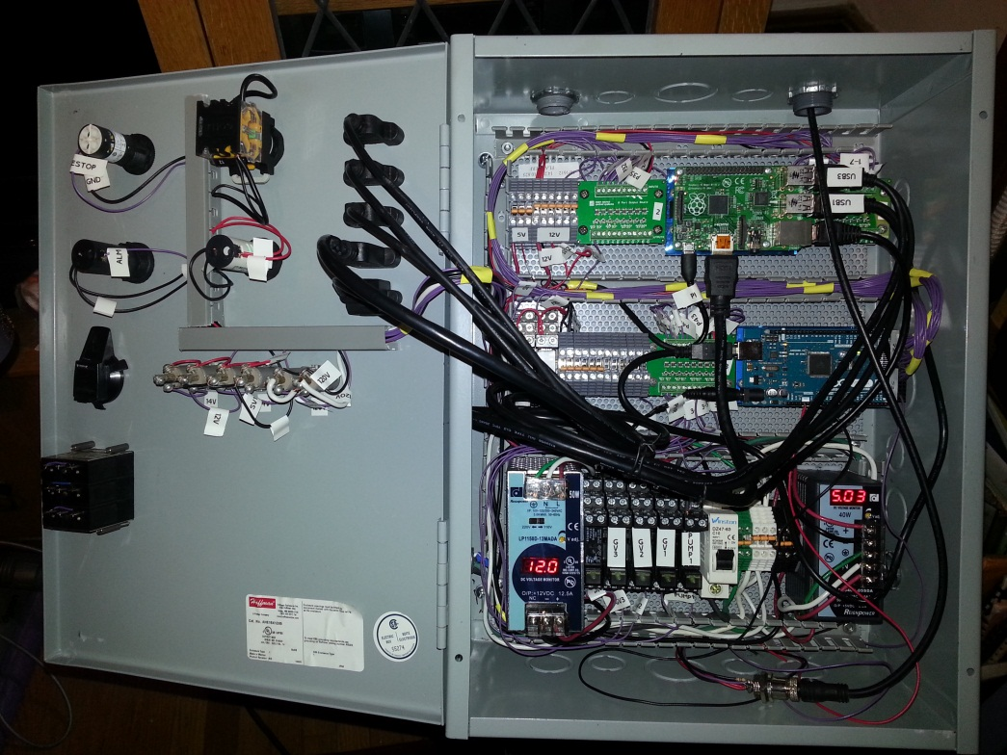
Control Electronics

Slide 12
Correcting Overshoot
Lag between applying heat via a propane burner and temperature probe responding.
This lag varies based on amount of water in keg, whether heat exchanger is operating, etc.
Simple setpoint / deadband doesn’t work.
PID has limited ability to correct for lag.

Slide 13
Correcting Overshoot
To correct for hysteresis, store burner history, e.g. burner was on X seconds out of the last 120 seconds.
Operator specifies Overshoot, in degrees F, based on observation.
Turn Burner On if Temp + (History * Overshoot / 120) < Setpoint – Deadband
Turn Burner Off if Temp + (History * Overshoot / 120) > Setpoint
Achieves +/- 0.5 F accuracy

Slide 14
The Heat Exchanger Problem
We measure three temperatures:
The grain mash in the mash tun
The water in the heat exchanger (directly controlled by the propane burner)
The output of the heat exchanger (what we want to control)
We have a desired setpoint for the heat exchanger output
We need to calculate a dynamic setpoint for the heat exchanger water, which the propane burner control algorithm will use.

Slide 15
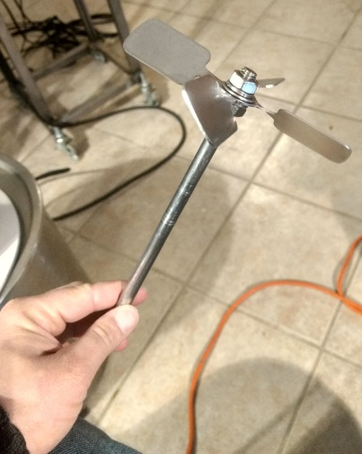
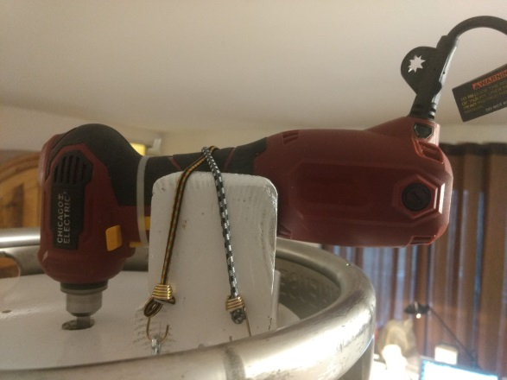
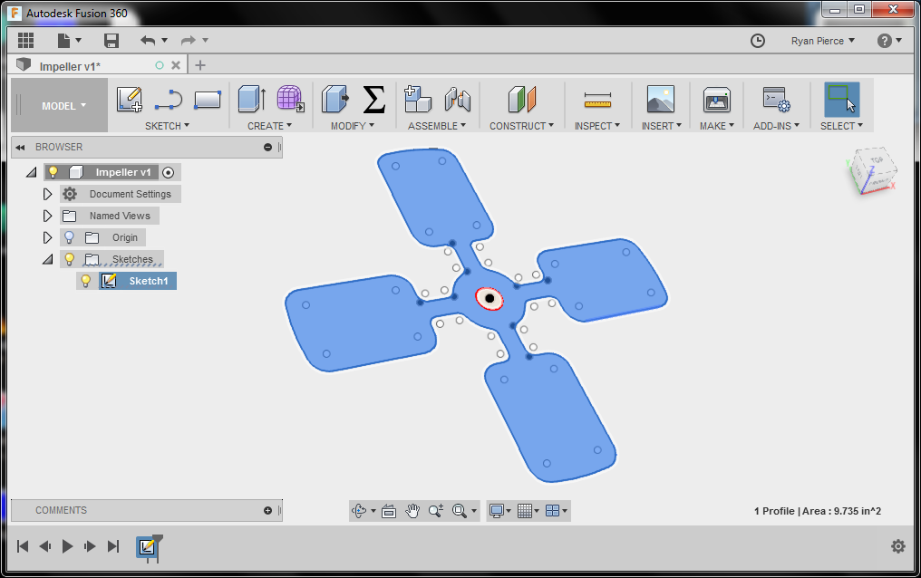
Improving Heat Exchanger Efficiency via Stirring
We observed the heat exchanger output was closer to the heat exchange water when the water was stirred.
We added an impeller to circulate water in the heat exchanger.

Slide 16
calcout -> Good Beer!
record(ao, "$(P)mash:sp") {
field(DESC, "Mash Temp Setpoint")
field(EGU, "F")
field(HOPR, "190")
field(LOPR, "30")
field(PREC, "2")
field(PINI, "YES")
field(VAL, "155")
}
record(bo, "$(P)mash:auto") {
field(DESC, "Mash Auto Setpoint")
field(ZNAM, "Off")
field(ONAM, "On")
field(PINI, "YES")
field(VAL, "0")
}
record(calcout, "$(P)mash:calc") {
field(INPA, "$(P)mash:sp CP")
field(INPB, "$(P)temp3:temp CP")
field(INPC, "$(P)mash:auto CP")
field(CALC, "C")
field(OOPT, "When Non-zero")
field(DOPT, "Use OCAL")
field(OCAL, "A+MIN((A-B)*2,10)")
field(OUT, "$(P)gas3:sp PP")
}
Experimentation with circulating water showed that:
Optimum dynamic heat exchanger temperature setpoint is the desired temperature plus twice the error.
E.g. if I want 155 F and the heat exchanger output is 154, the propane burner should use a 157 F setpoint.
2 * Error should be capped at 10 F so the heat exchanger setpoint won’t be dangerously high.
This dynamic functionality is only used during mashing.
Preheating before adding the grain, and sparging afterwards, use static heat exchanger setpoints.
This functionality requires an on/off switch.
Success! +/- 0.5 F heat exchanger output is achievable while brewing beer!

Slide 17
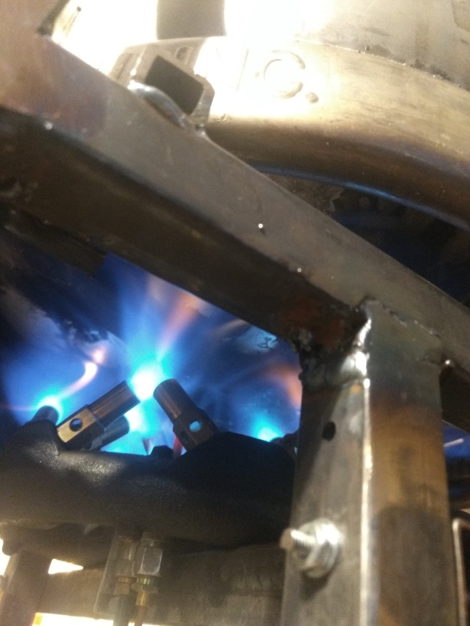
Brewing an IOC IPA

Slide 18
Brewing an IOC IPA

Slide 19
Next Steps
Hardware:
Complete valve automation
Fabricate a Boil Kettle
Calibrated water fill via flow rate sensors
Fluid level sensors
Stepper motor control of propane valve
Software:
Scripting, ramp/soak (SNL? Bluesky?)
Archiver Appliance? WebOPI? iPad control?
Touch screen on the Pi? (PyDM?)
Compare results with beer design software and quantify repeatability

Slide 20
EPICS and the Maker Ecosystem
EPICS solves the same problems for makers and physicists, even if the hardware being controlled is vastly different
Both communities strongly value open source, customizable ecosystems
Considerable crossover (Pi, Arduino) with the common maker hardware / software stack
Both communities compliment each other with different perspectives
Physics and the maker movement strive to achieve the audacious!

Slide 21
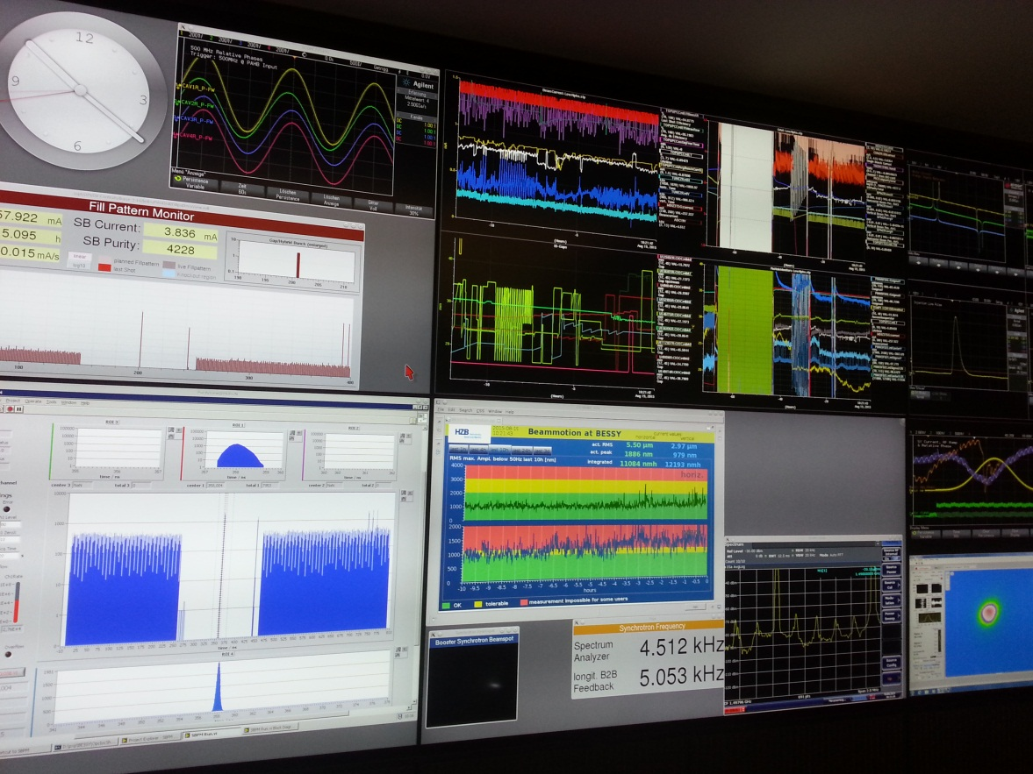
EPICS and Beer! Any questions?

