Slide 1
pmac
A model III driver for trajectory scanning on Delta Tau PMAC systems
Edmund Warrick, Diamond Light Source

Slide 2
Motivation
Need more, more complex, faster trajectory scans
Requirements on driver support:
Arbitrary trajectories
Low deadtime
Run-time CS configuration
Facilitates troubleshooting

Slide 3
Motivation – tpmac driver
Existing model 2 driver
Widely used at Diamond
PVT moves, CS configuration not supported
Handling of comms not ideal
motor
pmacUtil
tpmac
pmacCoord
hardware

Slide 4
pmac
motor
motor
pmacUtil
tpmac
pmacCoord
pmac
hardware
hardware
Replacement for tpmac, pmacCoord and pmacUtil.

Slide 5
pmac - features
Message broker
Run-time CS configuration
PVT trajectory scanning

Slide 6
Message broker
pmacController
pmacCSController
Message Broker
PMAC
pmacAxis
pmacCSAxis
3 polling levels for variables:
Slow (0.1Hz)
Medium (1Hz)
Fast (1Hz stationary, 10Hz in motion, configurable)

Slide 7
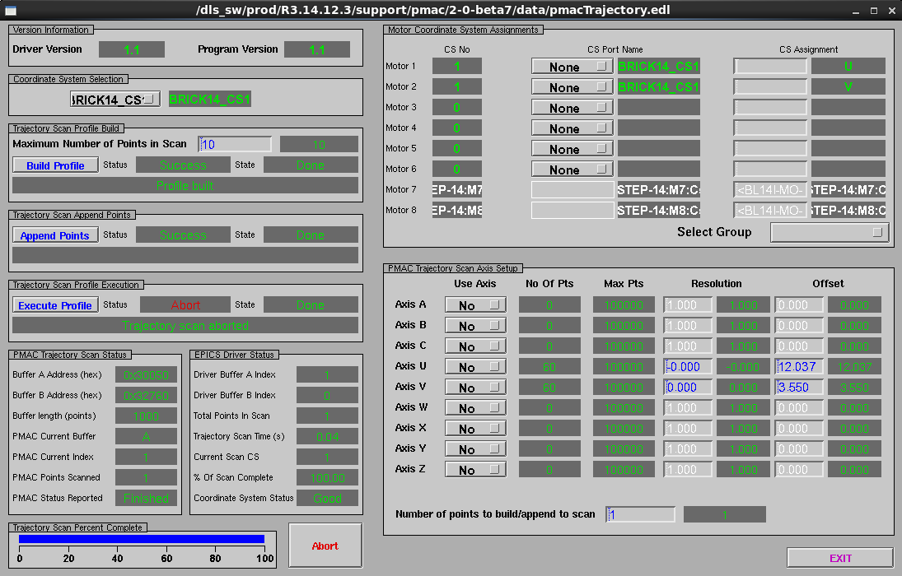
Coordinate System Configuration

Slide 8
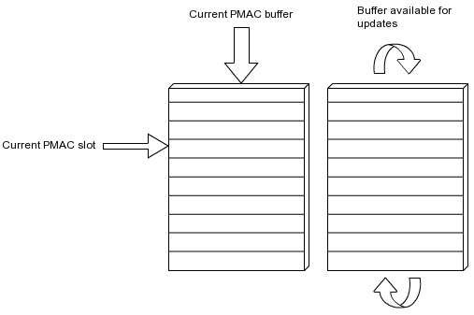
Trajectory Scanning – PVT moves
(P)osition (V)elocity (T)ime
Motion program trajectory_scan.pmc acts as interface to PVT moves.
Computes velocities and commands PVT moves.
Uses double buffering architecture.

Slide 9
Trajectory scanning – PMAC motion program
To specify a trajectory, populate the following PVs:
Array of (T)ime segments: ProfileTimeArray
Array of (P)ositions for each axis: A:Positions … Z:Positions
Array of (V)elocity calculation modes: VelocityMode
(Optionally) user modes for each point: UserArray

Slide 10
Trajectory Scan – Velocity modes
Velocity Vector
Previous-next
Current-next
Previous-current
Zero

Slide 11
Status
In use on Diamond beamlines I08, I14, I15, I16, I18
Rolling out for all new hardware triggered scans
Diamond maintainer: Giles Knap
Release 2-0 available:
https://github.com/dls-controls/pmac
Migration guide from tpmac:
https://github.com/dls-controls/pmac/blob/master/docs/source/migration.rst

