Slide 1
Using cameras for beam diagnostics in LCLS-II at SLAC
Jeremy Mock
SLAC National Accelerator Laboratory
June 2018

Slide 2
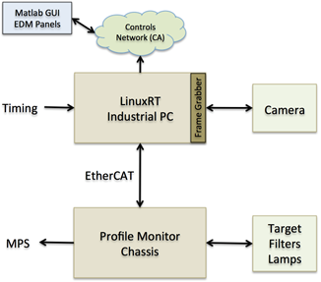
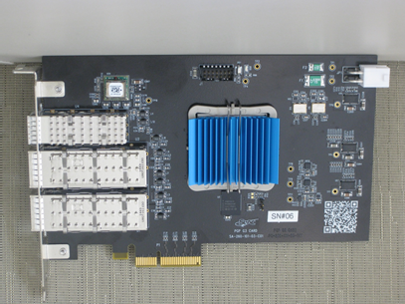
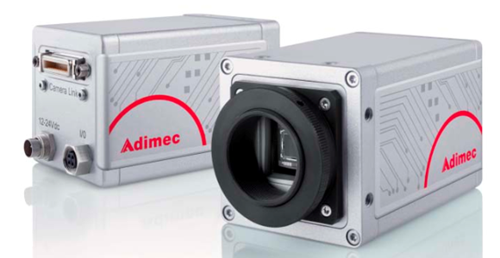
LCLS-II Camera Controls
Physics requirement to acquire beam profile rates up to 120 Hz
Developed Custom FrameGrabber based on PGP card developed in house
Firmware modification to handle camera link protocol
Provides 120 Hz Acquisition (tested in LCLS-I since 2016)
Connects up to 8 cameras
Includes embedded timing firmware
Provides reliable image time stamping
Minimizes number of CPU interrupts
Removes need for dedicated EVR
1 fiber optic pair to camera

Slide 3
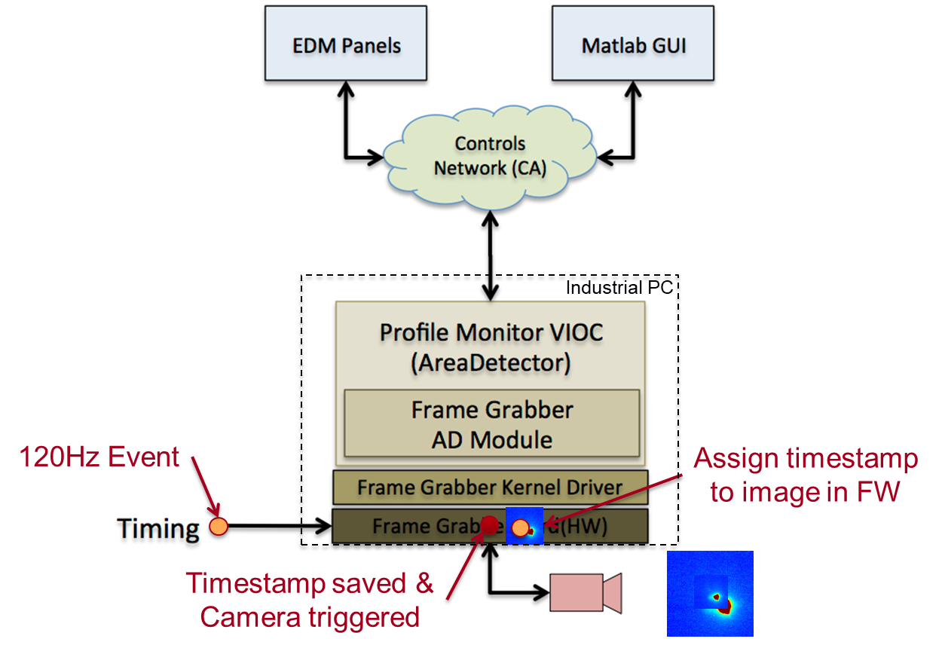
Software Stack
AreaDetector-based EPICS Module provides interface from hardware to EPCIS

Slide 4
Future Plans
This version of the system is working well
FPGA operating at ~95% capacity
Cannot load LCLS and LCLS-II Timing support simultaneously
Identified a commercially-available board from Xilinx
KCU1500
Much more cost effective
Much much larger FPGA
Both timing and some image processing
Only support 6 cameras

Slide 5
Conclusion
SLAC has identified a solution to acquire, tag, and process images at desired rates
Upgrade to the AreaDetector plugin
The system is operational in LCLS Production currently

