Slide 1
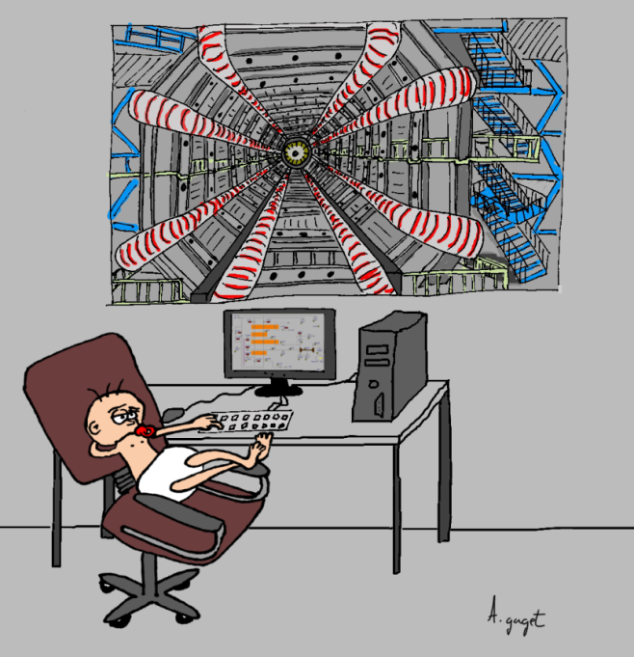

Slide 2
CONTEXT
Laboratory context
Cryogenic installation: complex drawings
AutoCAD precis drawings
Working on EPICS for more projects
Part of team doesn’t know CSS

Slide 3
Principle
DXF2OPI
Export text file
Application
Draw
PLC developer

Slide 4
Principle
Create animation
Custom AutoCAD block
2 types of drawings
Widget association
No widget association

Slide 5
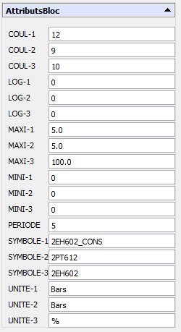
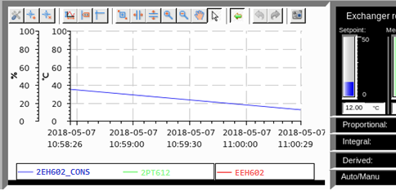
Widget association block
Graph block graph called TENDANCE

Slide 6
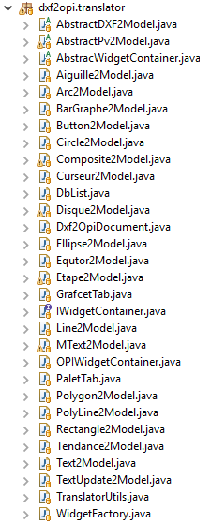
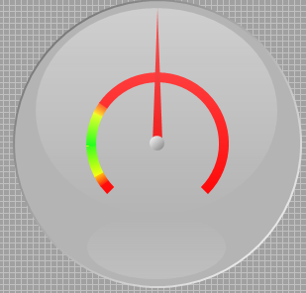
Widget association block

Slide 7
Non widget drawing
How to associate any drawing with a PV?

Slide 8
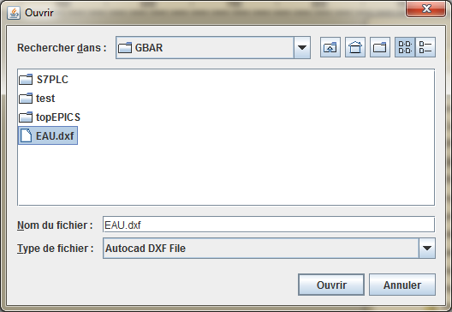
MISC
AutoCAD to OPI
Block position is relative to the insert entity => recalculation of the position of the widget
Eclipse plugin

Slide 9
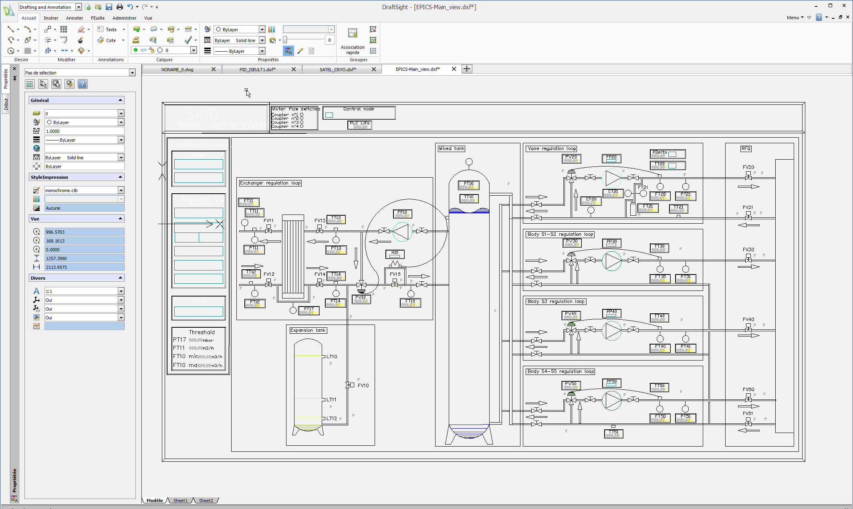
View example

Slide 10
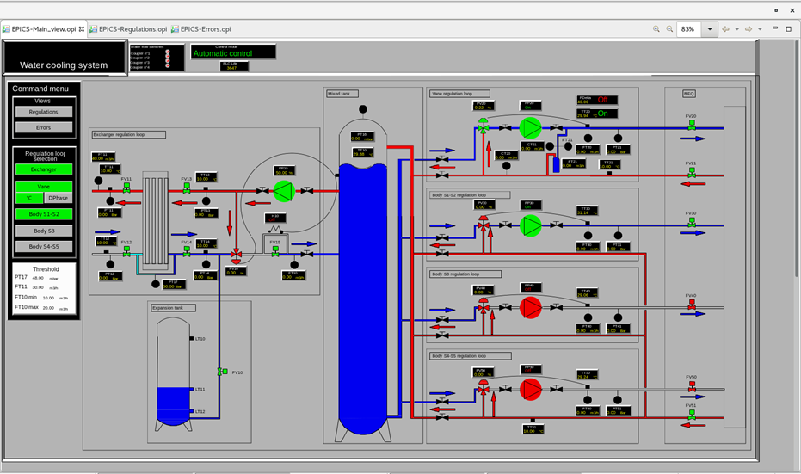
View example

Slide 11
View example
Thanks for your attention

