Slide 1
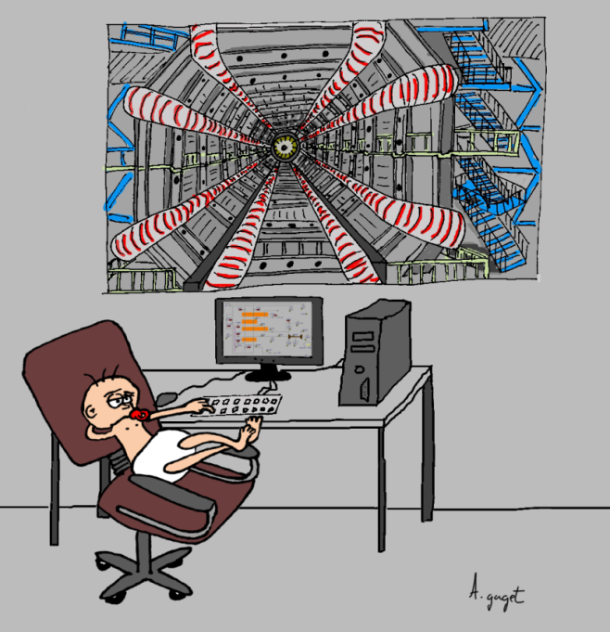

Slide 2
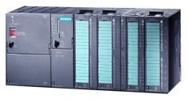
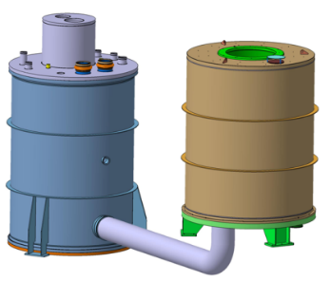
Context
IOC
Input Output Controler
Data block communication
PLC
Programmable Logic Controler

Slide 3
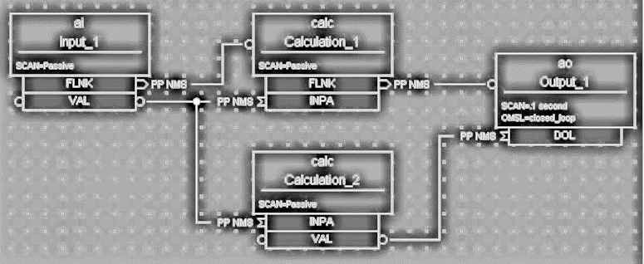
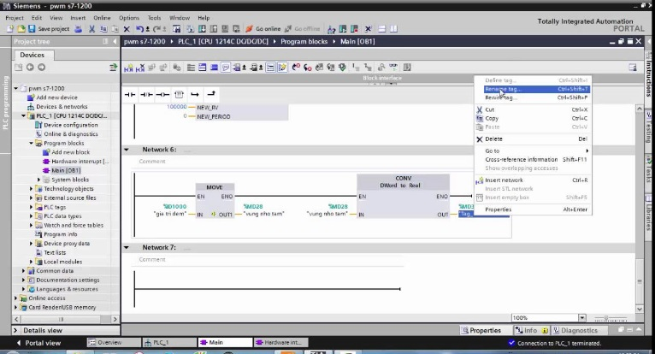
Context
IOC
Input Output Controler
Data block communication
PLC
Programmable Logic Controler

Slide 4
CEA context
5 projects per year with PLC
From 200 to 6000 variables
Need a programming communication solution for non EPICS developer
“Light” automatic solution

Slide 5
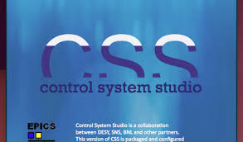
SOLUTION
IOC
Input Output Controler
Data block communication
Automatic generation
PLC
Programmable Logic Controler

Slide 6
S7PLC protocol example
TIA Portal: 2 awl files that contains 3 information: name, type, description
Application:
Calculate data offset in data block message
Add EPICS fields: SCAN, alarm, PINI
Possibility to add other fields
Communication: @IP, port, timeout,…

Slide 7
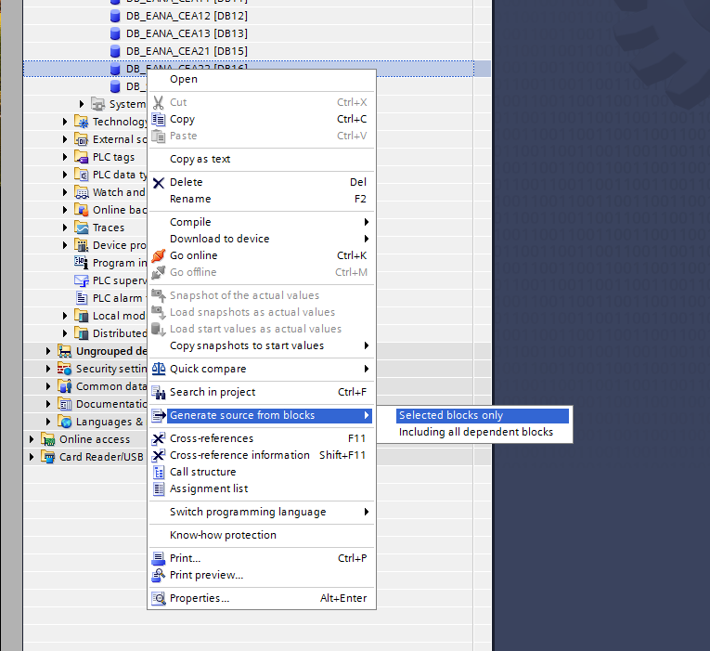
S7PLC protocol example
Export TIA Portal

Slide 8
S7PLC protocol example
Export TIA Portal
DATA_BLOCK "DATA_RECV_FROM_EPICS"
TITLE = SKID, Proj_Skid,,
{ S7_Optimized_Access := 'FALSE' }
AUTHOR : Joannem
FAMILY : ComEPICS
NAME : S7_PLC
VERSION : 0.1
NON_RETAIN
STRUCT
"SKID:PLC-001:R10P" : Real; // Regulation P
"SKID:PLC-001:R10I" : Real; // Regulation I
"SKID:PLC-001:R10U" : Real; // Regulation U
…
ENDSTRUCT;
SKID: name of EPICS IOC
Proj_Skid: PLC name in S7PLC

Slide 9
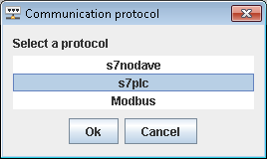
S7PLC protocol example
Import awl file: choose protocol

Slide 10
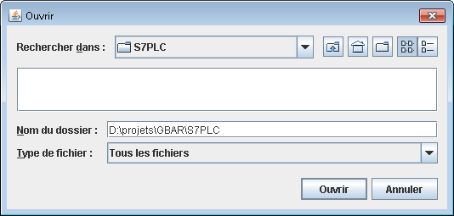
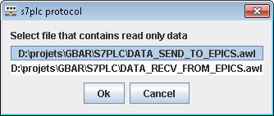
S7PLC protocol example
Import awl file: choose file

Slide 11
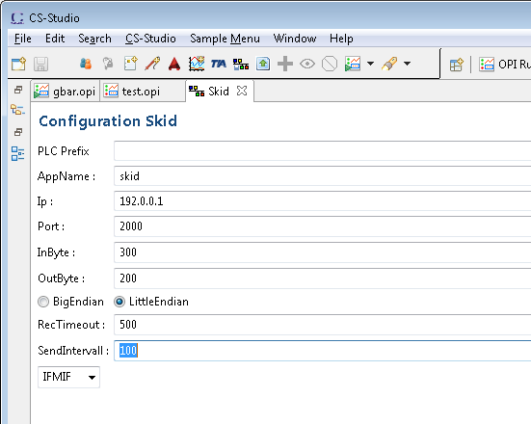
S7PLC protocol example
Import awl file: Define communication parameters

Slide 12
S7PLC protocol example
Default EPICS parameters : SCAN, ZNAM, ONAM, ZSV, OSV

Slide 13
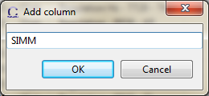
S7PLC protocol example
Add new EPICS field

Slide 14
S7PLC protocol example
Tricks
Search variable
Right click: Hide column, delete columns
Display hide columns
Sorting and unsorting by columns

Slide 15
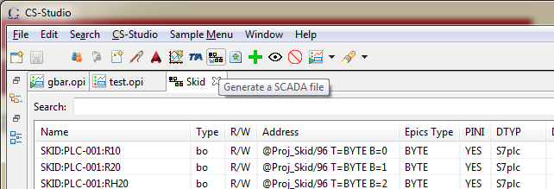
S7PLC protocol example
Generate IOC

Slide 16
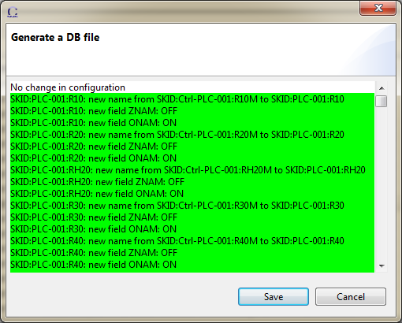
S7PLC protocol example
Generate IOC: display new parameters, change, and deleted

Slide 17
S7PLC protocol example
Generate IOC:
iocBoot/iocSkid/boot/iocTest.cmd
iocBoot/iocSkid/src/iocTestInclud.dbd
iocBoot/iocSkid/src/Makefile
skidApp/db/skid.db
skidApp/db/Makefile

Slide 18
S7PLC protocol example
Generate IOC: db file
#! DBDSTART
#! DBDEND
record(ao, "SKID:PLC-001:R10P"){
field(PINI, "YES")
field(DTYP, "S7plc")
field(DESC, " Regulation - PP10 - KP")
field(OUT, "@Proj_Skid/0 T=FLOAT")
}
record(ao, "SKID:PLC-001:R10I"){
field(PINI, "YES")
field(DTYP, "S7plc")
field(DESC, " Regulation - PP10 - TI")
field(OUT, "@Proj_Skid/4 T=FLOAT")
}
…

Slide 19
TODO
TODO:
Bugs resolution in progress like calculation of inSize and outSize
Better merge
Better design: Model View Controller
Standalone without Eclipse
Modbus/TCP

Slide 20
Generate IOC communication for Siemens PLC
Thanks for your attention

