Slide 1
babyIOC
Envisioned for
For mobile end-stations.
From past experience:
Had areaDetector-3-1 with Pilatus and several Prosilica IOCs running on Debian 8 6 y. old server with 2 GB of memory
New technology should offer same or better hardware and small factor.
First try was X15 from Beagle Bone with 2GB RAM
32 bit ARM architecture

Slide 2
Source | Product | Rekease Date | CPU | GPU | CPU speed | RAM | # Eth, GB | USB2 | USB3 | USB OTG | RS232 | price ~$ | Comments
https://en.wikipedia.org/wiki/Banana_Pi#Banana_Pi_BPI-R2 | Banana PI BPI-R2 | 2018 | MediaTek MT7623N, Quad-code ARM Cortex-A7 | Mali 450 MP4 GPU |  | 2G DDR3 SDRAM | 1 | NA | 2 | 1 |  | $100
https://boundarydevices.com/product/nitrogen6x-board-imx6-arm-cortex-a9-sbc/ | NITROGEN6X Nit6Q_2GB | 2013 | ARM Cortex™-A9 (1-4) | NA |  | 2G | 1 | 3 | NA | 1 |  | $225
https://www.pine64.org/ | Rock64 | 2017 | Rockchip RK3328 Quad-Core ARM Cortex A53 64-Bit | NA |  | up to 4GB 1600MHz LPDDR3 | 1 | 2 | 1 | NONe? |  | $50
http://www.nvidia.com/object/jetson-tk1-embedded-dev-kit.html | Nvidia Jetson TK1 dev kit | 2014 | NVIDIA 4-Plus-1 quad-core ARM Cortex-A15 CPU | NVIDIA Kepler GPU with 192 CUDA cores |  | 2 | 1 | 1 | 1 |  | 1 | $200 | only stretch, no jessie
https://www.nvidia.com/en-us/autonomous-machines/embedded-systems-dev-kits-modules/ | Nvidia Jetson TX1 | ? | 4x ARM Cortex™-A15, Cortex™-M4 (Companion MCU) | Kepler GPU with 192 CUDA®cores | up to 2.1 Ghz | 2 | 1 |  | 2 (1 OTG) |  |  |  | only stretch, no jessie
http://www.hardkernel.com/main/products/prdt_info.php?g_code=G145457216438 https://en.wikipedia.org/wiki/ODROID | ODROID-C2 | 2016 | Amlogic ARM® Cortex®-A53(ARMv8) 1.5Ghz quad core CPUs | Mali™-450 GPU (3 Pixel-processors + 2 Vertex shader processors |  | 2 | 1 | 4 |  | 1 |  | $46 | There is Jessie, image, but very minimal. Customer suppofrt is deap in China
https://www.pcengines.ch/apu2.htm | PC engines apu2 |  |  |  |  |  |  |  |  |  |  |  | totally cool, does not support Debian
https://www.embeddedarm.com/products/TS-7970 search ftp | TS-7970 | 2016 | ArmNXP i.MX6 800 MHz Solo or 1 GHz Quad Core ARM CPU NXP i.MX6 |  | 1GHz | 2 | 2 | 4 (?or) | 4(?) | 1 | 2 | $250 | Comes with Jessie by default
https://shop.udoo.org/usa/x86/udoo-x86-ultra.html?___from_store=other&popup=no http://www.seco.com/misk/UDOO_X86_datasheet.pdf | UDOO X86 Ultra | 2016 | CPU Intel Pentium N3710 2.56 GHZ x4 corse | ntel HD Graphics 405 Up to 700 MHz 16 execution units |  | 8 GB DDR3L DUAL CHANNEL | 1 |  | 3 |  |  | $280 | Any Linux Distribution for X86 platform

Slide 3
Source | Product | Rekease Date | CPU | GPU | CPU speed | RAM | # Eth, GB | USB2 | USB3 | USB OTG | RS232 | price ~$ | Comments
https://en.wikipedia.org/wiki/Banana_Pi#Banana_Pi_BPI-R2 | Banana PI BPI-R2 | 2018 | MediaTek MT7623N, Quad-code ARM Cortex-A7 | Mali 450 MP4 GPU |  | 2G DDR3 SDRAM | 1 | NA | 2 | 1 |  | $100
https://boundarydevices.com/product/nitrogen6x-board-imx6-arm-cortex-a9-sbc/ | NITROGEN6X Nit6Q_2GB | 2013 | ARM Cortex™-A9 (1-4) | NA |  | 2G | 1 | 3 | NA | 1 |  | $225
https://www.pine64.org/ | Rock64 | 2017 | Rockchip RK3328 Quad-Core ARM Cortex A53 64-Bit | NA |  | up to 4GB 1600MHz LPDDR3 | 1 | 2 | 1 | NONe? |  | $50
http://www.nvidia.com/object/jetson-tk1-embedded-dev-kit.html | Nvidia Jetson TK1 dev kit | 2014 | NVIDIA 4-Plus-1 quad-core ARM Cortex-A15 CPU | NVIDIA Kepler GPU with 192 CUDA cores |  | 2 | 1 | 1 | 1 |  | 1 | $200 | only stretch, no jessie
https://www.nvidia.com/en-us/autonomous-machines/embedded-systems-dev-kits-modules/ | Nvidia Jetson TX1 | ? | 4x ARM Cortex™-A15, Cortex™-M4 (Companion MCU) | Kepler GPU with 192 CUDA®cores | up to 2.1 Ghz | 2 | 1 |  | 2 (1 OTG) |  |  |  | only stretch, no jessie
http://www.hardkernel.com/main/products/prdt_info.php?g_code=G145457216438 https://en.wikipedia.org/wiki/ODROID | ODROID-C2 | 2016 | Amlogic ARM® Cortex®-A53(ARMv8) 1.5Ghz quad core CPUs | Mali™-450 GPU (3 Pixel-processors + 2 Vertex shader processors |  | 2 | 1 | 4 |  | 1 |  | $46 | There is Jessie, image, but very minimal. Customer suppofrt is deap in China
https://www.pcengines.ch/apu2.htm | PC engines apu2 |  |  |  |  |  |  |  |  |  |  |  | totally cool, does not support Debian
https://www.embeddedarm.com/products/TS-7970 search ftp | TS-7970 | 2016 | ArmNXP i.MX6 800 MHz Solo or 1 GHz Quad Core ARM CPU NXP i.MX6 |  | 1GHz | 2 | 2 | 4 (?or) | 4(?) | 1 | 2 | $250 | Comes with Jessie by default
https://shop.udoo.org/usa/x86/udoo-x86-ultra.html?___from_store=other&popup=no http://www.seco.com/misk/UDOO_X86_datasheet.pdf | UDOO X86 Ultra | 2016 | CPU Intel Pentium N3710 2.56 GHZ x4 corse | ntel HD Graphics 405 Up to 700 MHz 16 execution units |  | 8 GB DDR3L DUAL CHANNEL | 1 |  | 3 |  |  | $280 | Any Linux Distribution for X86 platform

Slide 4
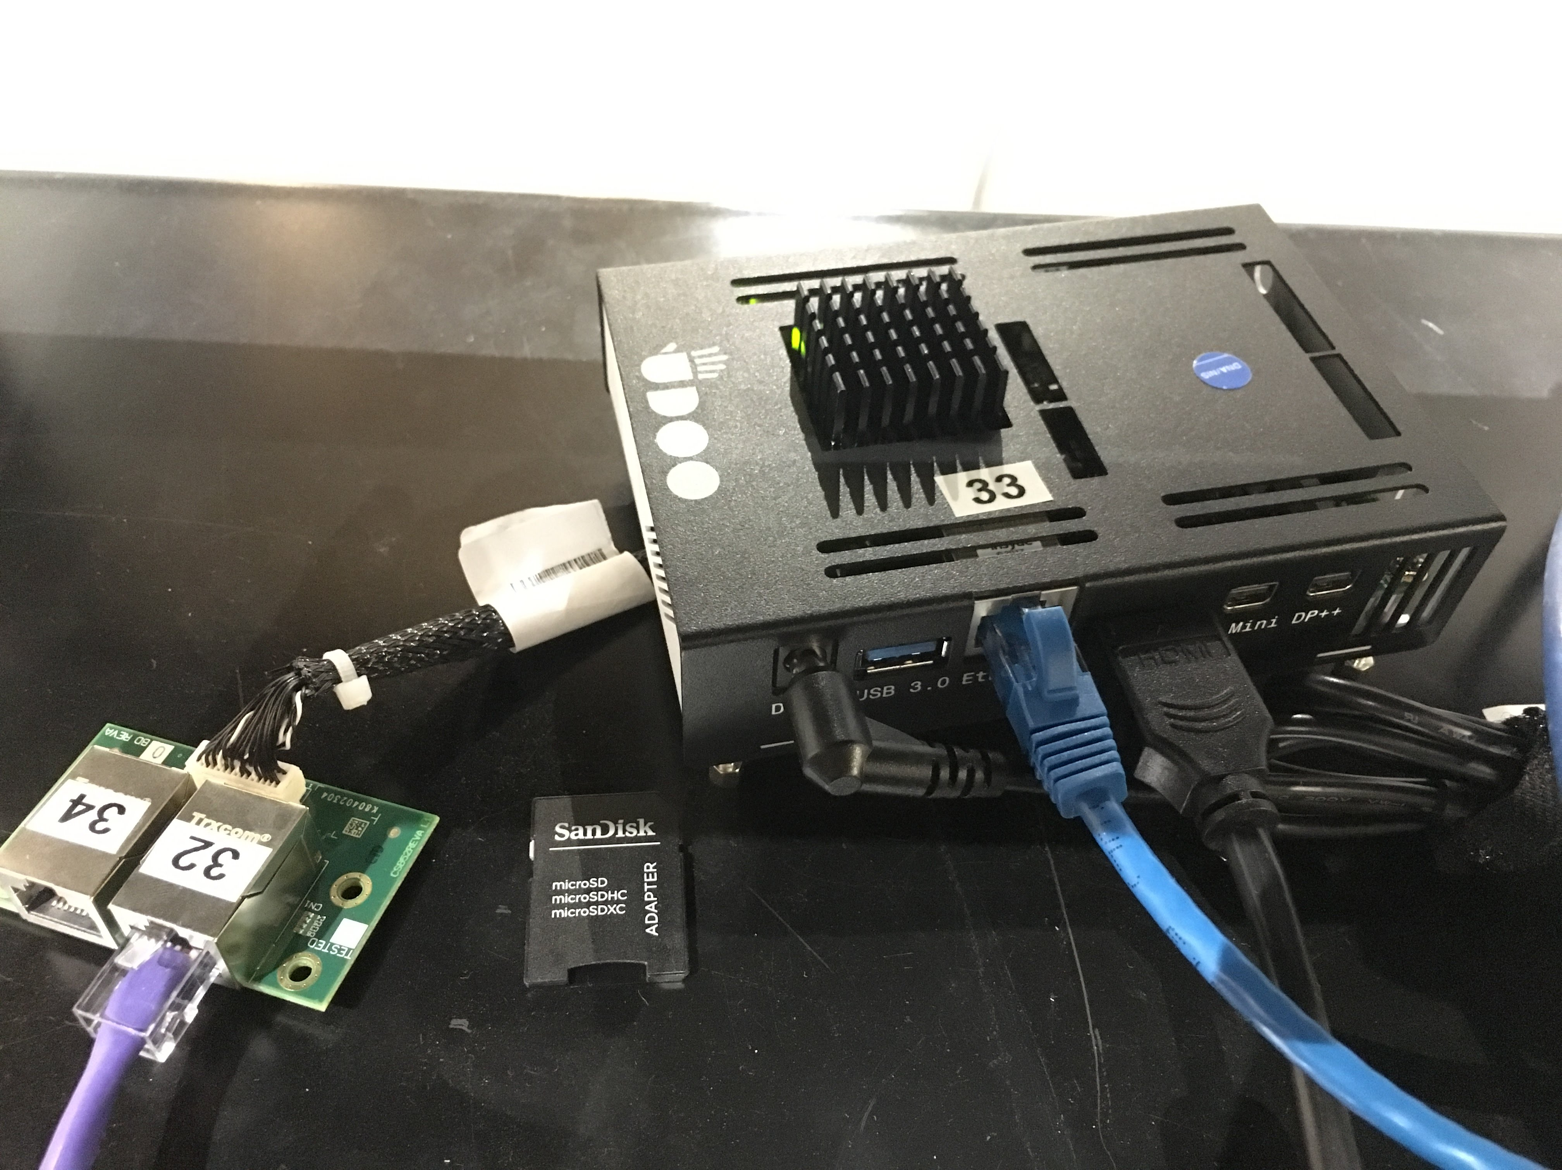
babyIOC, “Controls System in Box”
From Italian startup Udoo funded through Kickstarter in 2016
diskless SBC
64 bit Intel architecture
x4 core 2.56 GHz and 8GB RAM
x3 1Gbit Ethernet interfaces
boots and runs from microSD
New NSLS2 Debian distribution, compiled areaDetector-3-2, Prosilica IOCs, X2Go server.
Building another system like this comes to copying the image to another card.
~$400

Slide 5
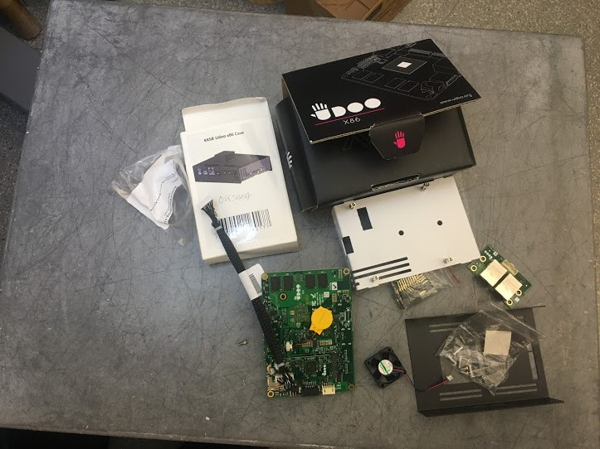
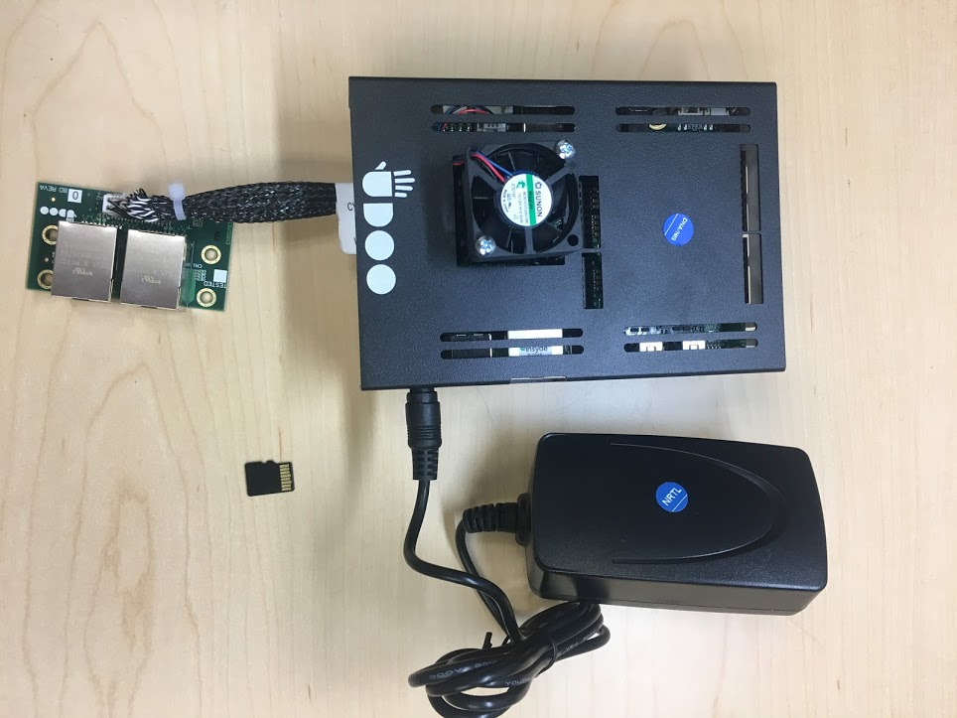
babyIOC runs areaDetector-3-2 on XFP beamline with PVA ONLY!
We see it as a intermediate compromise solution for EPICS software upgrade at NSLS2 beamlines

Slide 6
What next?
What we would like to have (please advise if you know)
Be ably to fully use microSD card of any size
When copying one SD card to another with dd command, the size of the target becomes always the size of the source, even if it is x10 bigger.
Plan to clean up puppet and NSLS2 specifics and make the image available to the community with instructions.

Slide 7
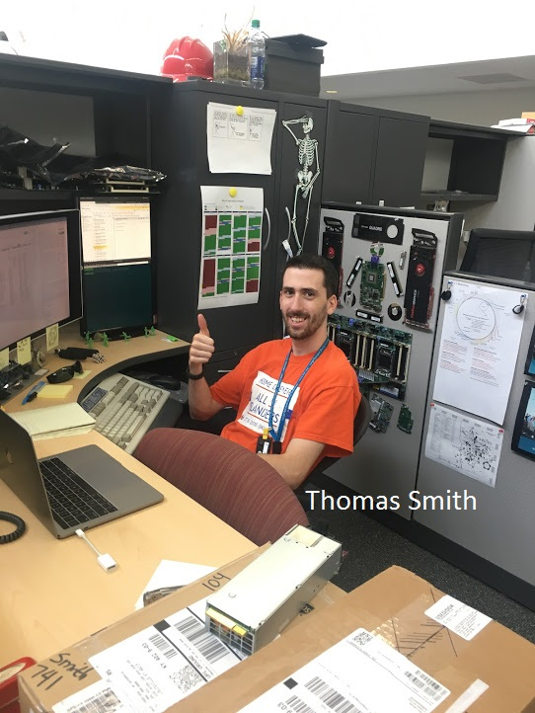
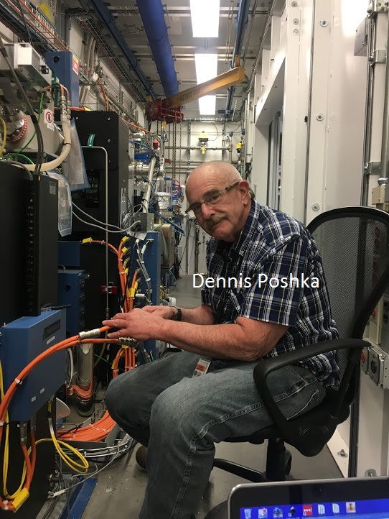
Credits:
Thomas Smith babyIOC admin parent.
Dennis Poshka babyIOC nurture technician
Matt Cowan babyIOC deployment caregiver

