Slide 1
EPICS Collaboration Mtg.
APS, Argonne/IL June. 15, 2018
On-axis 3D Microscope for X-ray Beamlines at NSLS-II
Kazimierz J. Gofron (kgofron@bnl.gov), NSLS-II
6/15/2018
1

Slide 2
Outline
Overview –NSLS2
Beamlines (26 operational + 3 under constr.)
End stations
Beam size(s) @ sample 1 [um], 4 [um], 4x6[um]
Sample/features: 1 [um]
On-axis microscope(s): Non-dispersive (mirror) optics
Computer Vision
Goniostat centering (17-ID, 19-ID)
X-ray beam detection, stability studies
Real time image processing
Focus stacking
3D microscope
AD barcode plugin
Credits

Slide 3
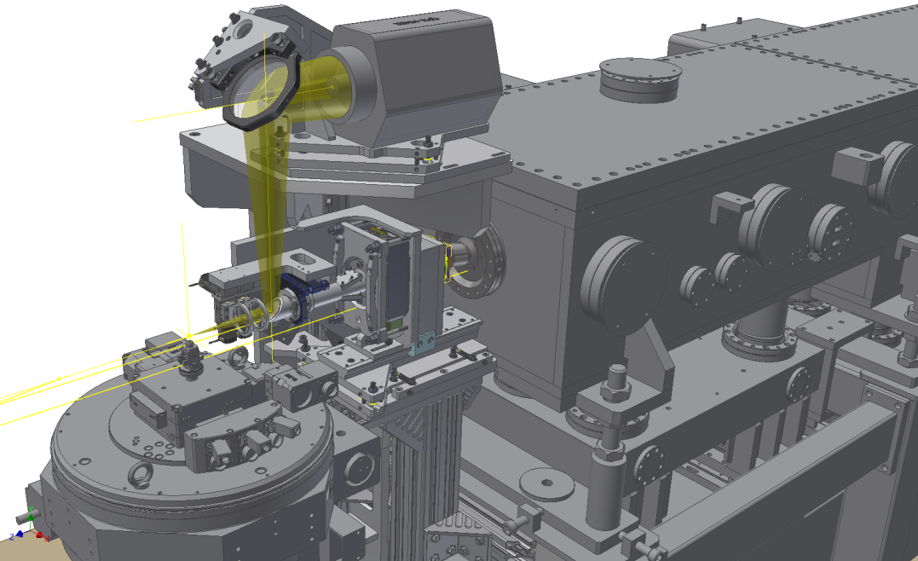
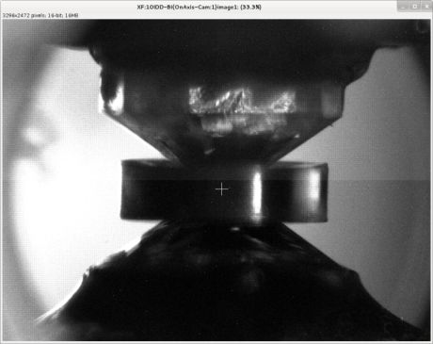
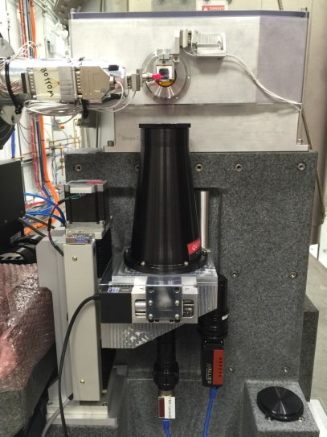
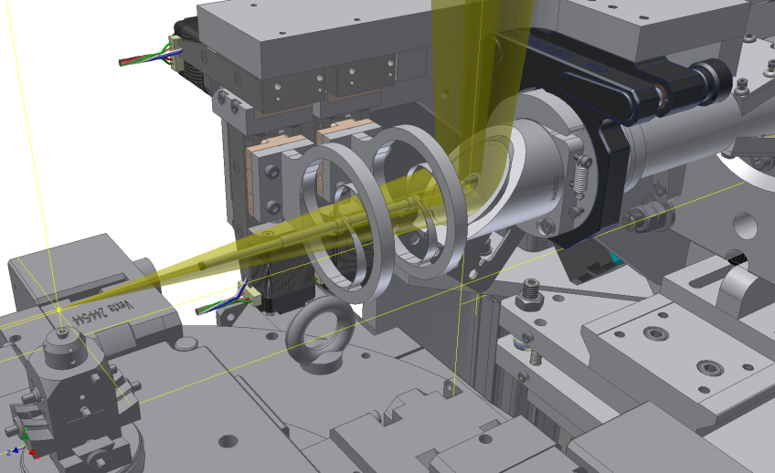
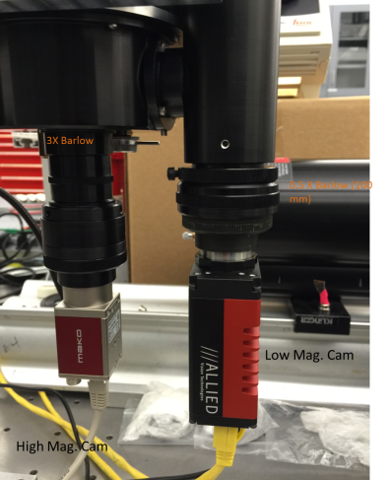
On-axis beamline microscopes
IXS (10ID)
WD=60 cm
3 [um]
3 x
M
Sample
X-ray
X-ray
Objective
Diamond cell (IXS)
Cam
K.J. Gofron, et. al., NIMA, Vol. 649, Issue 1,
1 September 2011, Pages 109-111.
AMX/FMX
(17ID)
30x,5x
1 [um]

Slide 4
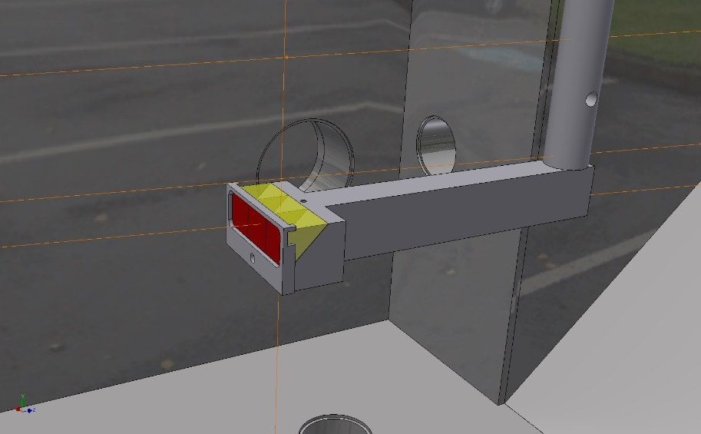
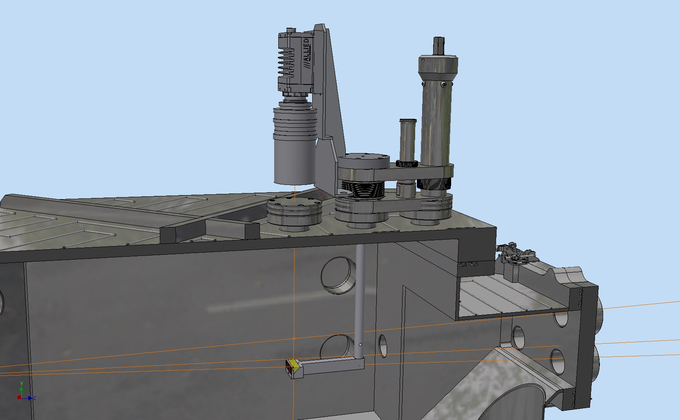
Endstation microscopes (IXS)

Slide 5
Endstation microscopes (TXM)
10x
5x
2x
2 X-ray detecting microscopes
1x
2 optical alignment microscopes
All are home assembled microscopes

Slide 6
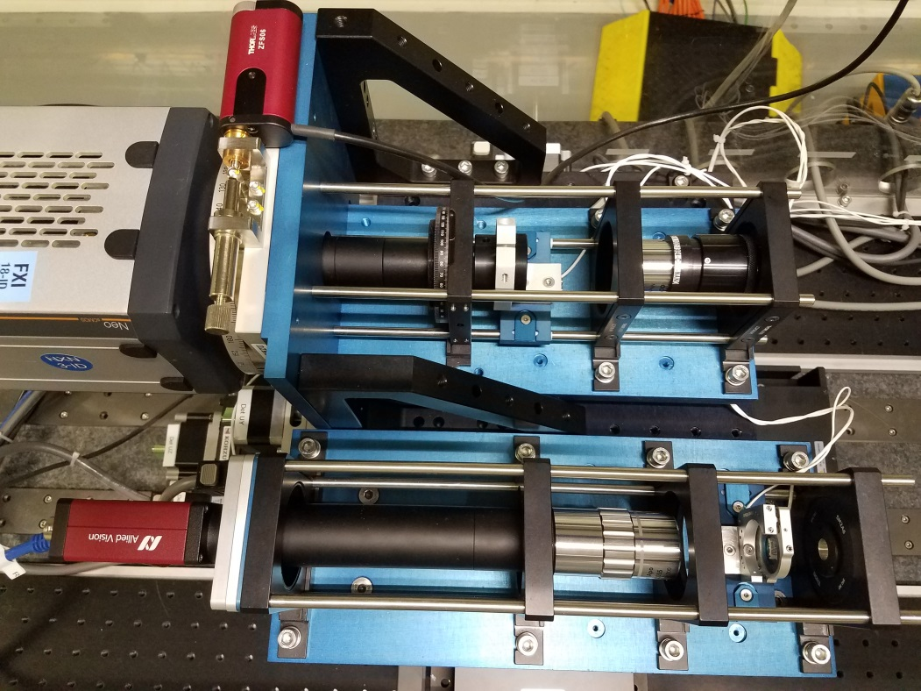
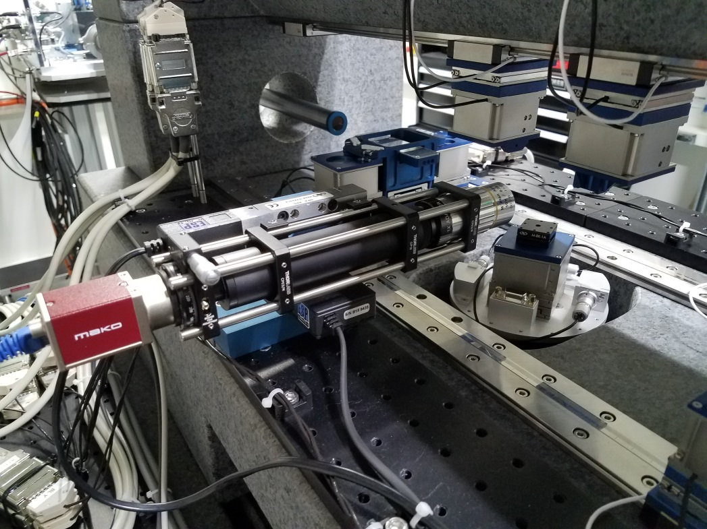
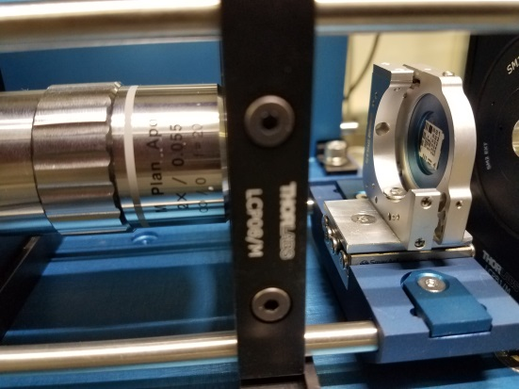
Endstation microscopes (FXI)
X-ray imaging , TXM
Sample imaging

Slide 7
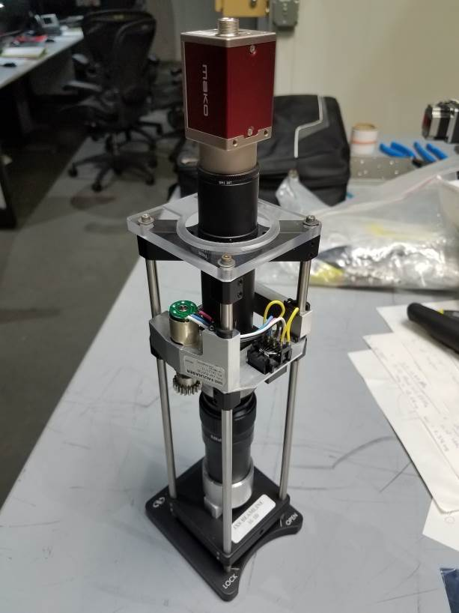
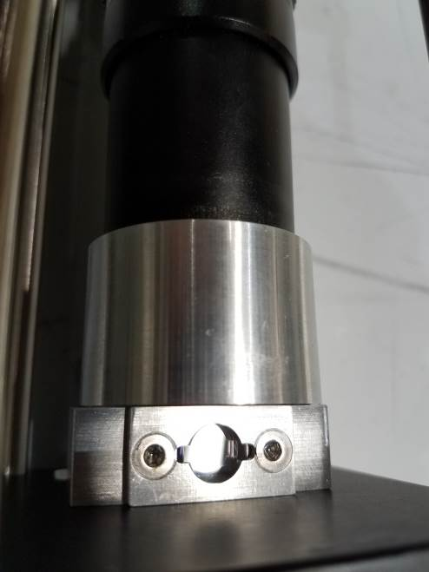
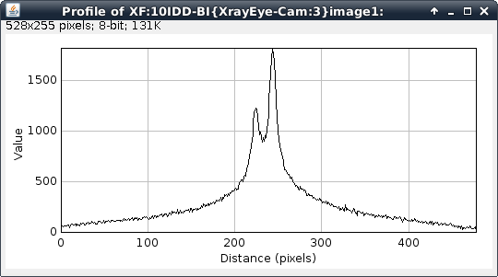
X-ray eye: 10ID (KB mirror - VFM)
Cam
Focus
20x
X-ray
7 um
Mirror
CWO
FWHM = 5 um
KB mirror (VFM)

Slide 8
Computer Vision
Computer Vision for beamline with openCV:
Development of image analysis software backed by OpenCV
Development of easy use python module to access OpenCV functions
Optimized results for fast computation via C/C++ backed code, along with Intel IPP/TBB libraries.
GPU role.
Camera -> areaDetector { | IP based} -> Comp. Vision -> Results {sorted size, intensity, position, pattern,…} -> EPICS PV { | file | control software | …}
Automate processes such as:
Positon, spread, and intensity of X-Ray Beams
Isolate crystals and X-Ray streaks
Provide assistance to sample mounting
Calibrate Goniostat Rotation and Robotic Vision
3D microscope

Slide 9
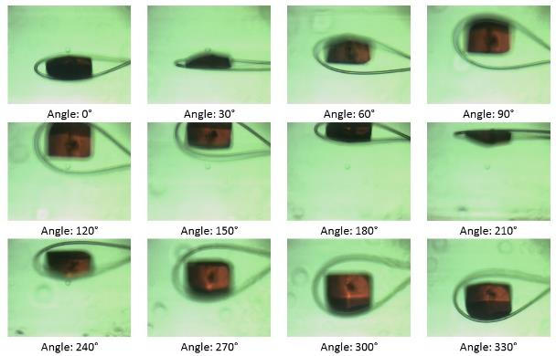
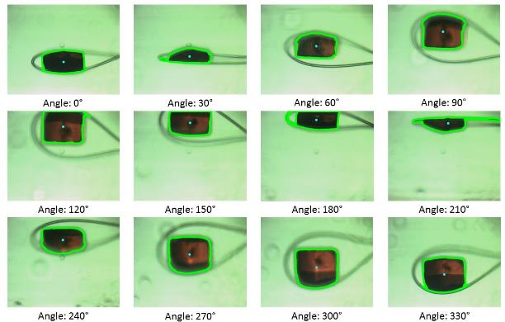
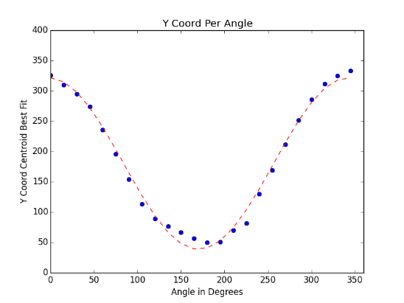
Computer Vision – loop center (5s)
[um]

Slide 10
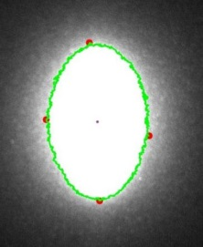
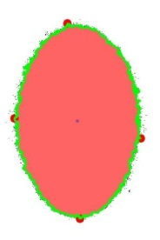
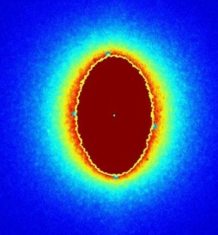
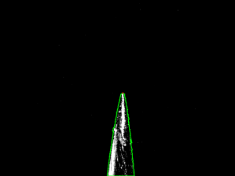
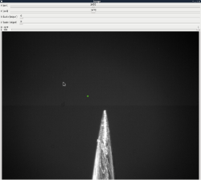
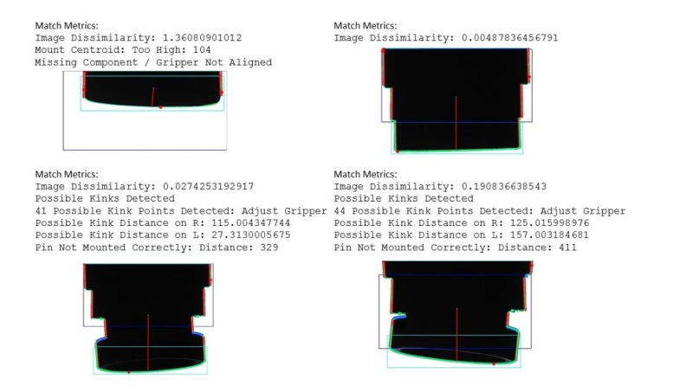
Computer Vision
IXS – BPM1
IXS: Merlin Data Results for First (Largest) Object
Console Output:
Object 1:
perimeter: 125.840619564
orientation: 179.981033325
max: (131, 78)
height: 55
extrema: {'B': (129, 122), 'R': (135, 98),
'L': (126, 92), 'T': (132, 67)}
area: 270.5
min: (134, 83)
sum intensity: 62689
width: 9
centroid: (130, 95)
mean intensity: 126.644444444
Console Output:
Object Details:
perimeter: 2356.99022925
orientation: 179.838363647
max: (925, 198)
height: 372
extrema: {'B': (938, 568),
'R': (1054, 415),
'L': (813, 377),
'T': (914, 196)}
area: 65058.5
min: (1047, 564)
sum intensity: 20426526
width: 241
centroid: (933, 382)
mean intensity: 227.842390577
AMX: Robot gripper – sample detection
IXS Point & Click: Left: Image Result with Contour and Top Extrema
Right: Point & Click GUI Interface ( X, Y, MC Scale Bars, Green Cursor)
Console Output: PIN TOP: (1723, 1306)

Slide 11
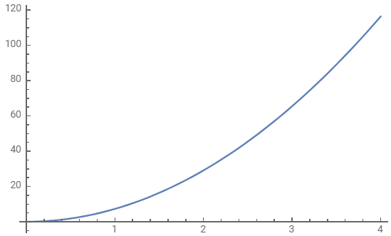
Resolution and Depth of Focus
Resolution R = wavelength / (2*NA)
Depth of field = wavelength*n/(NA)^2; n=1 for air
Depth of field = 4*n*R^2/(wavelength)
Shallow DoF is a Weakness
DoF [um]
Resolution [um]

Slide 12
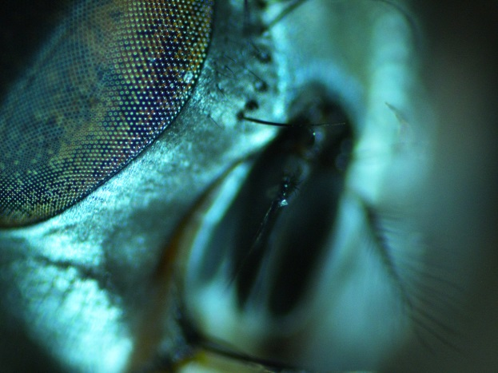
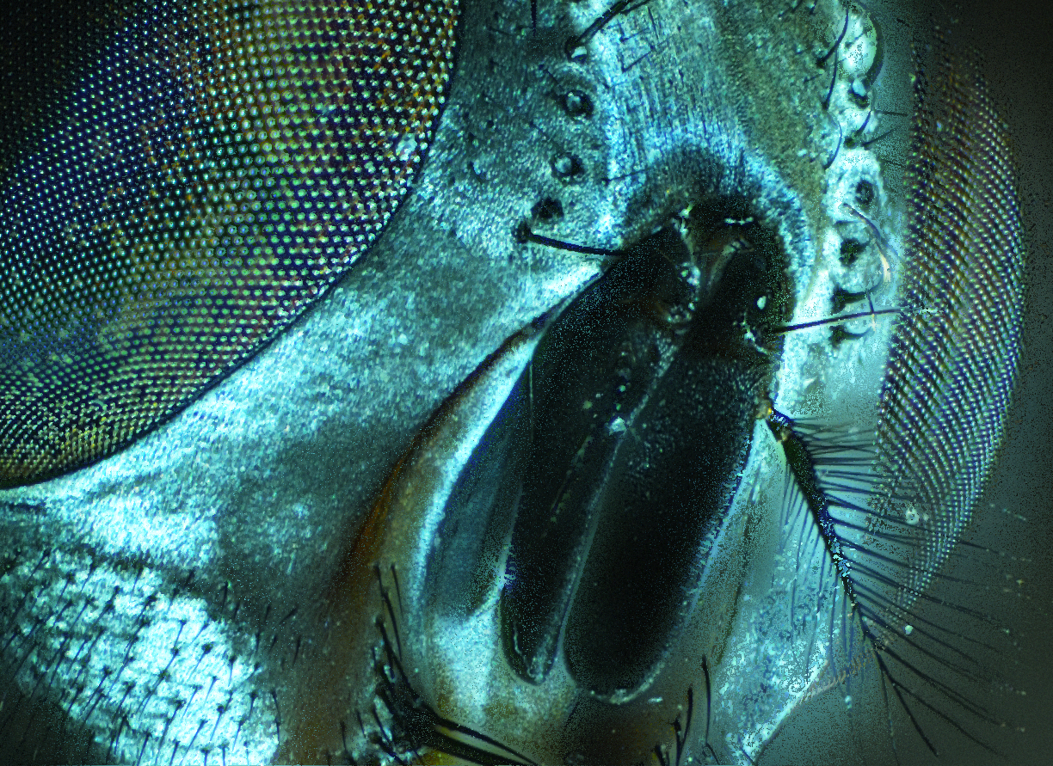
Focus – Horse Fly
?

Slide 13
How it Works
To begin, a set of images is taken by a shallow depth of field camera, all of the same sample.
The images must then be aligned, in order for the merge to create a seamless image.
A Euclidean transform was the alignment method used, after Oriented-Fast and Rotated-Brief proved ineffective when working with blurry images.

Slide 14
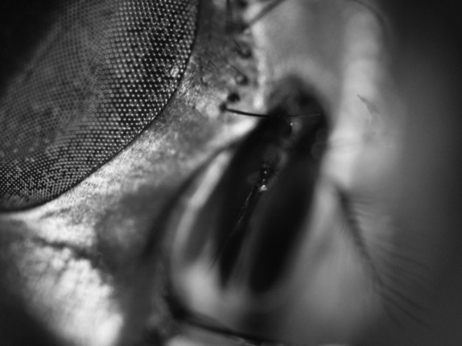
How it Works
Next, each image is blurred with a Gaussian blurring filter, to further emphasize the in-focus regions of the image
Finally, a Laplacian kernel is run across each image, assigning a sharpness value to each pixel.

Slide 15
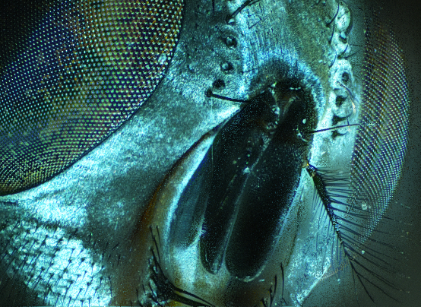
How it Works
Finally, we iterate over each pixel choosing the one from the image with the highest “sharpness” assigned to it
Additionally, during this step, we take note of which image provided each pixel, effectively creating a depth map of the image.

Slide 16
How it Works
Finally, using the depth map, a 3D model is constructed by a custom OpenGL pipeline, and the merged image is placed over this model.
The 3D model, once rendered is rotated, and made into a video for easier evaluation.
Additionally, using the EPICS python wrapper, automated image stack collection was implemented for supported cameras.

Slide 17
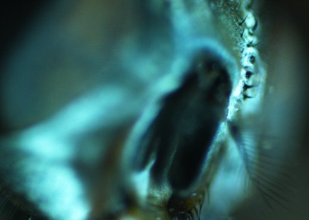
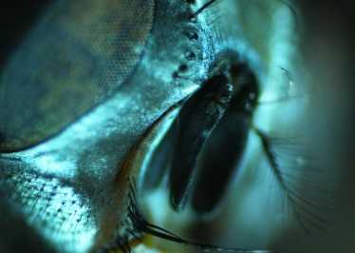
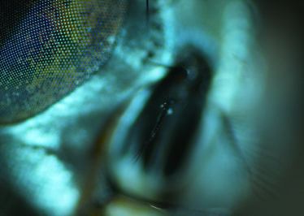
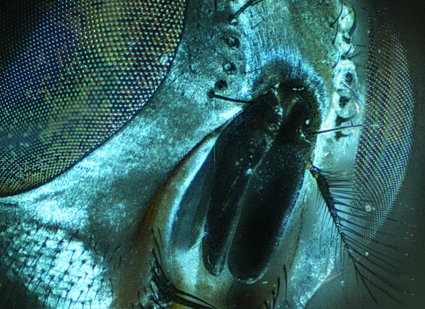
Focus Stacking – Horse Fly (5x)
Edge Detection
ECC
Gaussian Blur/Laplacian
Alignment
Original 38 Image Stack
ORB

Slide 18
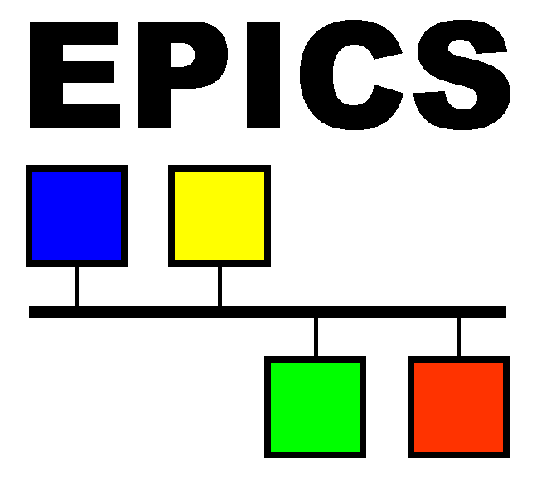
The code
Real Time

Slide 19
Key Points
Code portability was important: Python chosen as coding language because of this and because of ability to call efficient C and C++ functions through wrappers
OpenCV and OpenGL used for Computer Vision and Graphics respectively due to them being powerful, open source, and compatible with all major operating systems.
Python wrappers for OpenCV and OpenGL used to improve performance over native Python code

Slide 20
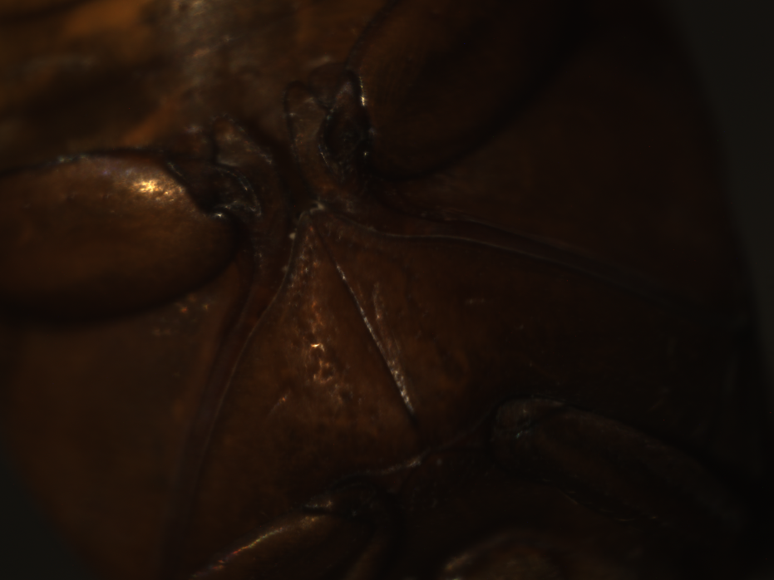
Beettle (10ID, 3x/3um)
Two examples out of a stack of 19 images. First we performed focus stacking and gamma correction. Images were taken at the IXS 10ID beamline.
https://www.youtube.com/channel/UC-SfBpwDIiuw41_r0qqYkZQ?view_as=subscriber

Slide 21
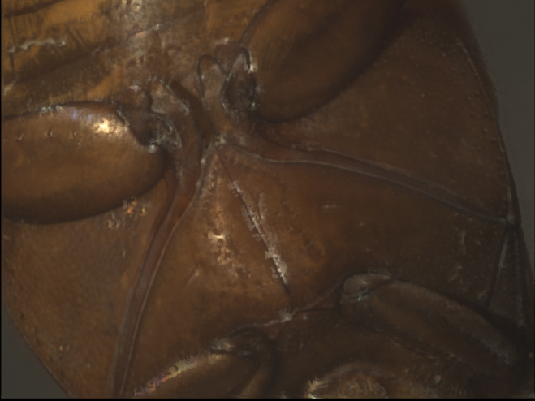
The Beetle – merged/gamma corrected (3x)
10ID

Slide 22
The Beetle – depth map

Slide 23
The Beetle: focus=3rd dimension
https://www.youtube.com/watch?v=UFx2EDouO-k

Slide 24
Mineral
https://www.youtube.com/watch?v=FdpdAdoirwA

Slide 25
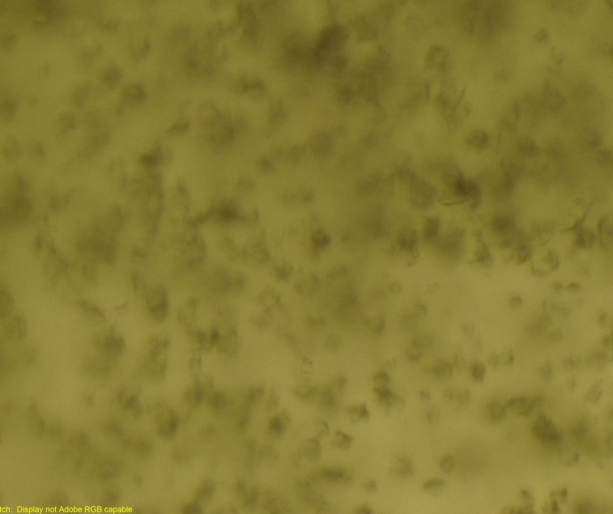
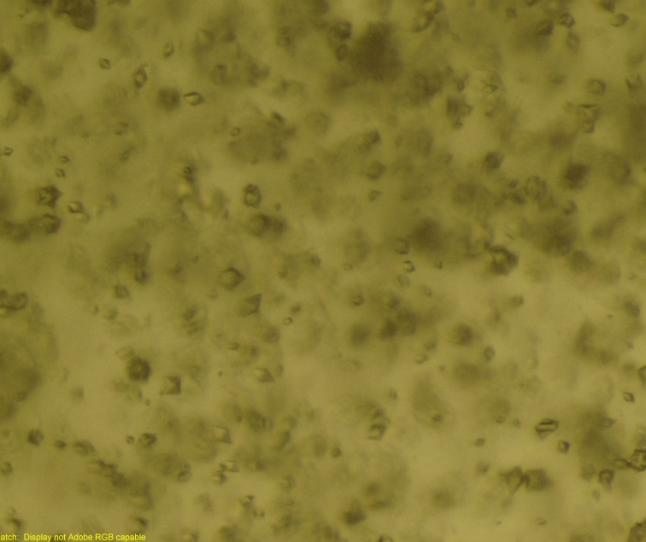
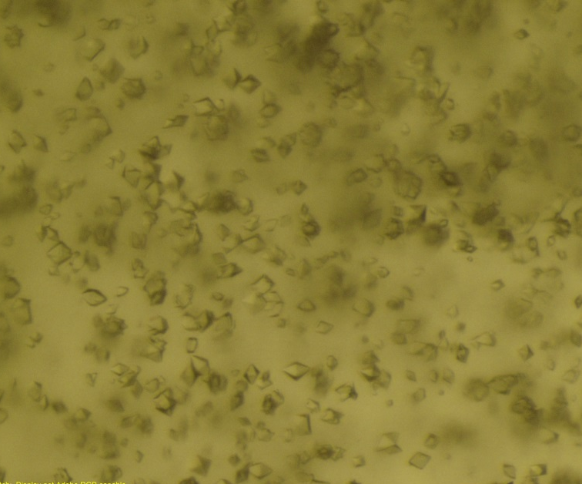
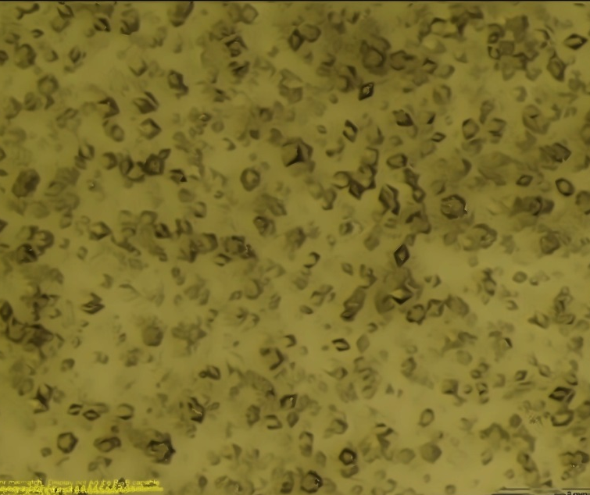
Crystal harvesting – sonic ejection
Crystal images are all courtesy of Alexei Soares and the Click to Mount Team. Focus stacks of 15 images.
Crystal are sonicly ejected only from top layer, and surface layer moves (with crystals) to “heal” the surface.
Crystals from lower layers are not harvested.

Slide 26
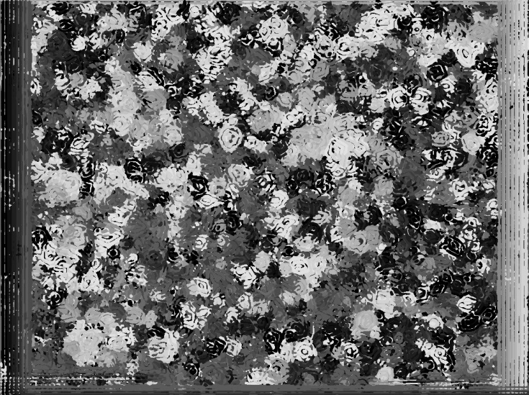
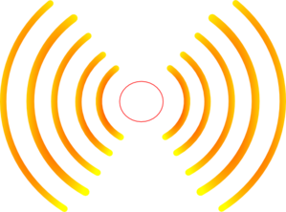
Crystal harvesting
Sonic harvesting of crystals
is driven by surface tension.
Crystals are ejected from surface layer
Conclusion 1:
Prevent crystals from settling to the bottom. Thus consider using Bingham fluid solutions.
(to be published)
L1 Surface
~10 um
L2 Middle
Depth map
………
Ln Deep
Sonic source
SUMMARY: Converted weakness (shallow DoF) into strength (recovered 3rd depth dimension)

Slide 27
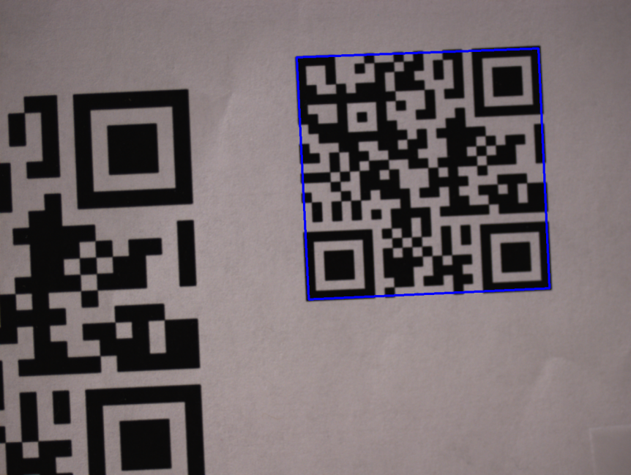
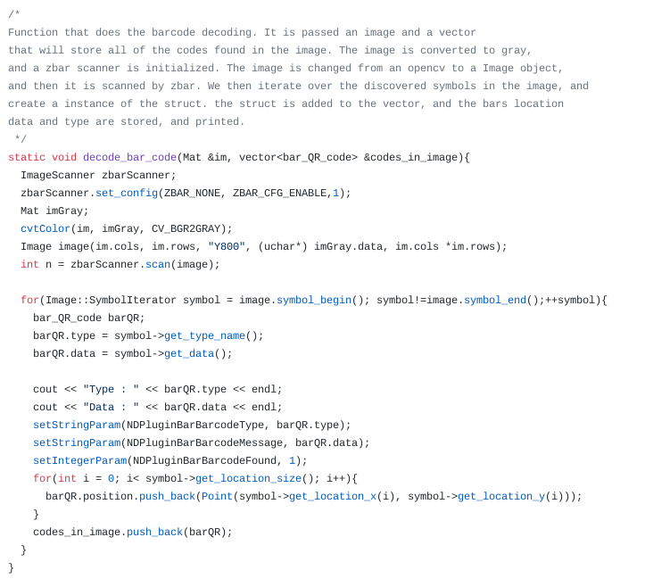
AD Plugin: Barcode reader
Open source
- openCV
- zbar
Enabling technology

Slide 28
References
Moeller, Michael, et al. “Variational Depth From Focus Reconstruction.” IEEE Transactions on Image Processing, vol. 24, no. 12, 2015, pp. 5369– 5378.,doi:10.1109/tip.2015.2479469.
“OpenCV Library.” OpenCV Library, opencv.org/.
Group, Khronos. “The Industry's Foundation for High Performance Graphics.” OpenGL.org, www.opengl.org/.

Slide 29
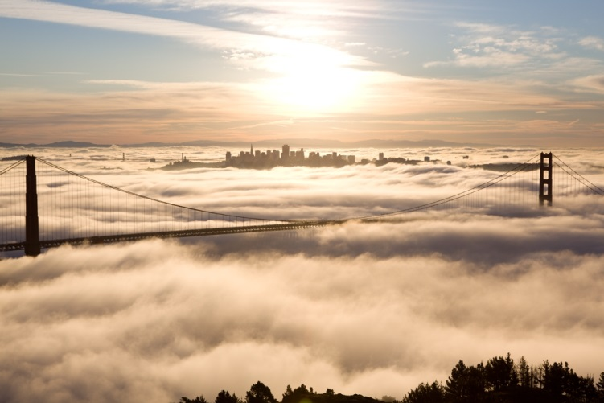
Credits
Jakub Wlodek (focus stack)
Yong Cai (10ID)
Bill Watson (comp. vision)
Scott Coburn (mechanical)
Stephen Antonnelli (mechanical)
Bruno Martins
Martin Fuchs (17ID)
Jean Jakoncic (17ID)
Work at Brookhaven was supported by the Department of Energy, Office of Basic Energy Sciences under contract DE-AC-02-98CH10886

