Slide 1
Ptychography Scanning
Andrew Wilson Beamline Controls Diamond Light Source
Spring 2018 EPICS Collaboration Meeting at the APS

Slide 2
Contents
Introduction to Ptychography
Challenges posed for Controls
Deploying a standard solution
Developing support for J13 beamline

Slide 3
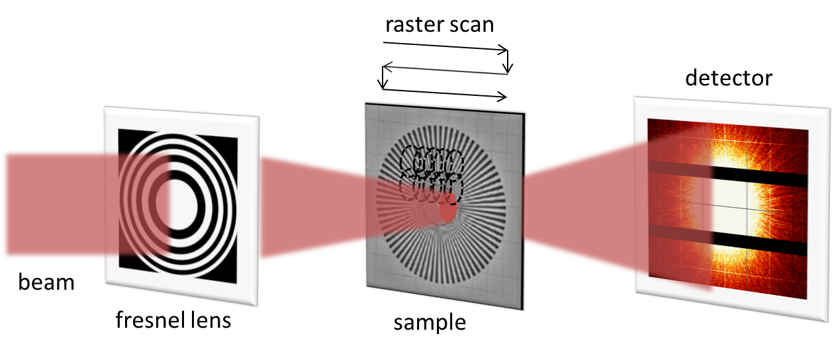
Ptychography
Coherent scanning diffraction microscopy

Slide 4
Ptycho-tomography

Slide 5
Big datasets
30 * 30 images
1000 projections
~
1 million frames
*
~
*
8 MB
8 TB
One projection
One ptychotomo
One dataset
One frame
High rates of data collection
Fine and stable motion

Slide 6
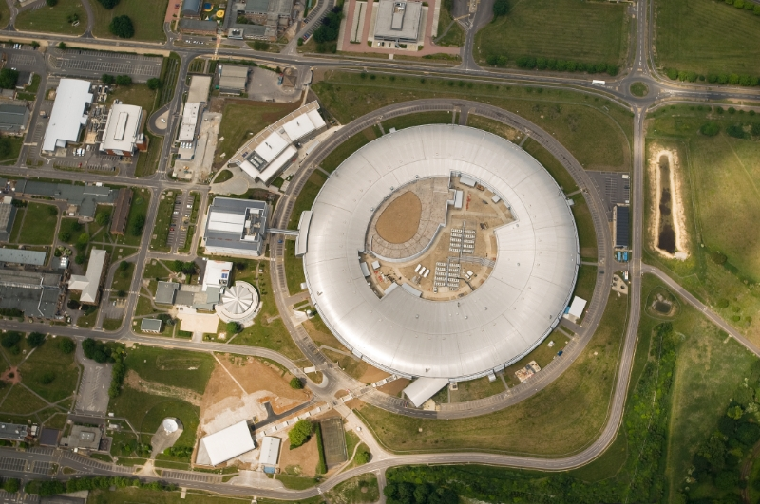
J08
I08
J13

Slide 7
Standard Hardware Triggered Scanning framework
Experiment control (Java)
GDA
Coordination middle-layer (Python)
Malcolm
EPICS IOCs
AreaDetector
pmac
Detector
PandA
GeoBrick
Stages

Slide 8
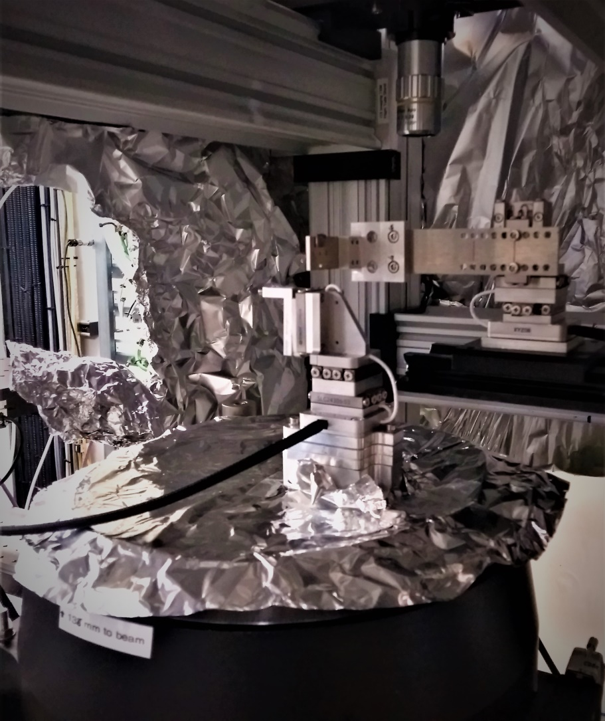
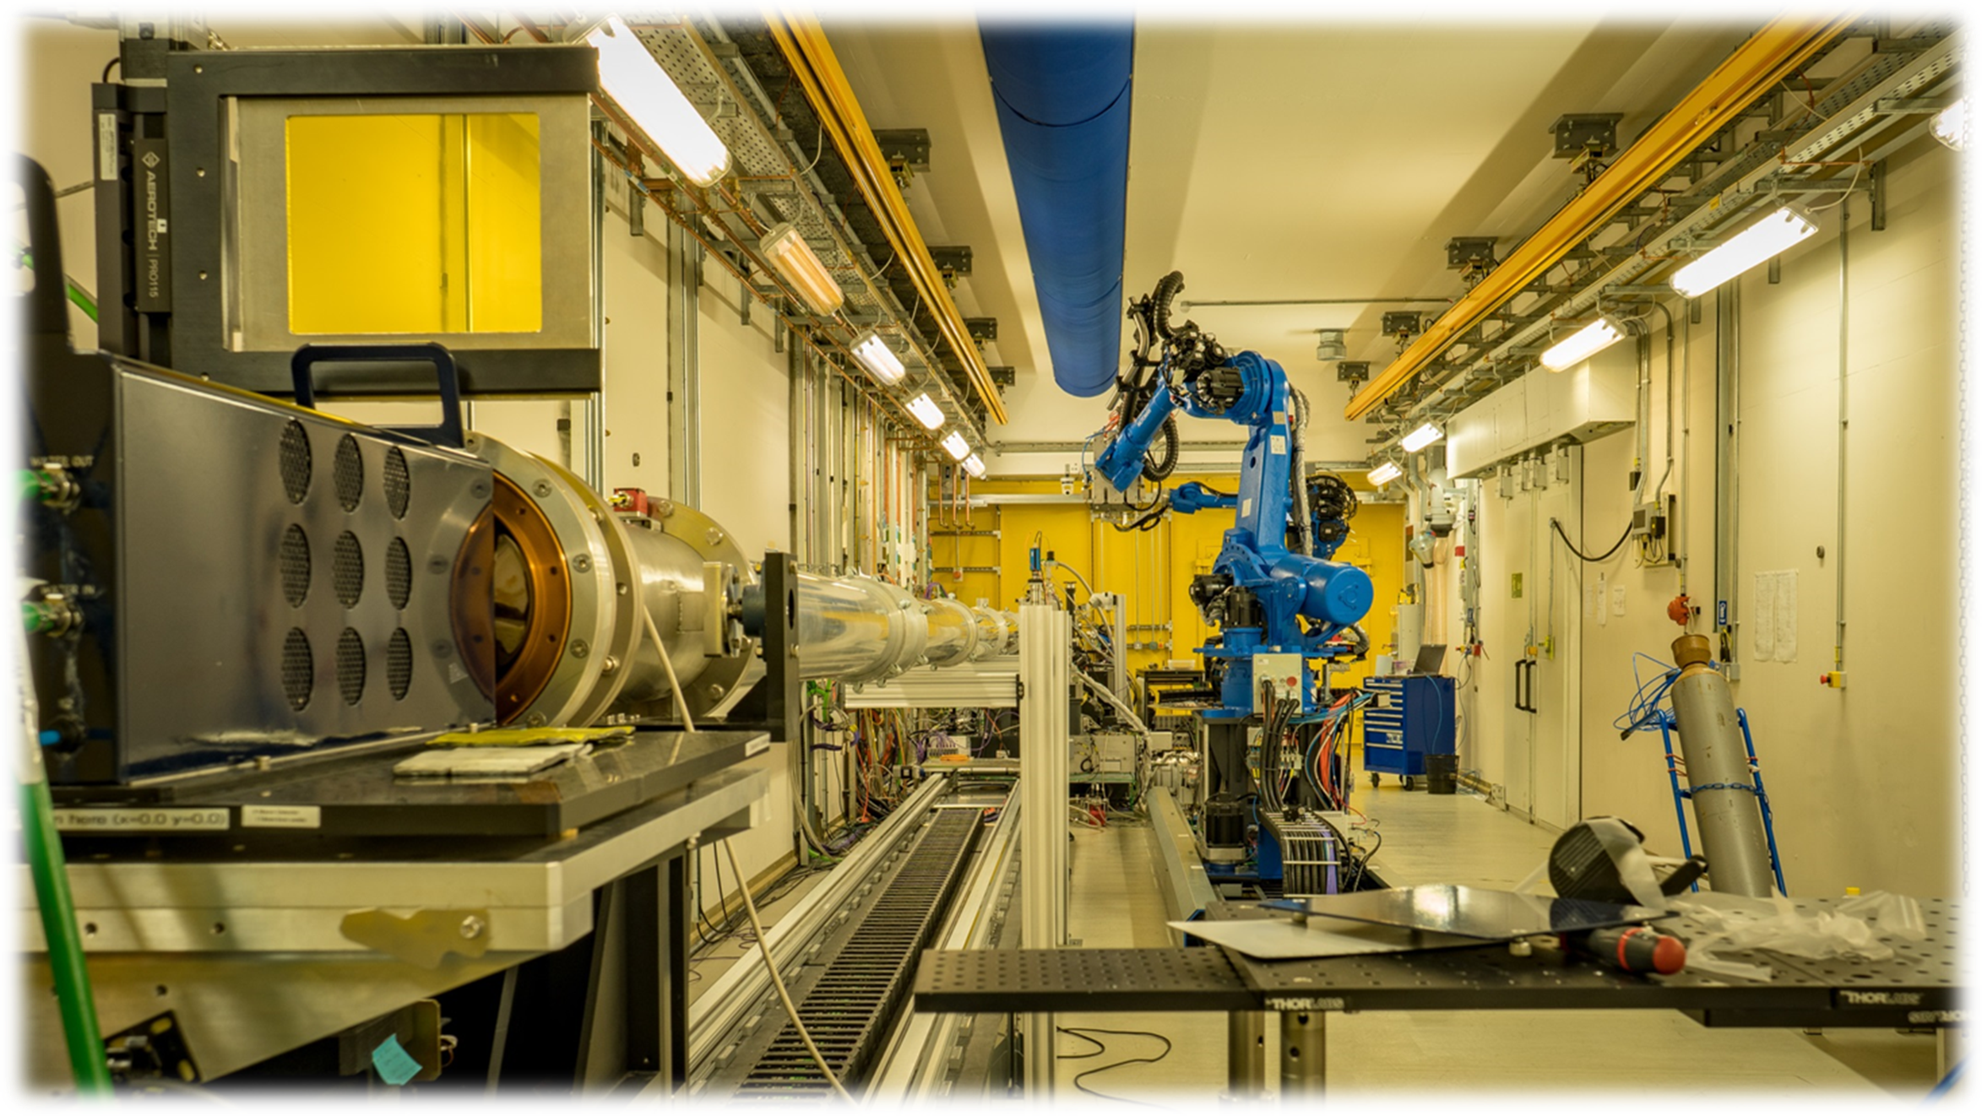
J13 beamline

Slide 9
GDA
Channel access
Motion IOC
AreaDetector IOCs
Ethernet
6x1 Gb Ethernet
Delta Tau GeoBrick
Lustre filesystem
Parallel HDF5
Step & direction
SmarAct SDC2 controller
SmarAct XYZ slip-stick stages
Excalibur detector

Slide 10
Go faster asap

Slide 11
GDA
Custom Jython script
Channel access
Motion IOC
AreaDetector IOCs
Ethernet
2x 10 Gb Ethernet
Delta Tau GeoBrick
TTL
GPFS filesystem
Custom motion program
Zebra
HDF5 + VDS
Step & direction
LVDS
SmarAct SDC2 controller
SmarAct XYZ slip-stick stages
Excalibur detector

Slide 12
Stage performance and detector reliability

Slide 13
GDA
Custom Jython script
Channel access
Motion IOC
AreaDetector IOCs
Ethernet
2x 10 Gb Ethernet
Delta Tau GeoBrick
TTL
GPFS filesystem
Custom motion program
Zebra
HDF5 + VDS
± 10V
Analog control
LVDS
PI E727 controller
PI flexure stages
Excalibur detector

Slide 14
GDA
Custom Jython script
Channel access
Motion IOC
AreaDetector IOCs
ODIN
Ethernet
2x 10 Gb Ethernet
Delta Tau GeoBrick
TTL
GPFS filesystem
Custom motion program
Zebra
HDF5 + VDS
± 10V
Analog control
LVDS
PI E727 controller
PI flexure stages
Excalibur detector

Slide 15
Make it work with common framework

Slide 16
GDA
Malcolm
Channel access
Motion IOC
with pmac
AreaDetector IOCs
ODIN
Ethernet
2x 10 Gb Ethernet
Delta Tau GeoBrick
TTL
PandAbox
With ADC
GPFS filesystem
Standard motion program
HDF5 + VDS
± 10V
Analog control
LVDS
± 10V feedback
PI E727 controller
PI flexure stages
Excalibur detector

Slide 17
Thank you
Acknowledgements
J13 Beamline Team Darren Batey, Silvia Cipiccia, Xiaowen Shi, Russell Marshall, David Eastwood
Controls & Data Acquisition Alan Greer (Observatory Sciences), Ulrik Pedersen, Kaz Wanelik, Ed Warrick
Motion Control & Electrical Tec Lee Hudson, Nico Rubies, Russell Marshall
Detector Group
Scott Williams
References
Pmac support module https://github.com/dls-controls/pmac
Pymalcolm https://github.com/dls-controls/pymalcolm
PandaBox http://quantumdetectors.com/pandabox/
ODIN detector framework https://github.com/odin-detector
Contact me
Nanocellular polymer sample, showing a 3D rendering (left) and a single reconstructed slice (right). (Courtesy of S. Perez)
Bumblebee wing. 100 x100 μm FOV (Courtesy D. Eastwood)

