Slide 1
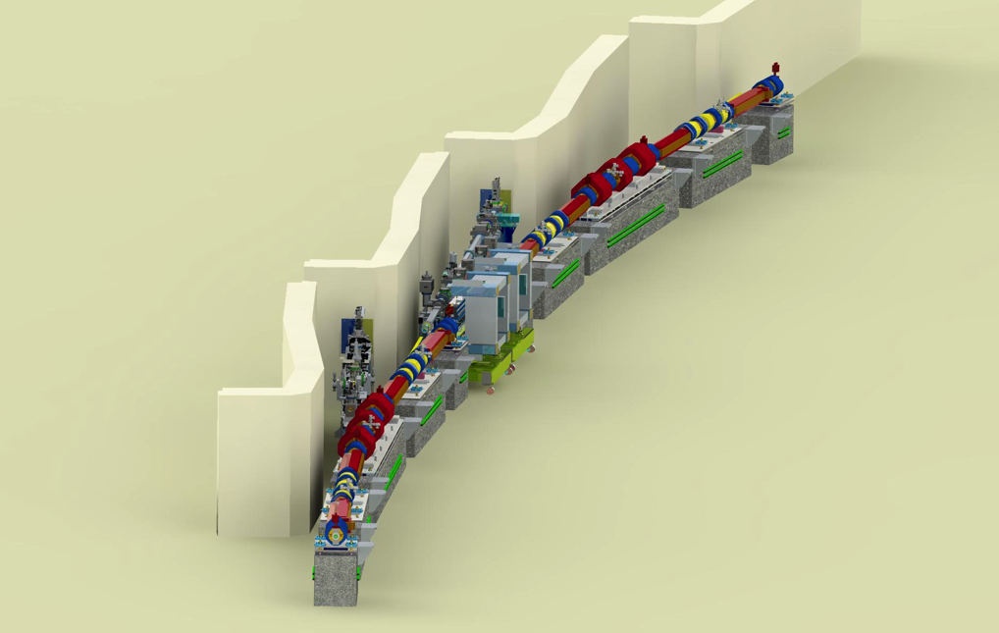
APS-U
Component Database eTraveler
…
Advanced Photon Source Upgrade Project:
The World’s Leading Hard X-ray Light Source
Ned Arnold / Dariusz Jarosz / Sinisa Veseli
Argonne National Laboratory
EPICS Collaboration Meeting @ APS
June 15, 2018
cdb.aps.anl.gov
Notes:
Univ of Chicago Review, Aug. 30, 2010
1

Slide 2
The Need …
Do we have all the parts?
Where are they?
Are they ready?
Are you sure?

Slide 3
The Need …

Slide 4
Component Database (CDB)
What Does It Do ?
Assists staff in tracking components
  Provides a mechanism to associate drawings, documents, specifications, requisitions, … to a component
  Define additional properties that a set of components have in common
  Allows for identifying and tracking inventory items (where installed, repair record, periodic maintenance, …)
  Captures installed components (type / instance / location)
Allows for “Project-wide” processes to be applied
  Common naming conventions (good luck)
  QA Properties and work flow
  Organizing of eTravelers

Slide 5
Component Database (CDB)
Vocabulary
What is a ”component”?
  Something you design
  Something you buy
  Something you build/assemble
  Something you refer to … even if it doesn’t exist
What do you call it?
  Part / assembly / widget / …
  Component / component-type / component instance / …
  Configuration item / lattice element / accelerator component / …

Slide 6
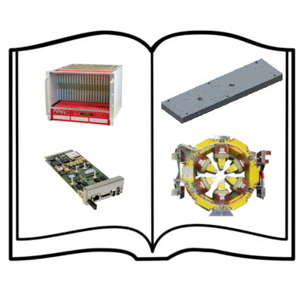
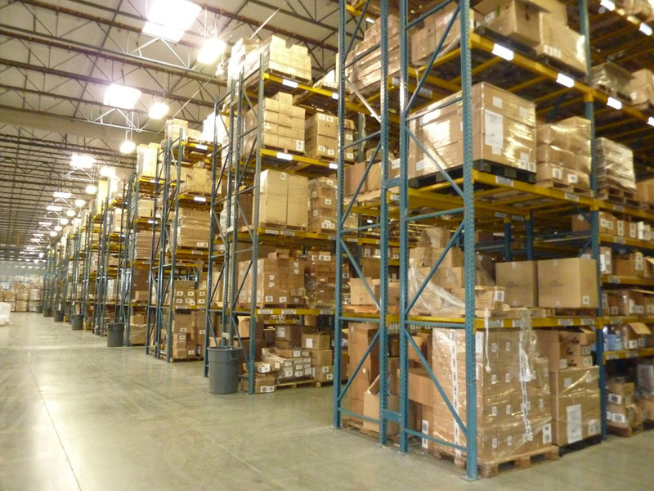
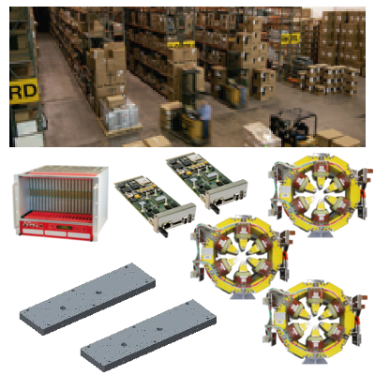
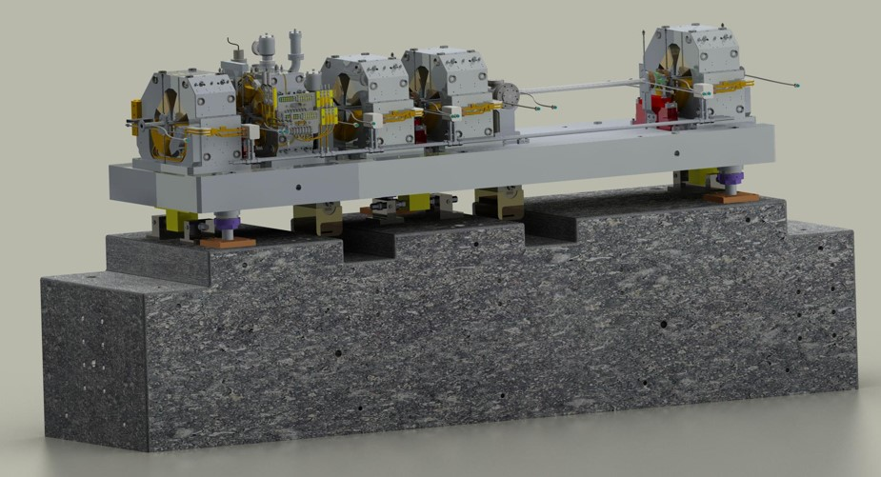
Component Database (CDB)
Vocabulary
Catalog
(each unique type of component or component design or COTS item + properties/drawings/specification/..)
Inventory
(each unique instance of component procured or fabricated) + properties/serial #/QR code/travelers/pictures/…)
Machine Designs
(A group of catalog components to perform a particular function + inventory items to build it +
Properties/pictures/locations/…)

Slide 7
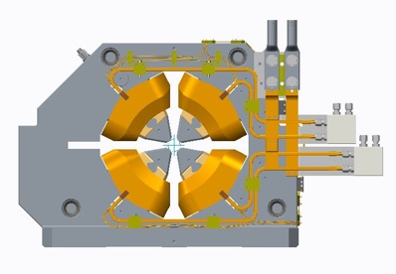
Component Database (CDB)
WARNING!!!! THREE DIFFERENT NAME SPACES!!!!
Vocabulary
Catalog Item
DMM Quadrupole
Machine Design
S27A:Q1
Machine Design Item is a place holder or ”address”. It has …
A reference to a Catalog Item
A reference to an Inventory Item
It’s own properties, history, etc.
Q1 Production - [Unit: 1]
Inventory Items:
Specific units of “DMM Quadrupole” can be tracked for inspection, testing, where installed, maintenance log, etc.
Q1 Production - [Unit: 2]
Q1 Production - [Unit: 3]

Slide 8
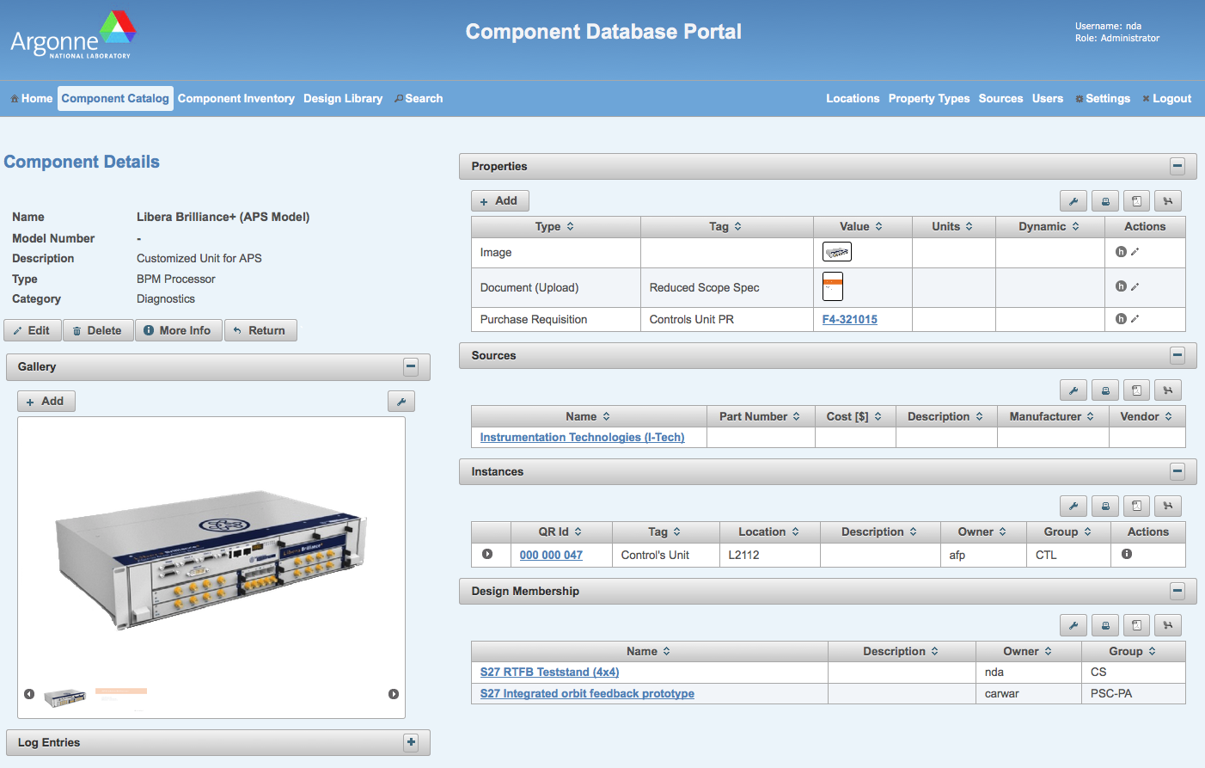
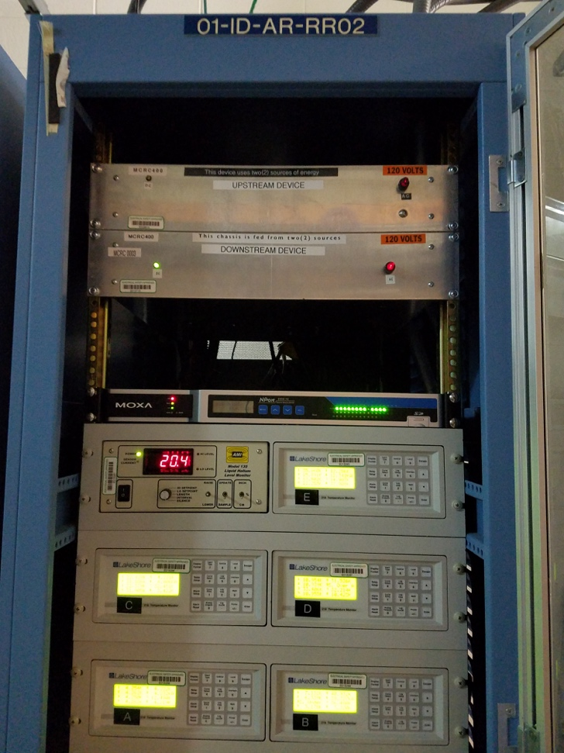
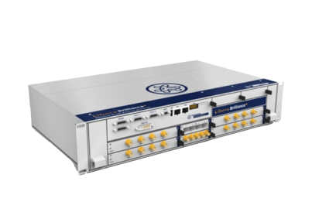
Component Database (CDB)
WARNING!!!! THREE DIFFERENT NAME SPACES!!!!
Vocabulary
Catalog Item
Libera Brilliance+ (APS Model)
Machine Design
01-ID-AR-RR02
S27A:LIB1
S28A:LIB1
Machine Design Item is a place holder or ”address”. It has …
A reference to a Catalog Item
A reference to an Inventory Item
It’s own properties, history, etc.
Inventory Items:
Specific units of “Libera Brilliance+ (APS Model)” can be tracked for inspection, testing, where installed, maintenance, etc.
3/15/2022: Installed Libera+/APS Unit 14 into S27A:LIB1
3/16/2022: Installed Libera+/APS Unit 19 into S28A:LIB1

Slide 9
Catalog Entry
Optional Properties
Common Properties

Slide 10

Inventory Entry
Optional Properties
Common Properties

Slide 11
Inventory Entry

Slide 12
Browse using Common Properties
Links to Catalog Items
Links to Inventory Items

Slide 13
Features …
Numerous view features can be customized for an individual or a group
  Item filters
  Columns displayed
  Rows per page
  Favorites / Owned / …

Slide 14
Features …
User Interfaces
  Web Portal
  Customized views for individuals and groups
  REST Web Service (Python and Java APIs)
  Command Line Interfaces (built on top of Python APIs)
  Mobile Apps (in development)
Privileges
  Authentication: APS LDAP
  Authorization: Users are members of one or more CDB-defined groups. You can modify entities you own and entities owned by your CDB-defined group if they are set to “group writable”.
  Administrators: Certain tables can only be modified by Users assigned to the CDB_ADMIN group

Slide 15
Features …
Properties
Catalog Items | Inventory Items | Machine Design Items
Name | Name | Name
Model Number | Tag | Machine Tag
Alternate Name | Catalog Item (automatic)
Description | Description | Description
Project | Project | Project
Technical System | QR #
Function | Serial Number
Sources (Vendors) | Location | Location
 | Location Details | Location Details
<< Optional Properties >> Links to Drawings & Documents Images Web Links Uploaded Documents Form Factor eTraveler Templates QA Level QA Requirements Link to Software Support Modules | << Optional Properties >> Purchasing Info Images Uploaded Documents Revision # eTraveler Instances Inspection Results Test/Measurement Results | << Optional Properties >> IP # Host Name GPIB Address VME/VXI Configuration Location in Rack Radiation Safety Component Link to Source Code

Slide 16
Features …
Catalog Item Classifications
  Classifications allow catalog components to be grouped by technical system, function, or ownership. If categorized carefully, items can be found expediently
  Function: generic function(s) that the component performs (e.g. stand, magnet, ADC, vacuum chamber, etc)
  Technical System: Items are further grouped into “Technical Systems” which are intended to group component types by discipline (e.g. Diagnostics, Controls, Accelerator, Beamline, RF, ...)

Slide 17
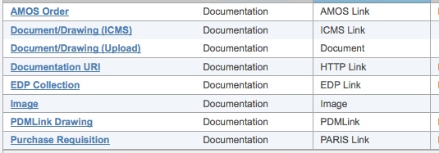
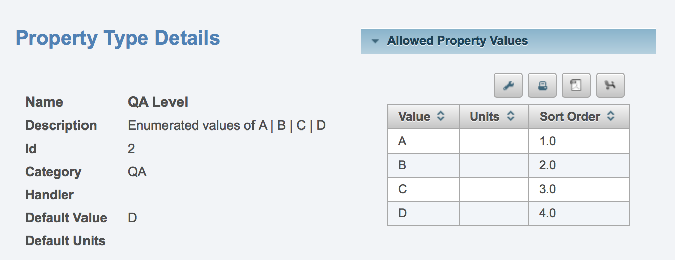
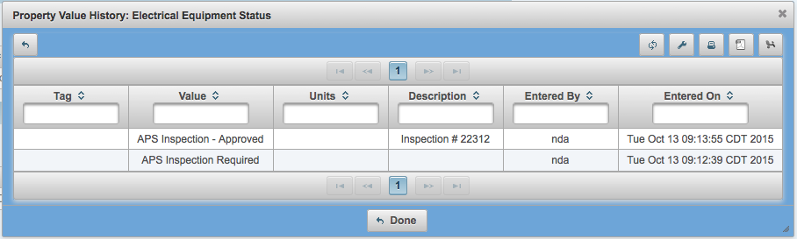
Features …
Properties
  Properties provide a flexible mechanism for capturing object-dependent information (e.g. not all components will have the same meta-data)
  Property types may be associated with a restrictive set of “allowed” property values
  Property types may be linked to unique a “handler”, which adds specific functionality to that property
      ICMS Handler, PARIS Handler, PDMLink Handler, …
  A time-stamped history of each property value is kept to provide a historical log

Slide 18
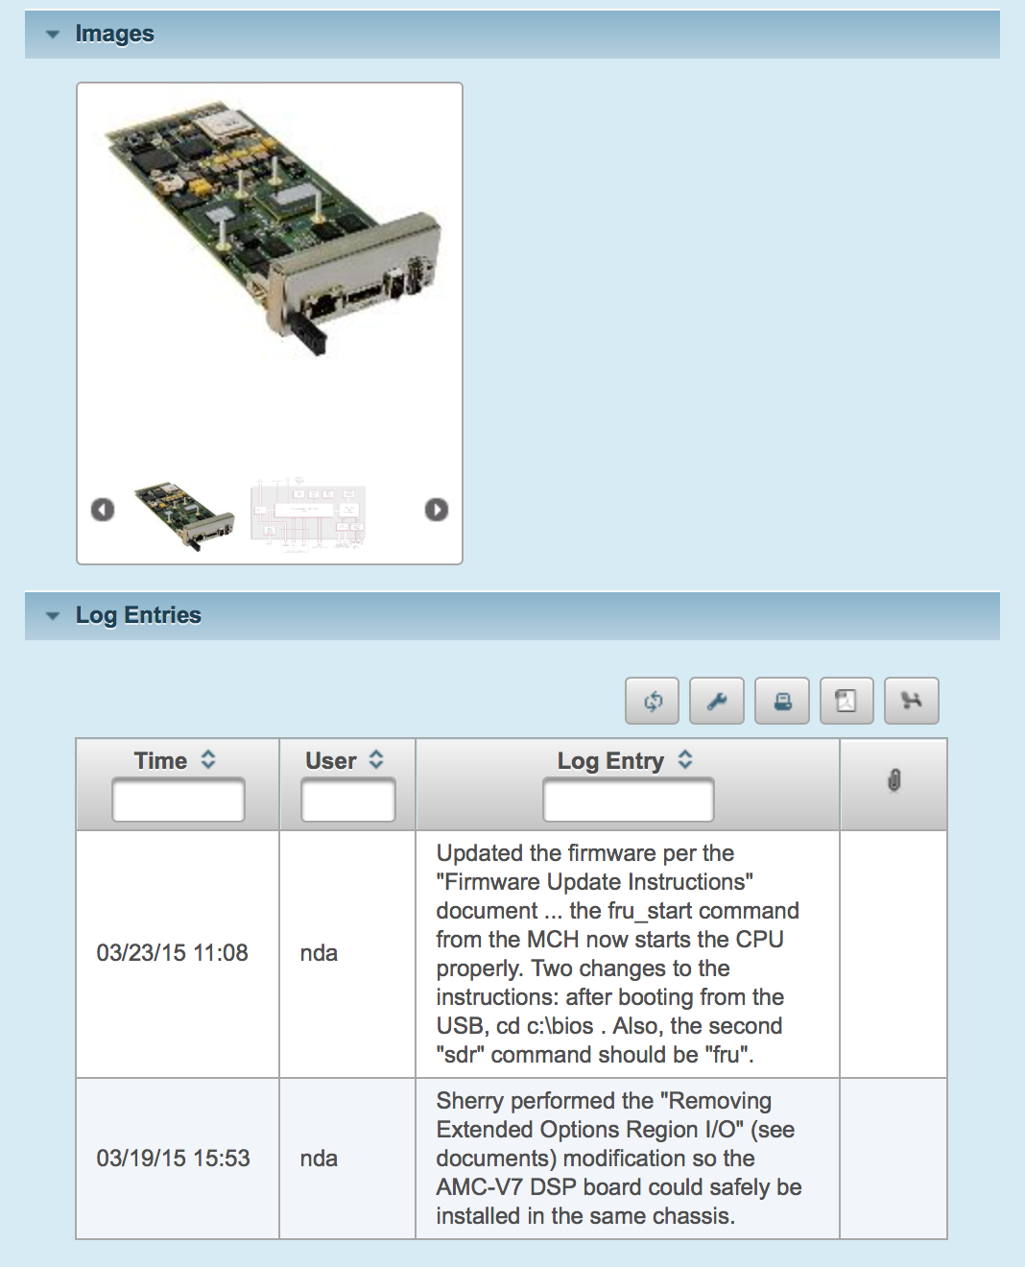
Features …
Assemblies
  A simple hierarchy of components can be created
  Discussion Starter: Should you create “assemblies” in the Catalog or in the Machine Design?
Mini-logbooks
  Chronological log entries for each item in all domains
  Upload an attachment to a log entry

Slide 19
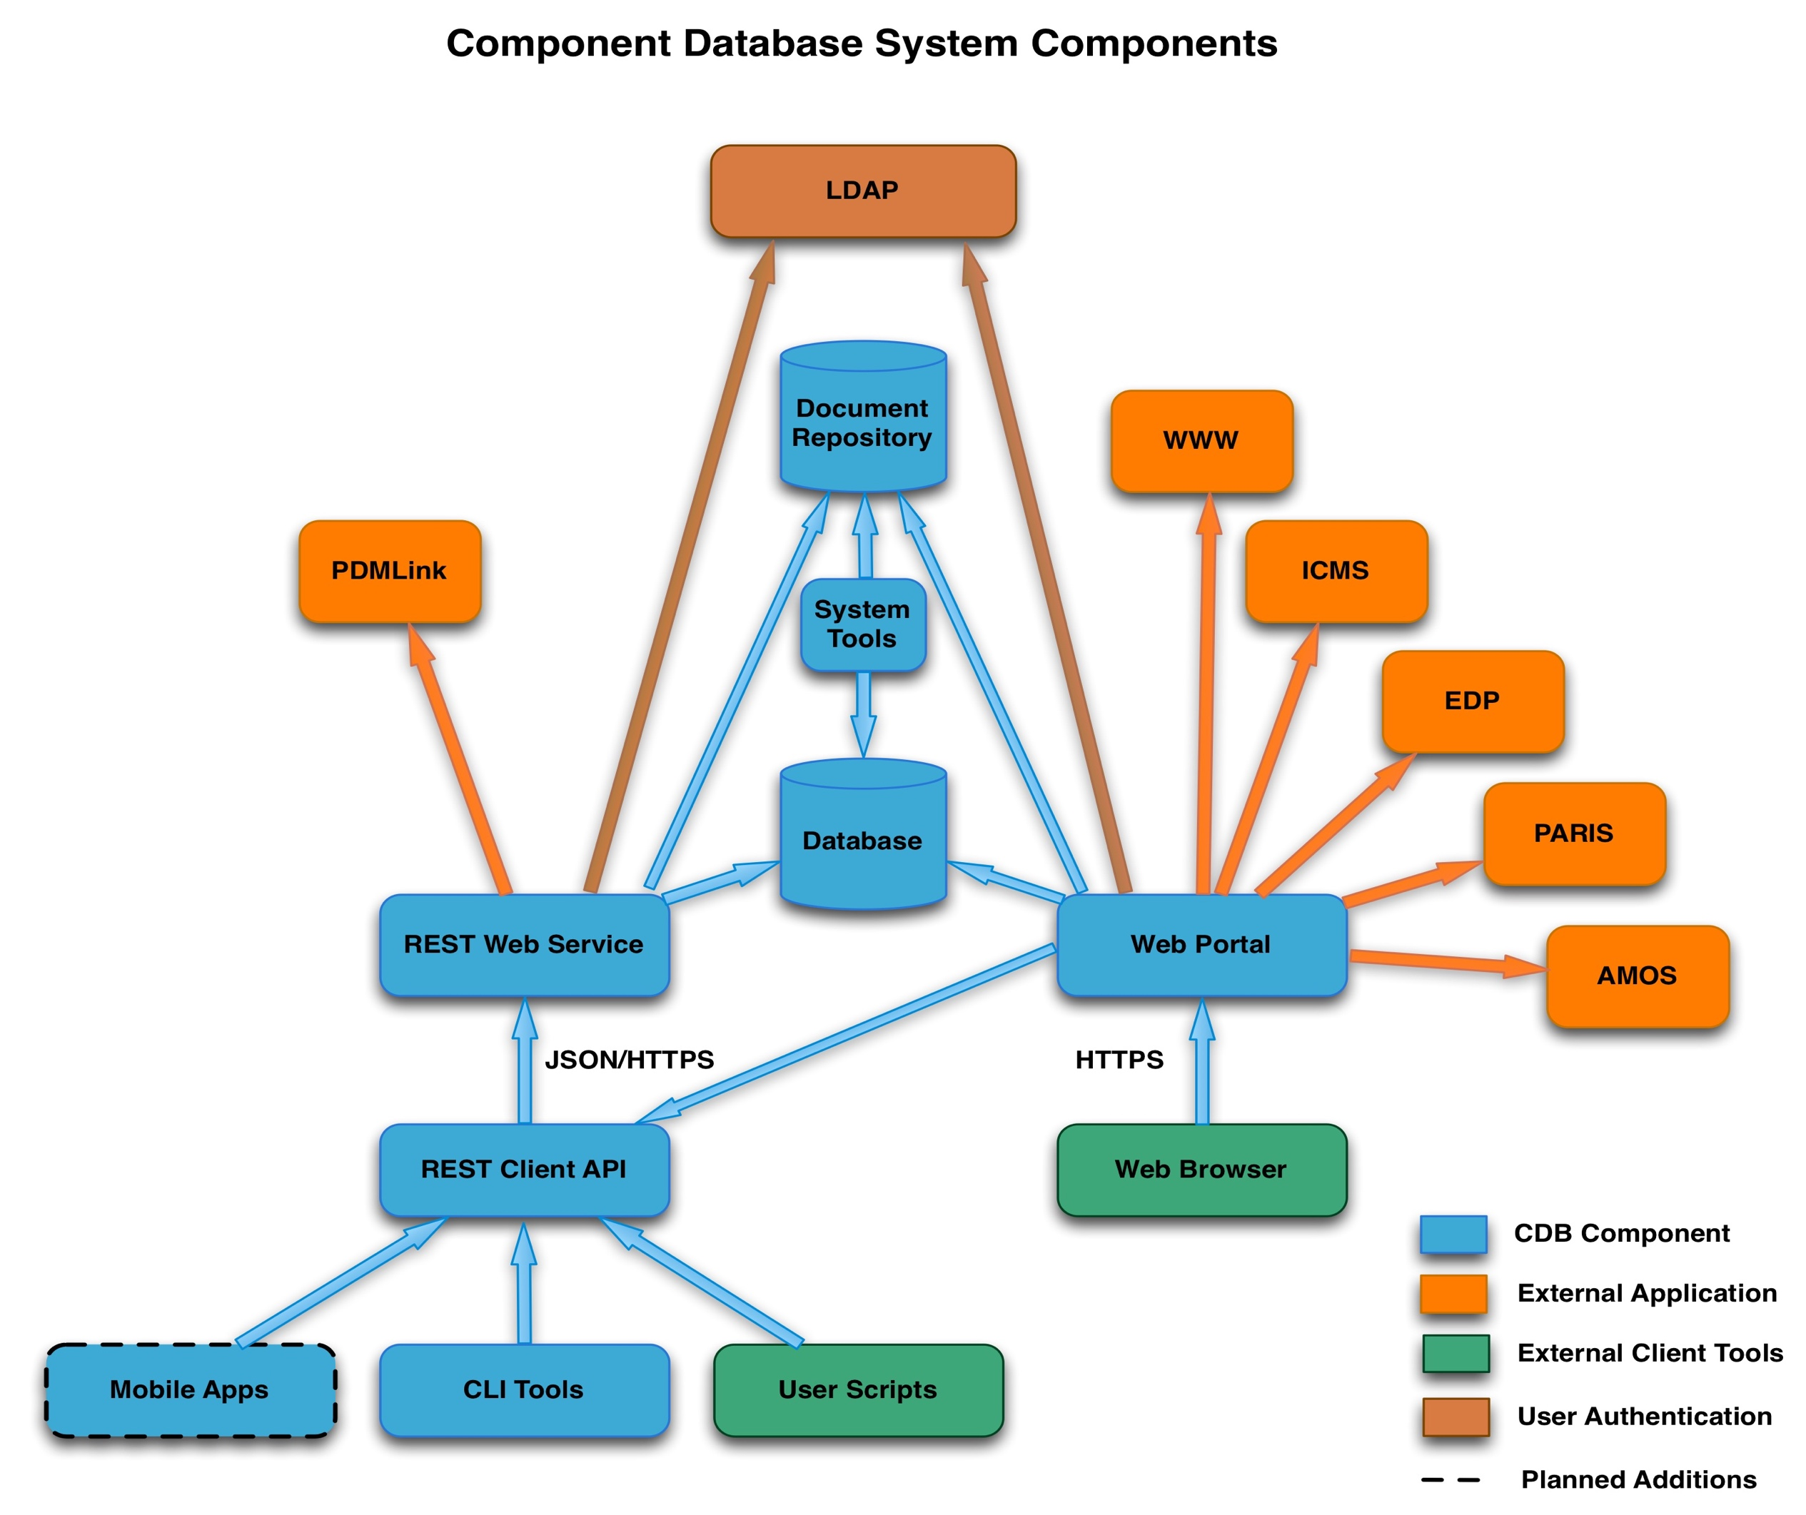
Features …
PTC Windchill
(Mechanical Dwgs)
Document Management System
FRIB eTraveler

Slide 20
Features …
Integration with Mechanical Drawing Repository
Fetched from Windchill

Slide 21
Features …
Integration with FRIB’s Traveler Application

Slide 22
Features …
Integration with FRIB’s eTraveler Application
Catalog
(each unique type of component or component design or COTS item + properties/drawings/specification/..)
Inventory
(each unique instance of component procured or fabricated) + properties/serial #/QR code/travelers/pictures/…)
Machine Designs
(A group of catalog components to perform a particular function + inventory items to build it +
Properties/pictures/locations/…)
Coming Soon …
eTraveler Templates/Forms
(an electronic form designed to guide the user through a set of steps <for specific component types>)
eTraveler [Instances]
(A copy of a Traveler Template filled in for a particular instance of a part)
eTraveler Example
Hydro Test for Mask Type #2:
Qrid = 000 001 679
Hydro Test for Mask Type #2
Vacuum Test Type #2
Hydro Test for Mask Type #2:
Qrid = 000 001 682
ACL for Mask Type #2
Vacuum Certification
Hydro Test for Mask Type #2:
Qrid = 000 001 683

Slide 23
Features …
Integration with FRIB’s Traveler Application
Catalog Items have ”Templates (Forms)”

Slide 24
Features …
Integration with FRIB’s Traveler Application
Inventory Items have ”Instances”

Slide 25
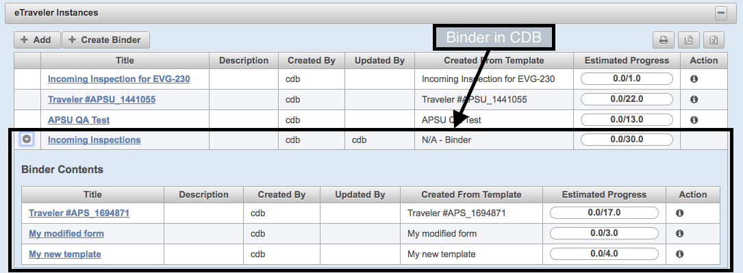
Features …
Integration with FRIB’s Traveler Application
  Supports “binders” (groups of eTravelers)
  Traveler specific columns with info fetched from traveler system

Slide 26
Features …
User interface will be very tricky … would like it to be graphical
Capture an exhaustive Bill of Materials for the entire accelerator??
Coming Soon …
  Machine Design Domain

Slide 27
Features …
Coming Soon …
  MAARC – Measurement and Analysis Archive
      User Interface to “Data Management” entries
Data uploaded via Data Management scripts
Captures user-defined meta-data for each item
Items can be associated with any other CDB item
First use will be Magnet Measurement data

Slide 28
Features …
Coming Soon …
  Mobile Apps

Slide 29
Technologies
CDB
  MySQL (DB)
  Java / Glassfish (Web Portal)
  PrimeFaces (UI framework)
  CherryPy (Web services)
Future Needs …
  Generate reports from data in eTravelers
      e.g. “Display the width measurement for each bellows received”
  Item Relationships (like IRMIS 2.0, circa 2005)
  Cable Management
  Directory Service / Name Database

Slide 30
0 → CDB in 4:59 (our aspiration)
Install … (djarosz@anl.gov)
Prerequisites command for red-hat is:
yum install -y gcc libgcc expect zlib-devel openssl-devel openldap-devel readline-devel git make cmake sed gawk autoconf automake wget mysql mysql-libs mysql-server mysql-devel curl
Prerequisites command for debian is:
apt-get install wget gcc git make cmake build-essential libcurses-ocaml-dev curl expect mysql-server libmysqlclient-dev openssl libssl-dev libldap2-dev libsasl2-dev sed gawk
Deployment Process:
--- Create a directory for installation and cd into it
mkdir install
cd install
--- Get the repository from github [ https://github.com/AdvancedPhotonSource/ComponentDB ]
--- NOTE: we also have releases on the page for more stable code)
git clone https://github.com/AdvancedPhotonSource/ComponentDB.git
cd ComponentDB
--- Get additional support installed within the cdb install directory
make support
source setup.sh #load env with new support
--- Follow on screen instructions to generate required configurations for the application
make configuration
--- Add necessary data to mysql database
make clean-db
--- Apply configuration and configure connections to db for glassfish
make configure-web-portal
--- finally deploy the portal
make deploy-web-portal

