Slide 1
November EPICS Collaboration Meeting Invitation

Slide 2
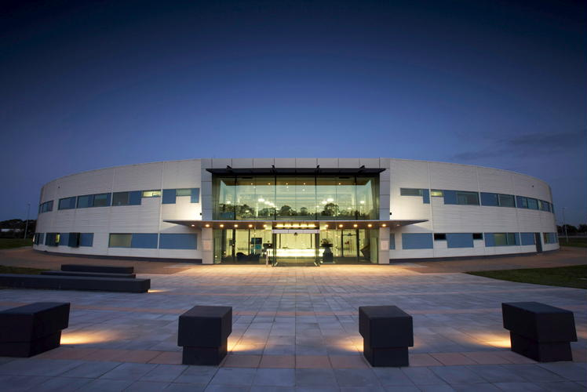
When and Where
Hosted By: The Australian Synchrotron
Location: Melbourne, Australia
Dates: 12 – 16 November 2018
Weather: Warm late spring

Slide 3
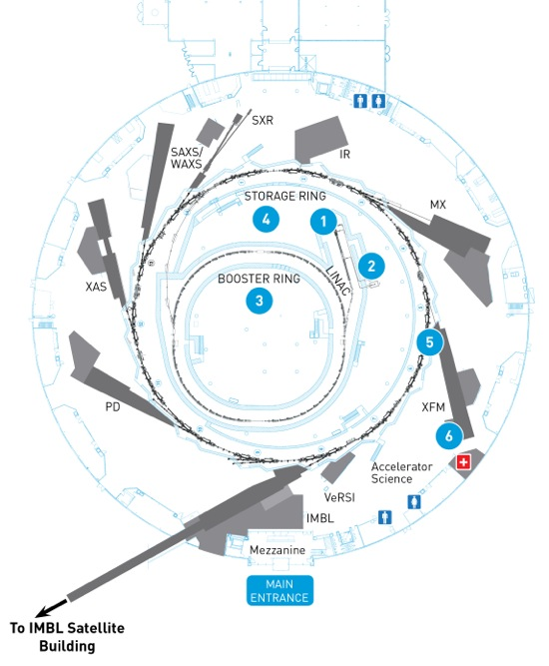
About the AS
3rd generation 3.5 GeV light source
Circumference: 216 m
8 exiting beam lines
7 new beam lines over the next eight years
Currently in design phase for the first two:
Micro-Computed Tomography
Medium Energy X-ray Absorption Spectroscopy
Guarantied 10-year operational support
Became part of ANSTO in late 2016

Slide 4
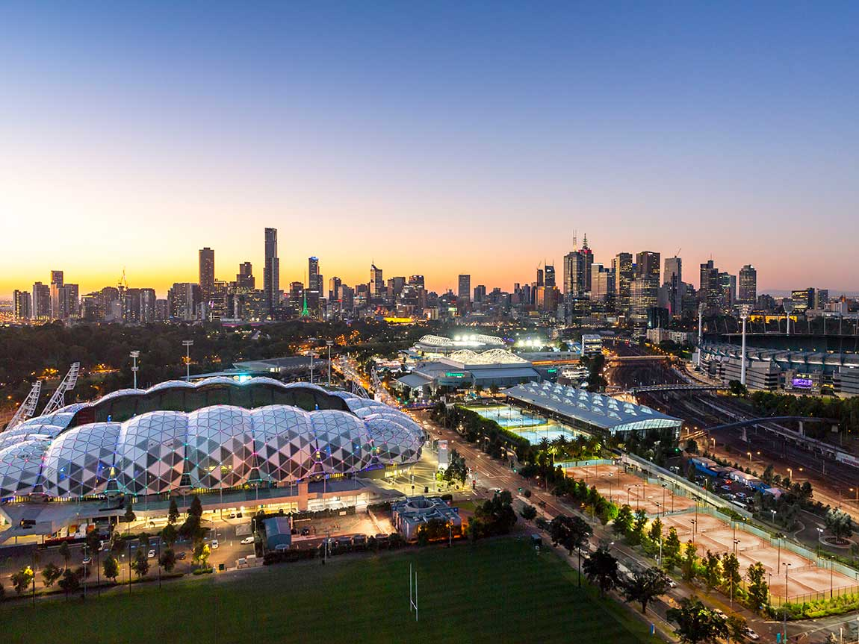
About the AS
Come visit the world’s most liveable city
for seven years in a row

