Slide 1

Distributed I/O for
Dynamic Equipment
Nathanael Maytan
Anton Derbenev
10/05/19

Slide 2
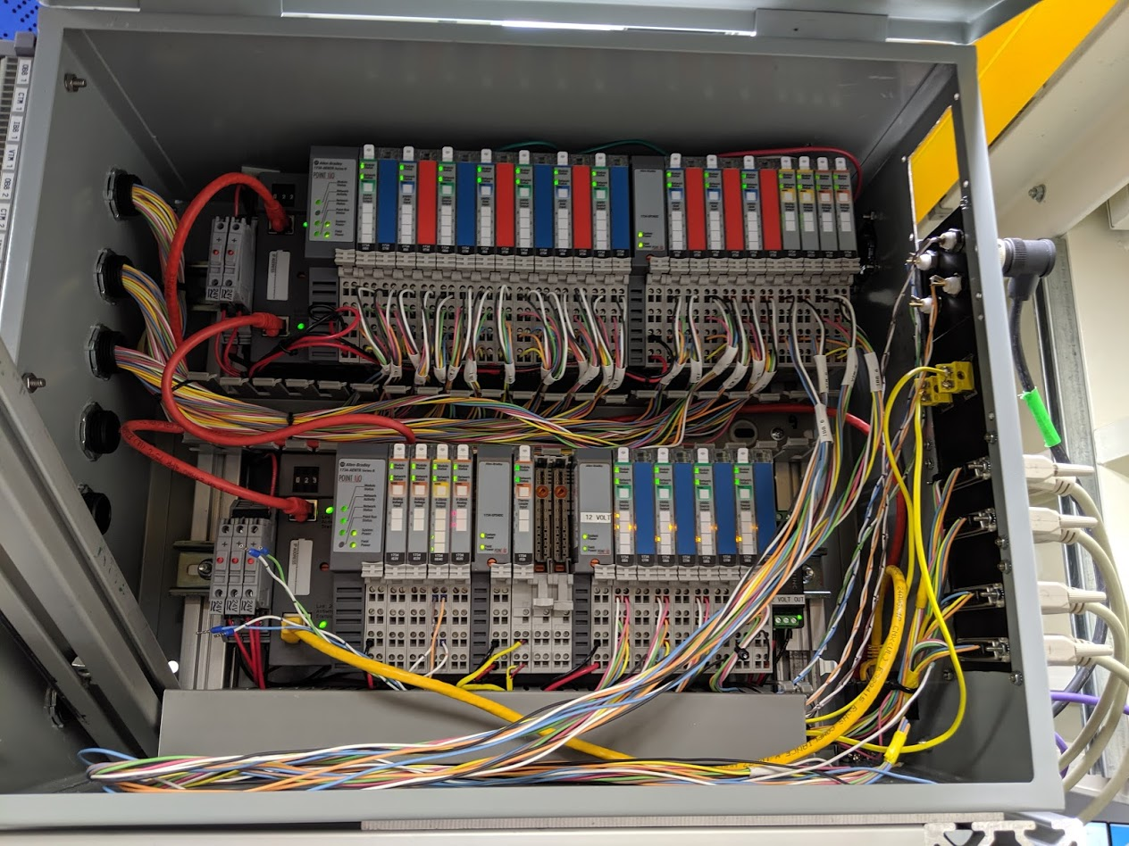
Contents
Introduction
Background
Scope
Design
Hardware
Software
Project Status
Next Steps
End/Questions

Slide 3
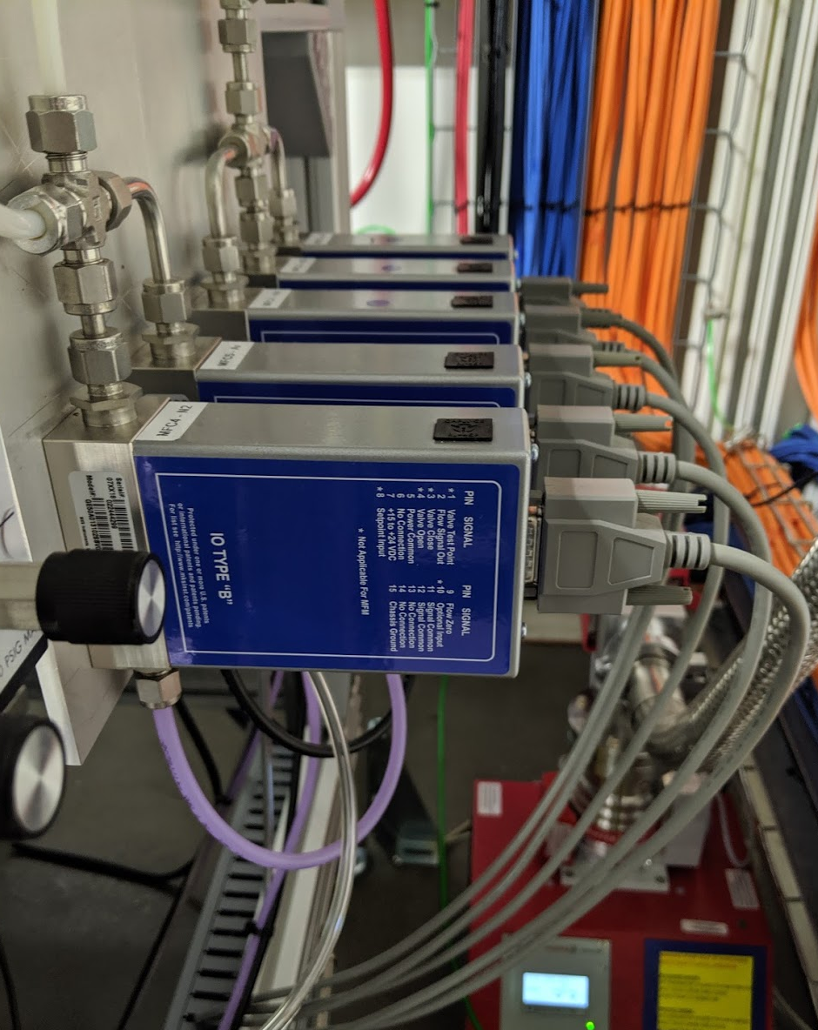
Introduction
Beamlines need to integrate lots of different equipment
Some equipment requires protection or protects something itself (i.e. other devices or staff)
For these devices, dedicated protection systems exist at each beamline
Other equipment does not have protection implications, but may still need to be integrated
We call this category of devices “dynamic equipment”
DIODE is a PLC-based solution aimed at the need for dynamic equipment integration
DIODE makes it possible to integrate equipment in a flexible, safe, and maintainable way while providing a system that is versatile, extensible, and reliable

Slide 4
Background
There are currently two major controller-based systems in use at each NSLS-II beamline: the Equipment Protection System (EPS) and the Personnel Protection System (PPS)
Historically, dynamic equipment would be lumped onto the EPS
  The EPS is much more mutable than the PPS, which is more strictly controlled
  The EPS is typically more physically-distributed throughout the beamline
While using the EPS has been a simple solution to the growing need for dynamic equipment integration, there are real consequences to that approach
  Every time the EPS is touched, there is a risk of introducing mistakes or errors
  Unnecessary complexity is added within the EPS.
  I/O boxes become overloaded
DIODE was proposed as a third controller-based system to enhance the reliability and maintainability of the beamline subsystems
With DIODE, the existing problems surrounding dynamic equipment integration can be avoided
  Using DIODE does not require introducing changes to the EPS
  New devices can be added or modified more quickly with less overhead

Slide 5
Scope
Each beamline will have its own DIODE installation
DIODE will support remote I/O boxes for distributed control capability
Existing dynamic equipment at a beamline can be migrated to DIODE
EPS/PPS functions should remain in their corresponding systems
DIODE software, hardware-base, and delivery will be uniform across every beamline

Slide 6
Design
There were many requirements to consider in forming a solution which can be applied uniformly across all beamlines
Amount of remote nodes
Possibilities for complex controls and automation
Flexible installation requirements
Room for expansion
Program storage space
Electrical Safety
Compatibility with existing hardware/spares
Component, fabrication, and installation costs
On-line code modifications
Sufficient passive heat dissipation
Availability of replacement or alternative parts
Maintenance and support overhead
Support for device hot-plugging
Facility-wide upgradability
Self-help options
Separate I/O and controls network interfaces
Completeness of solution
Cable ampacity and hardware derating

Slide 7
Hardware – Short Description
Allen-Bradley 5069-L310ER PLC
  Supports up to 24 remote nodes and has 1MB of storage
  Dual ethernet ports can be configured with independent IPs
  Compatible with existing facility components
  Expertise from EPS team can be carried over
Default box layout includes one OB16 module and one IB16 module
  16-digital outputs and 16-digital inputs
4x fused 24V supply outputs + 4x I/O network ethernet ports
  Plus one controls network port
10A Power supply to power both the controller and remote nodes
High-density terminal blocks provide plentiful source/return connections for equipment
Housed in a typical NEMA-rated electrical enclosure (20x20x8 in.)
Plugs into a standard 120V outlet (NEMA 5-15P)
Placement is up to the beamline, typically inside of a hutch

Slide 8
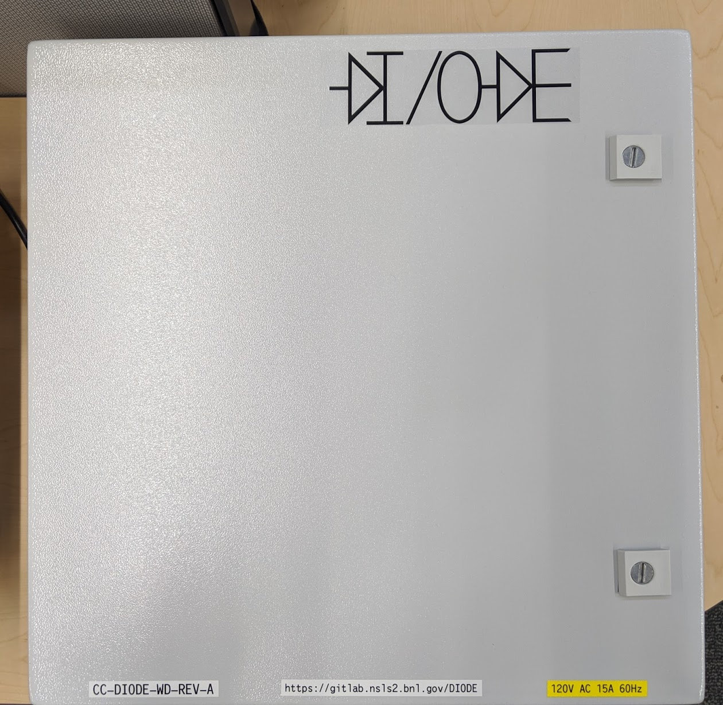
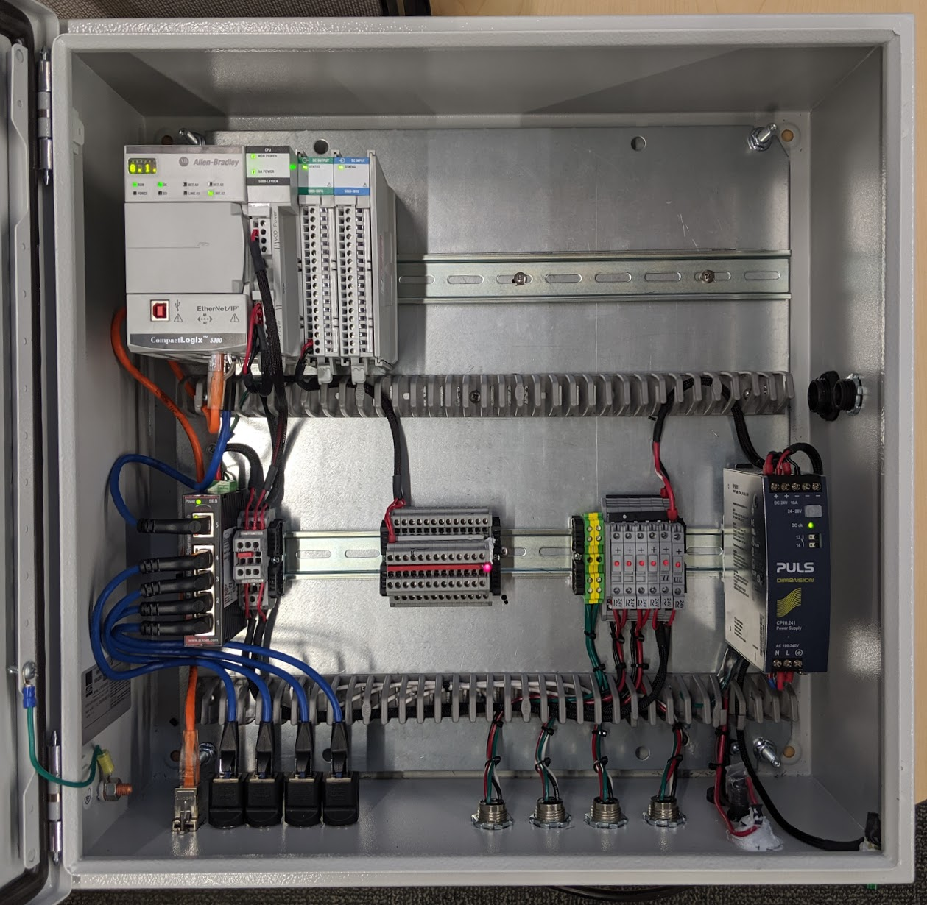
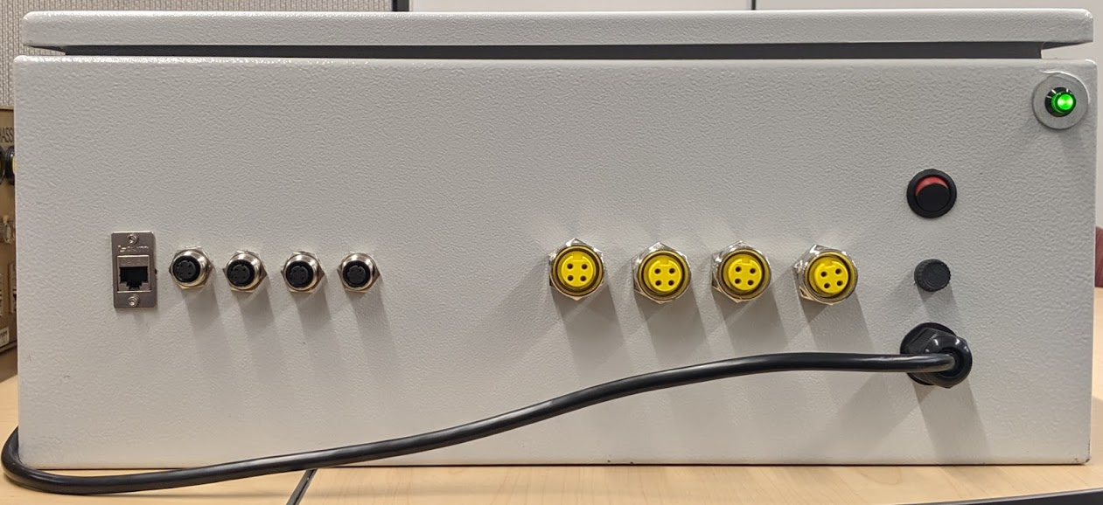
Hardware – Box Pictures
Front
Inside
Bottom

Slide 9
Software – IOC Overview
EPICS IOC uses EtherIP driver for CompactLogix controllers
IOC record substitutions are generated via bash script for every PLC module in a DIODE installation
The IOC will only attempt to build databases for which a substitutions file is found
PLC module I/O channels are immediately usable through “generic PVs”, thus enabling device hot-plugging without software changes
New PLC modules are supported by adding a corresponding database template in the IOC source code
Custom databases can also be included with the DIODE IOC by an available bash script without manually modifying the IOC
The goal is to make things as self-help friendly as possible. No in-depth expertise is needed to swap devices or add record aliases for a channel

Slide 10
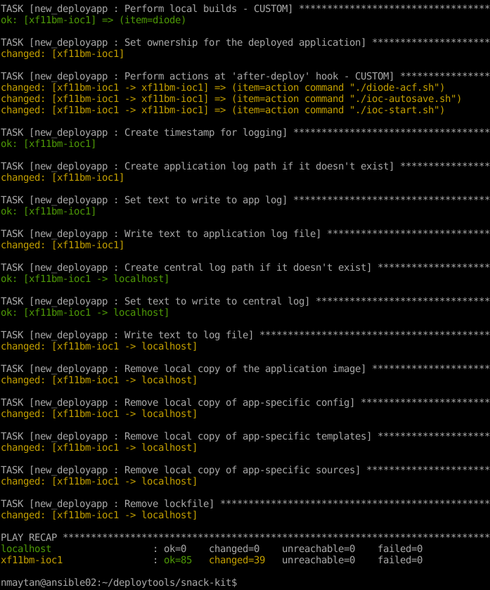
Software – SNACK Delivery
The DIODE IOC is deployed and version controlled using SNACK, an Ansible-based configuration management tool
DIODE IOC source code lives in its own repository, whereas configuration entities are kept in our central configuration repository
Each IOC instance requires only a beamline-specific SNACK template file (and any optional custom IOC databases)
All other application customization comes through configuration templates
PV-generating scripts are made into templates and handled by SNACK, though they can be used on their own

Slide 11
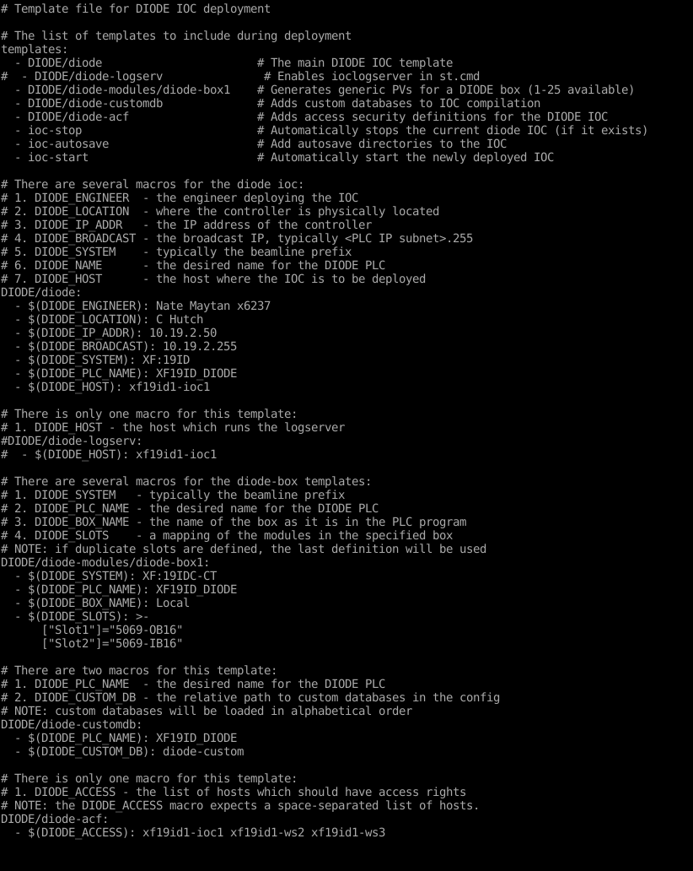
Software – SNACK Template File
These will do several things:
Add the template startup script to the app
Generate PVs for the DIODE “Local” box
Add custom databases to the IOC
Set the specified hosts in the ACF
Stop the existing IOC
Create autosave folders
Start the new IOC when deployment is finished
This list determines what SNACK templates are included with the app during deployment
Defines the macros in the template startup script
If used, this defines the macro that sets the logserver host
A “diode-box” template should be included for every I/O box. Each template can have different modules defined in any order. The first box is named “Local” according to the Studio 5000 defaults
Describes what modules are in a given I/O box so that PVs can be generated
Sets what folder in the app config contains the custom databases to include
Defines which hosts have write permissions

Slide 12
Software – User Interface
DIODE comes with a set of CS-Studio OPI screens
Each supported module has its own OPI, while each beamline has its own DIODE page
  Module OPIs give control and readback for every channel and allow for configuration of related I/O settings
  Beamline-specific DIODE pages will provide an overview of available boxes and their installed modules, allowing any box or slot to be accessed

Slide 13
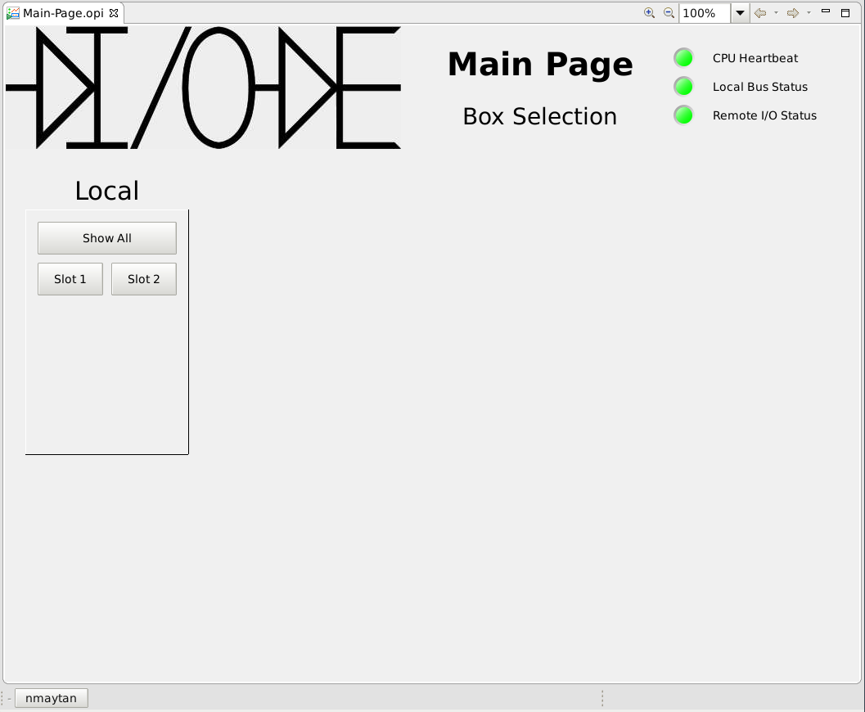
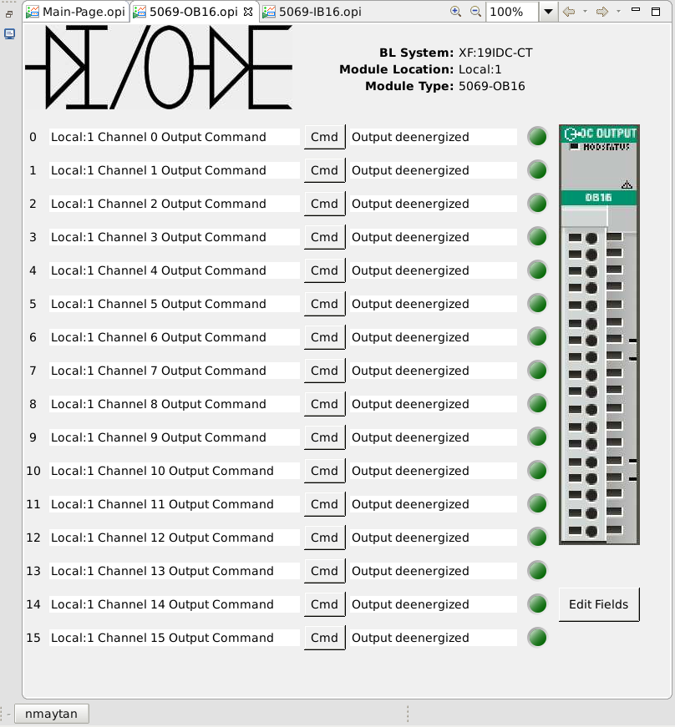
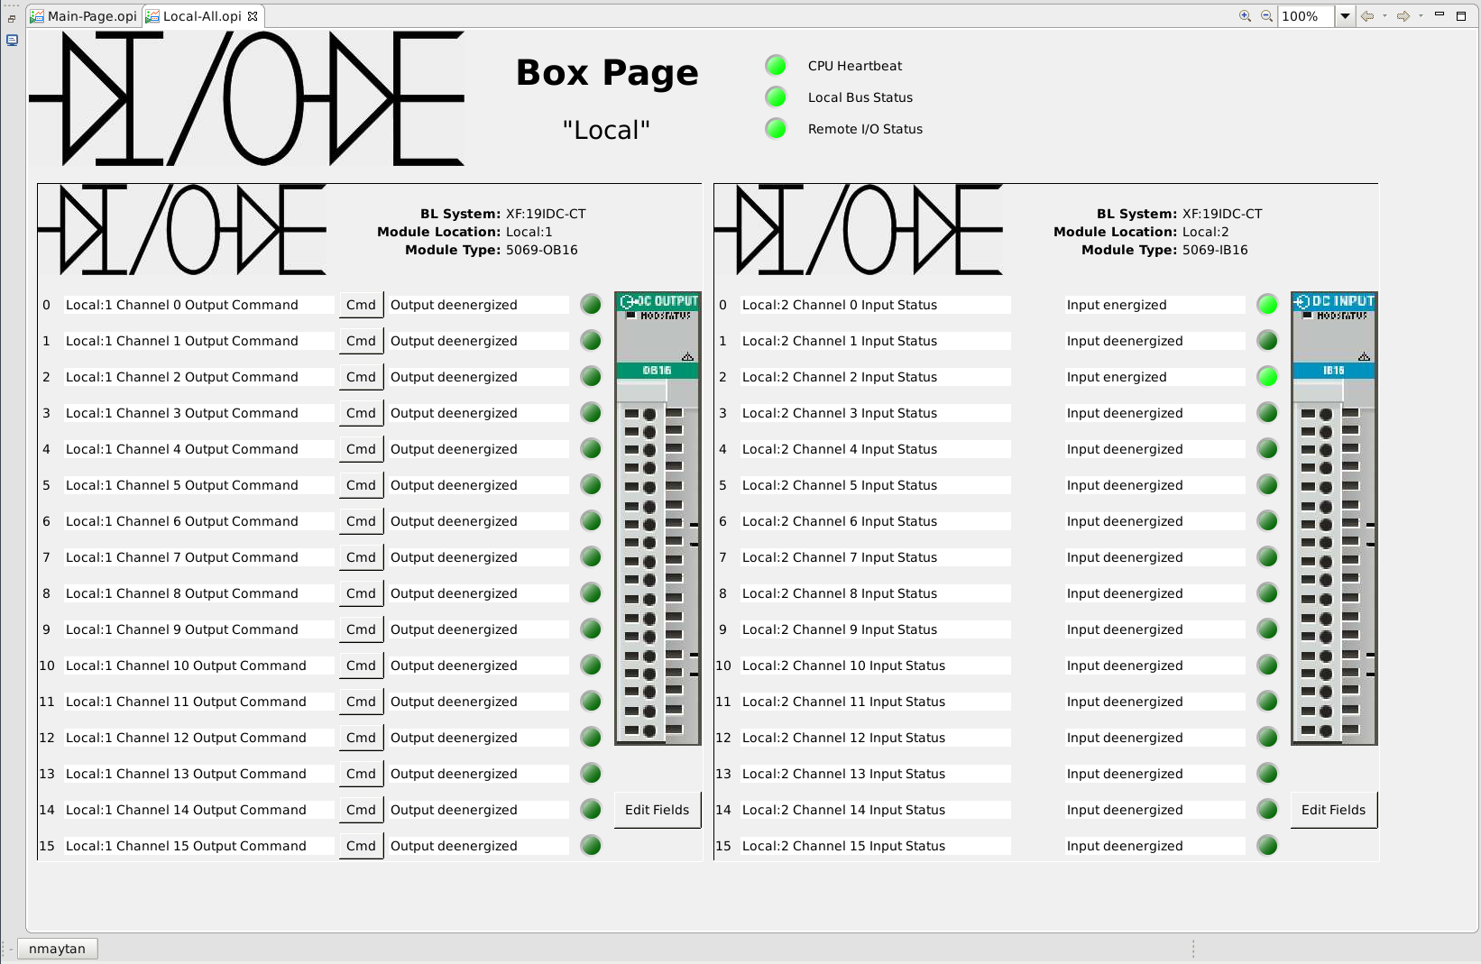
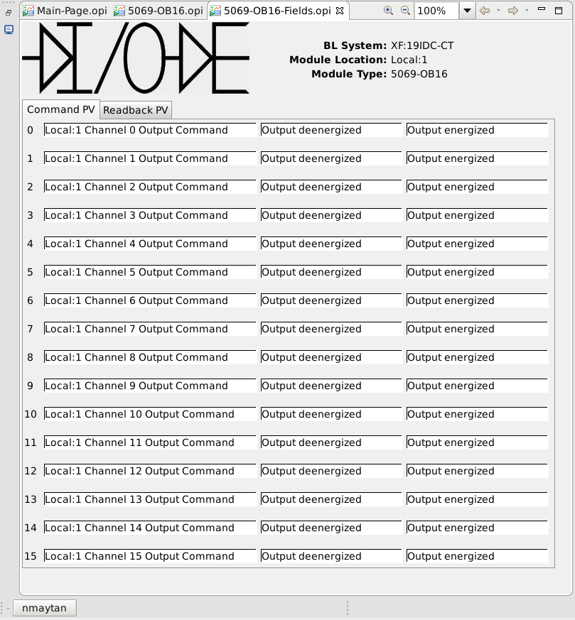
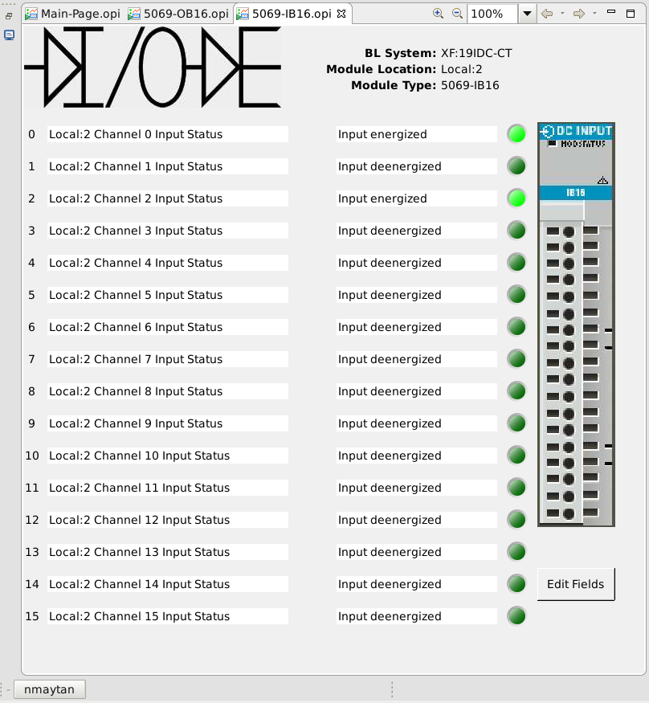
Software – CS-Studio Pages
Module OPI for Slot 1
Box Page – Shows all slots on one screen
Module config for Slot 1
Module OPI for Slot 2

Slide 14
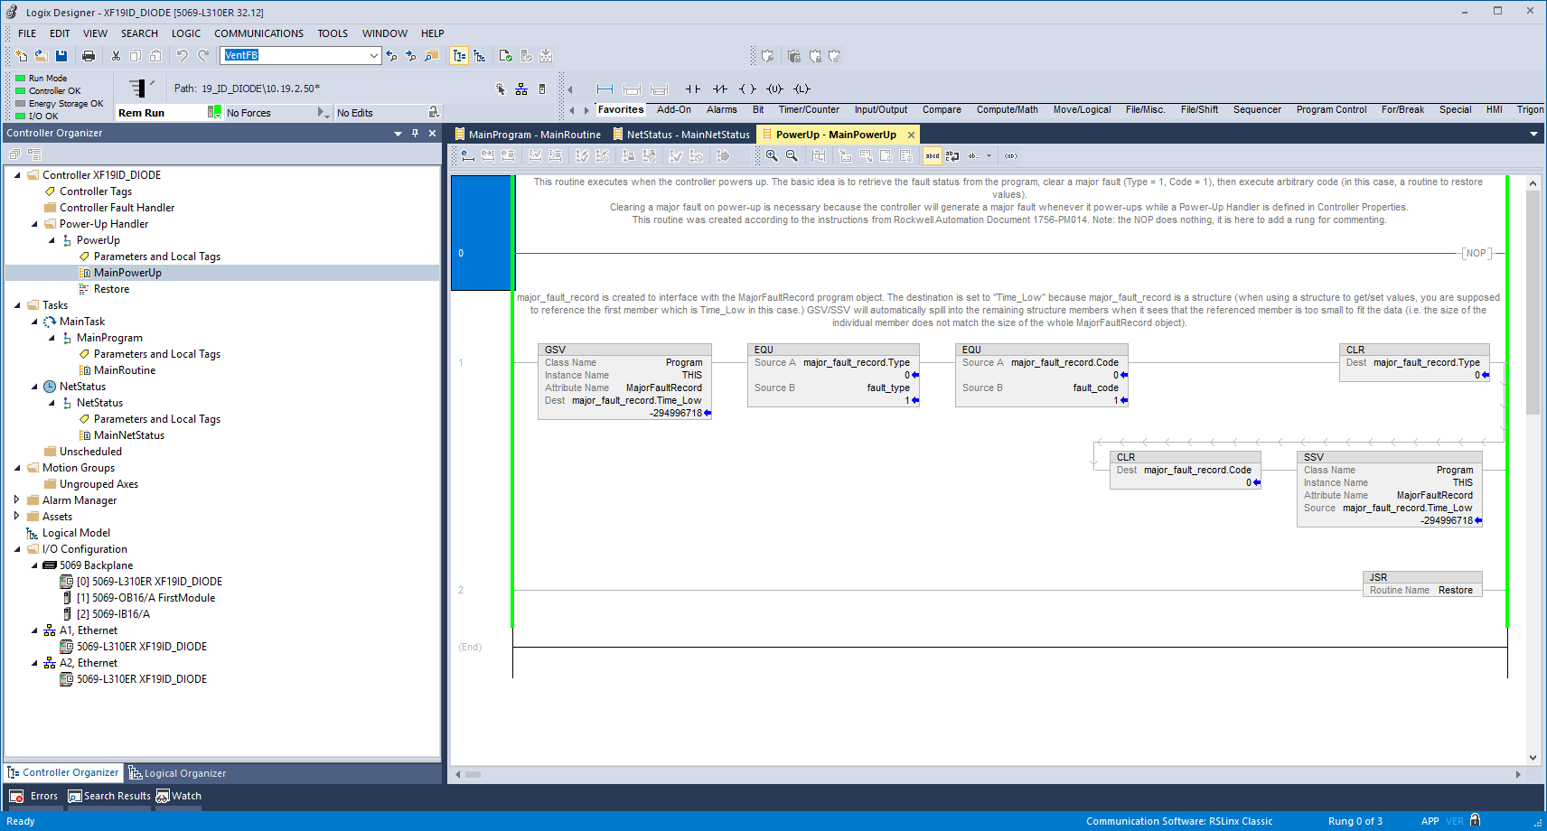
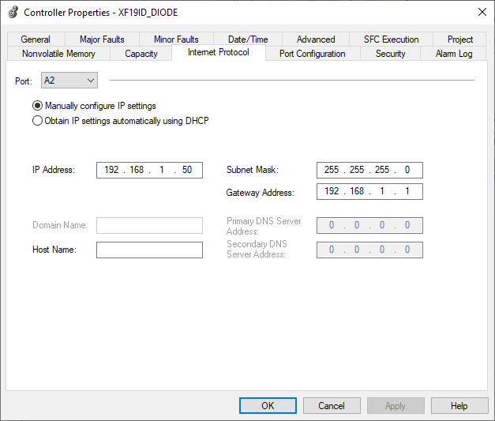
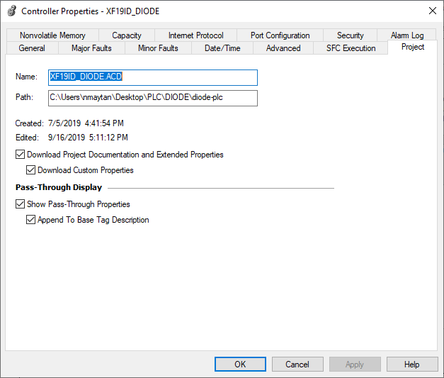
Software – PLC Program
A starter PLC-program is downloaded to each controller
  Developed in Studio 5000 v32 (latest)
  Enables power-up restore, comm status checks, and controller heartbeat
Controllers run AB firmware major revision v32
  Unlike older controllers, newer software base supports important new features such as:
    Preserve comments when uploading to the controller
    Independent IP assignment per ethernet port

Slide 15
Project Status
DIODE has been successfully installed at two beamlines: 11-BM CMS and 19-ID NYX
At NYX, some equipment has already been integrated and is controlled by generic PVs (pneumatic screens)
Boxes have been assembled for 8-ID ISS and 22-IR FIS/MET – boxes are awaiting integration
Assembly of the next box has started and will be installed at 17-BM XFP
The DIODE IOC is available for on-demand deployment and configuration through SNACK, complete with CS-Studio screens
DIODE is being supported and can be shipped as a complete solution to dynamic equipment integration requests

Slide 16
Next Steps
Continued roll-outs to the beamlines in queue:
7-BM QAS, 8-ID ISS, 17-BM XFP, 22-IR FIS/MET
Support for more modules through generic PVs (implies database templates and module OPIs)
DIODE setup to be installed in the Controls Lab for equipment and integration testing
More documentation updates and additions
Gather feedback from first adopters
Identify use-cases for DIODE at other beamlines
If there is demand, introduce some self-configurable control tools (i.e. PID loops, pulse generators, timers, etc.)
  The uniformity that DIODE provides means that new features can be rolled out facility-wide
DIODE Trainings?

Slide 17
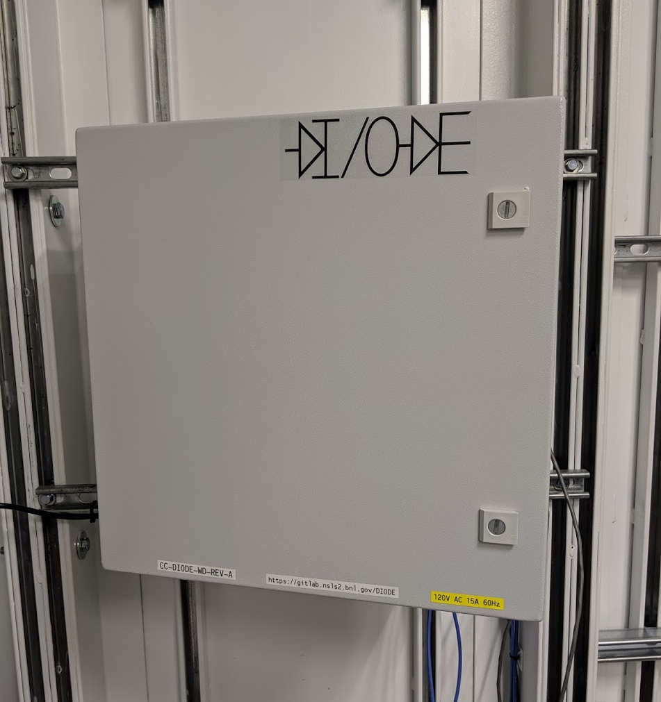
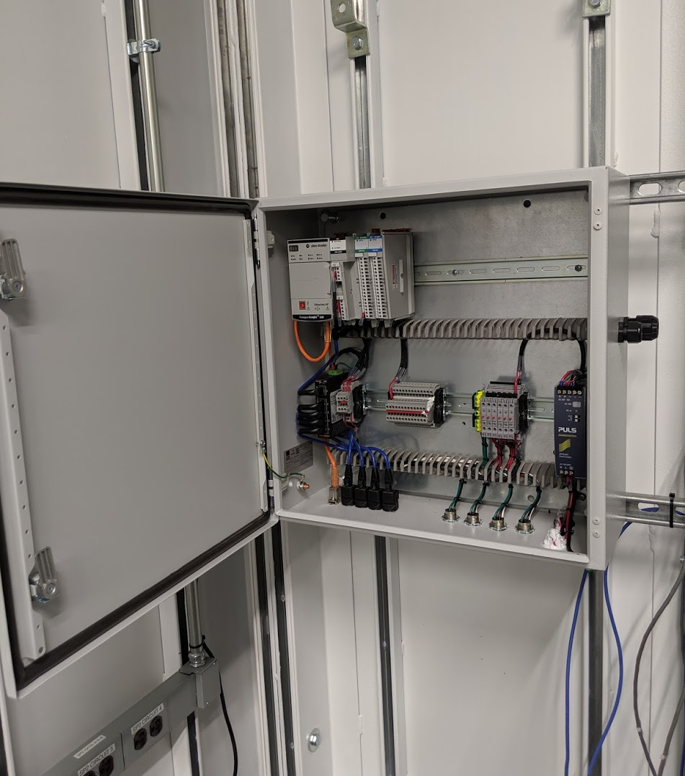
End
Thank you for your time
Questions?

