Slide 1
Display Builder Web Runtime
https://github.com/kasemir/pvws
https://github.com/kasemir/dbwr
Kay Kasemir, October 2019

Slide 2
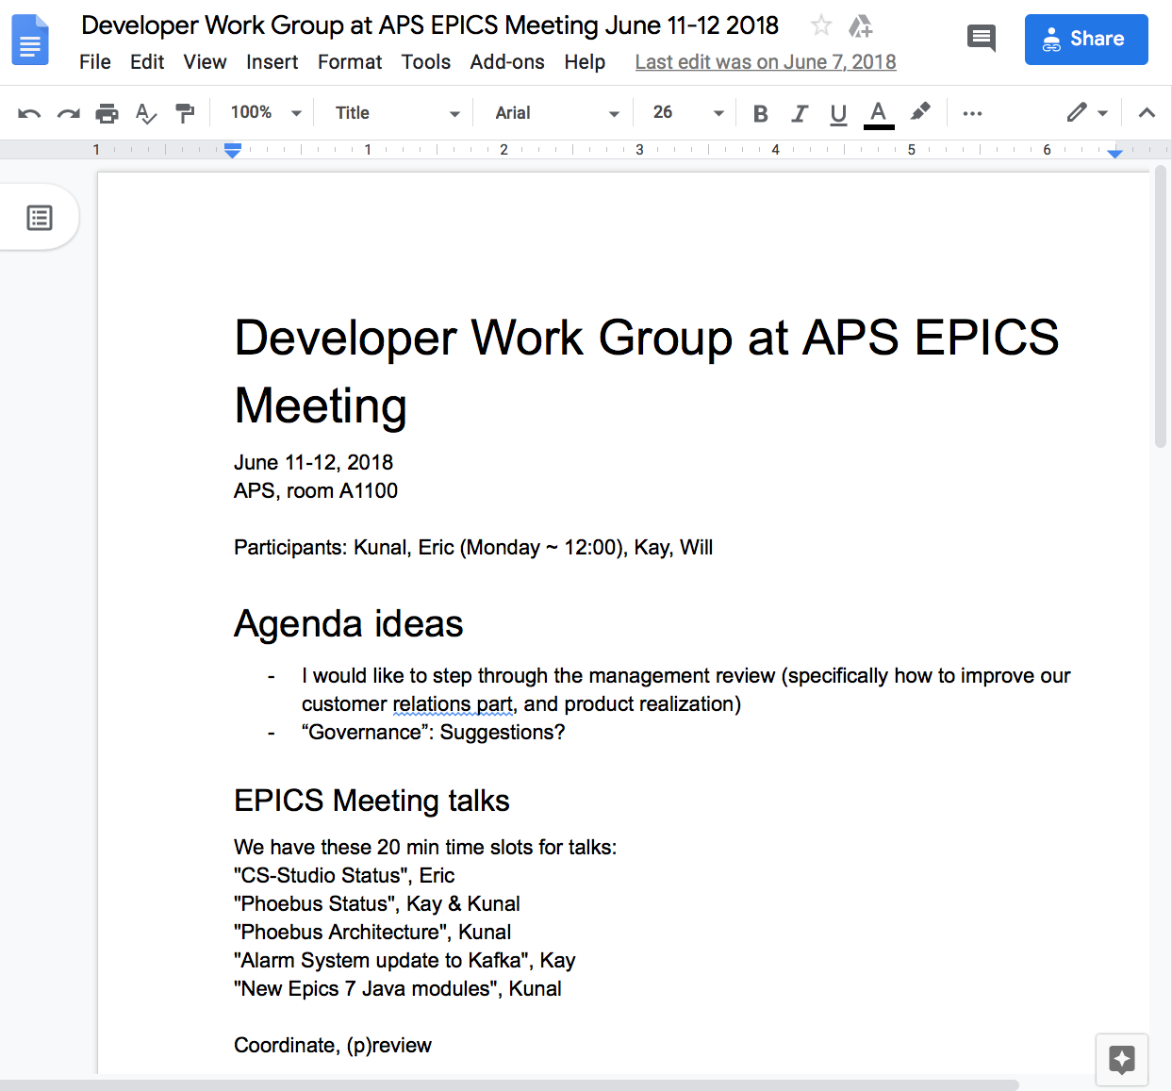
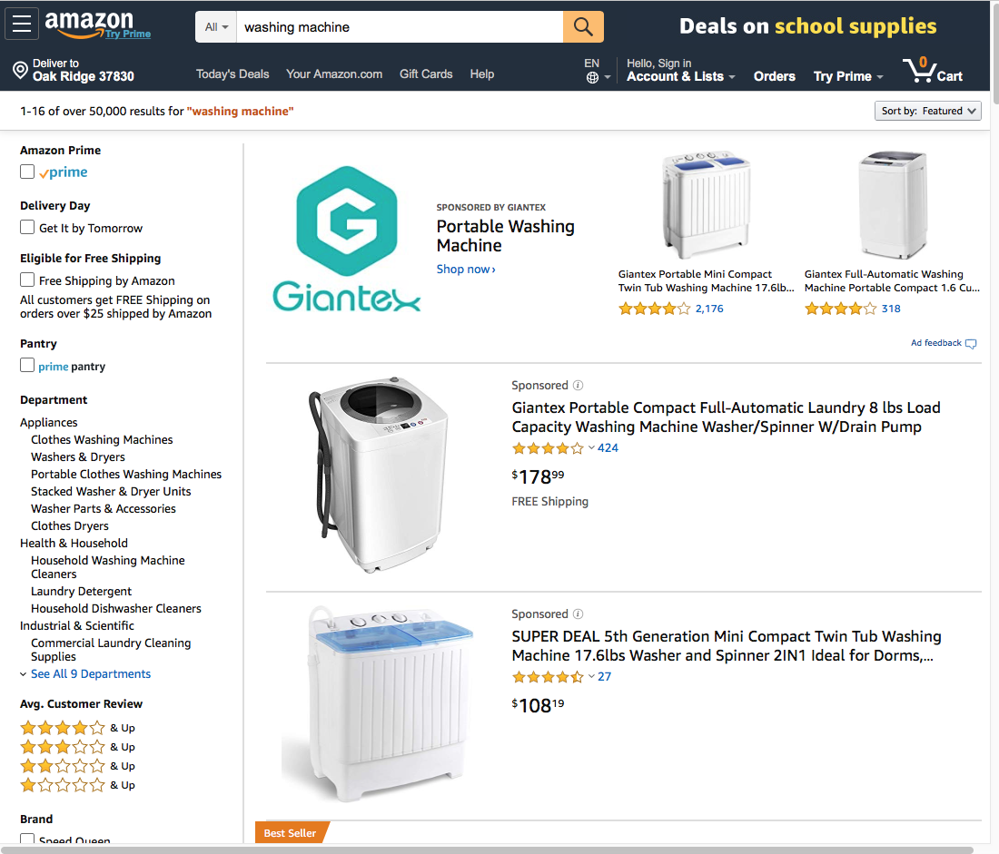
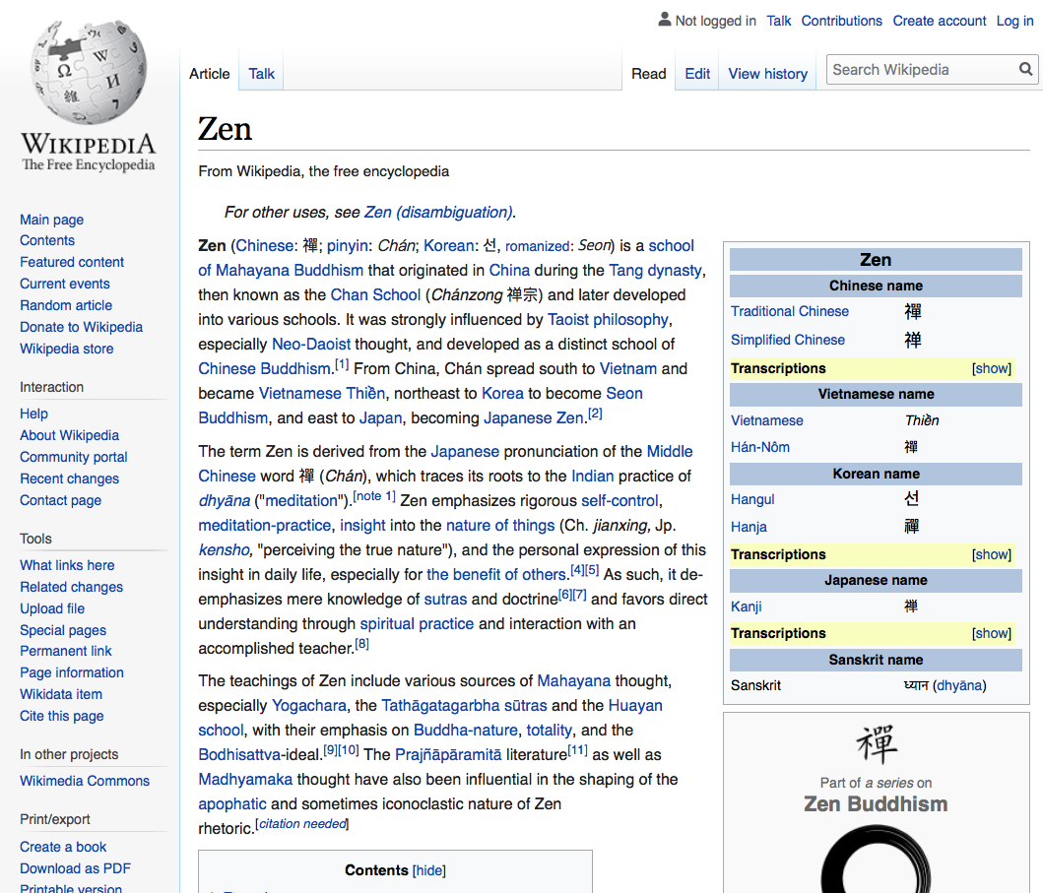
Web Applications can be amazing
Google Docs
Amazon
Wikipedia

Slide 3
Internals
Desktop App
Web App
Desktop or Laptop
Server
The App
Java or C++
Web Server
Java, C++, PHP, Node.js, …
HTTP,
Authentication Credentials,
XML, JSON
Desktop, Laptop, Phone
Web Browser
HTML
CSS
JavaScript

Slide 4
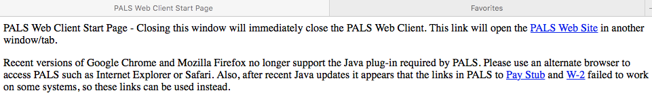
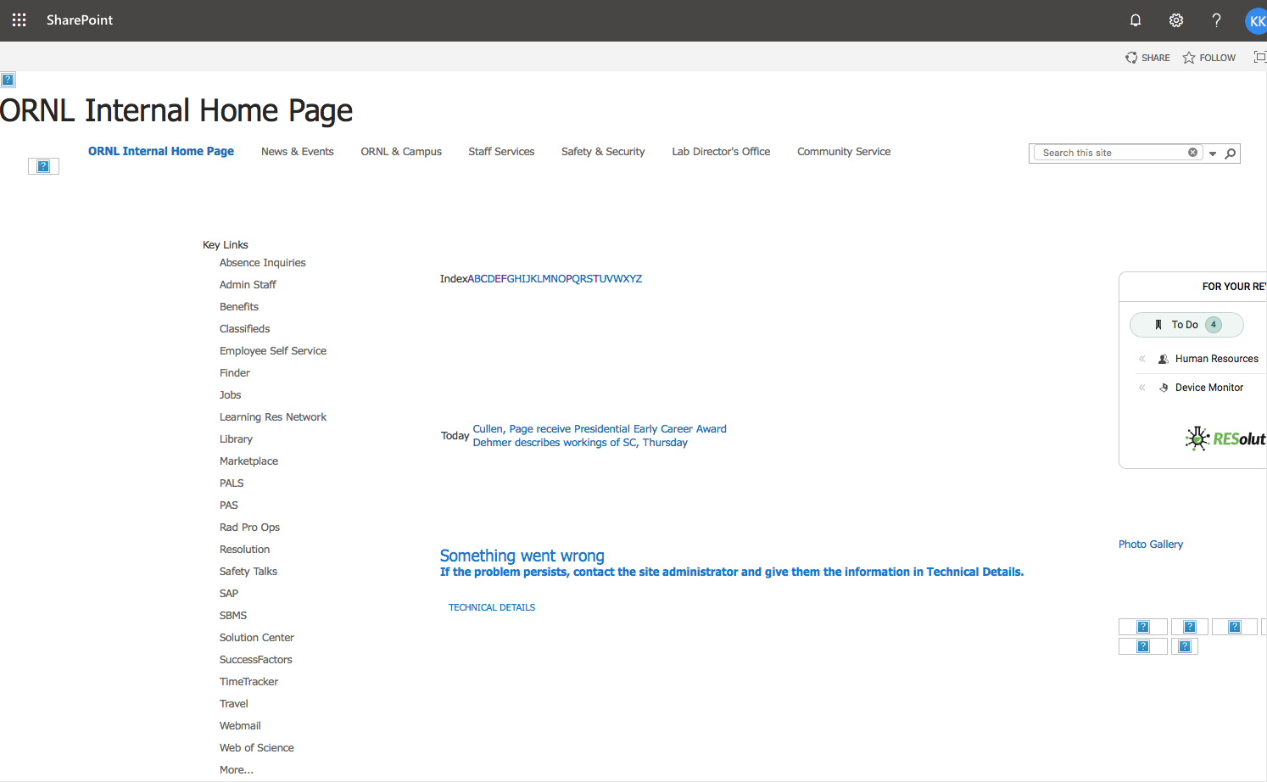
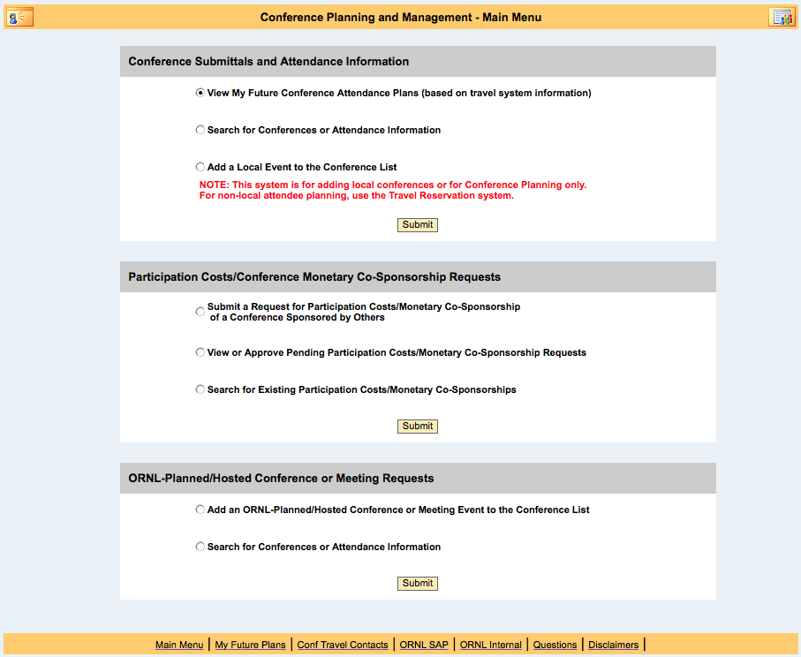
Beyond Google, Amazon, Wikipedia

Slide 5
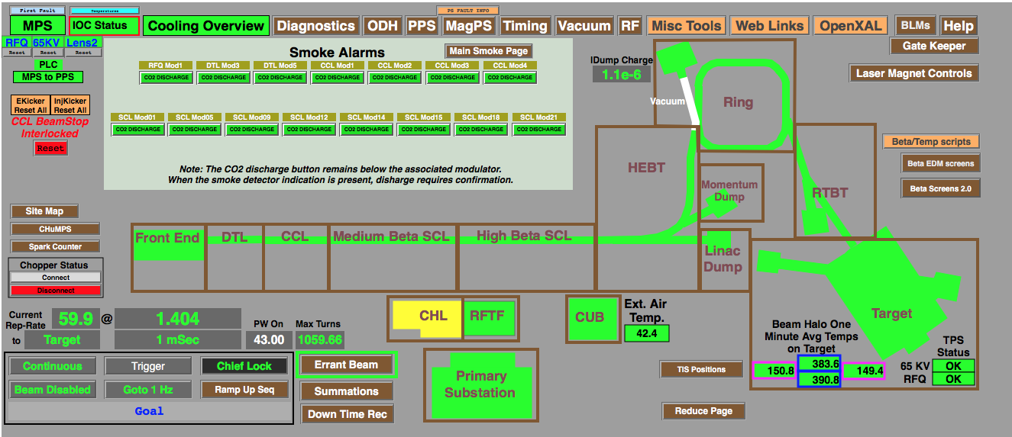
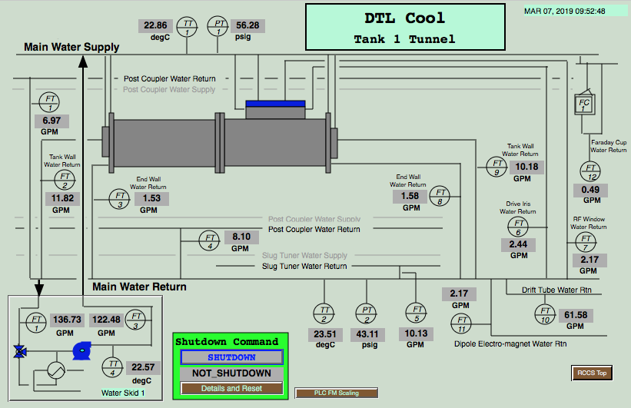
Web EDM
Ryan Slominski,
JLab,
2017 EPICS Meeting
Very useful and performant
for EDM displays
and Channel Access IOCs
Limitations:
No waveforms (plots, images)
No metadata from non-IOC servers (LabView, Python)
No PV Access support

Slide 6
General Web Display Idea
Some EPICS Display
Web Server (Tomcat)
Web Browser
Create HTML
HTML, CSS, JavaScript
Subscribe to PVs
PV Web Socket
Metadata, then value updates
ca
pva
sim
Ctrl System
At runtime,
network traffic similar to
{
pv: "SomePV",
value: 3.14
}

Slide 7
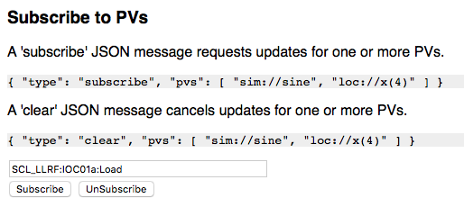
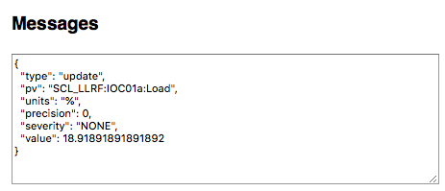
PV Web Socket - https://github.com/kasemir/pvws
Same as CS-Studio (Phoebus) Stack
  VType PV for loc://, sim://, ca://, pva://, …
  PV Pooling
  RXJava Throttling
Data Packaged as JSON
  Sends metadata once
    No separate connections to *.EGU, *.PREC, …
  Severity and value on change
  Arrays packed as Base64-binary
  JavaScript in client merges received updates
Defaults to read-only, but can write

Slide 8
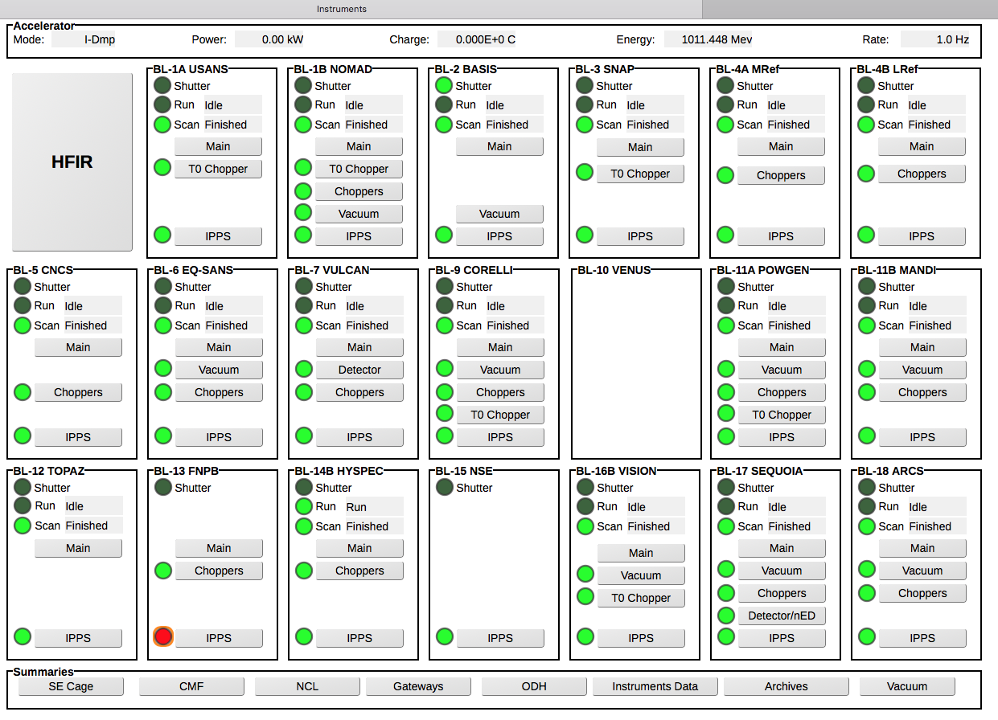
Display Builder Web Runtime - https://github.com/kasemir/dbwr
Labels, LEDs, Text Updates
Groups, Embedded displays, Macros

Slide 9
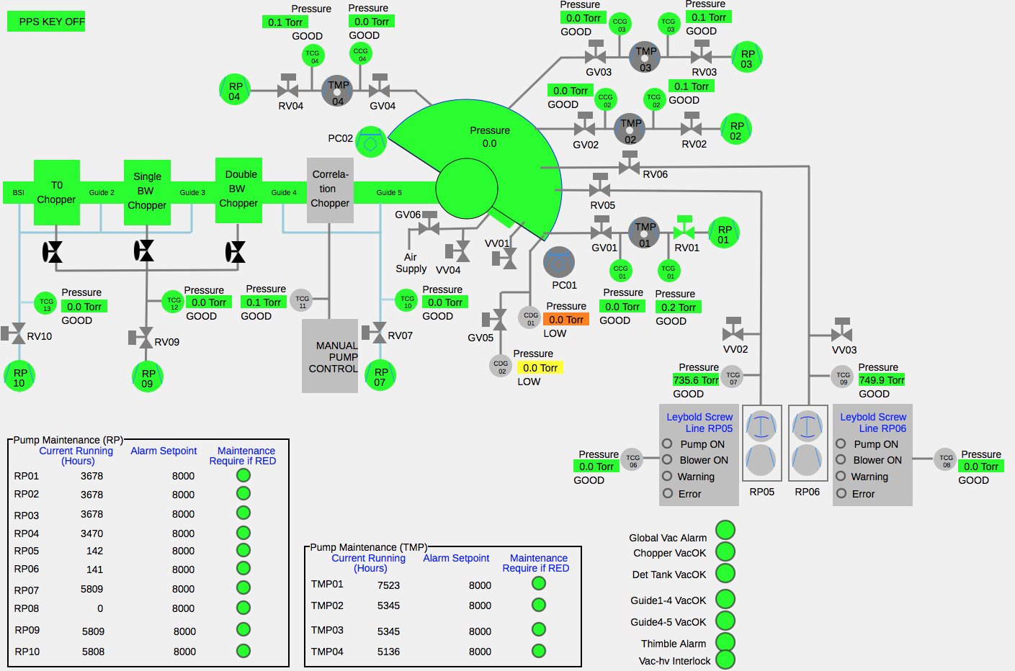
'Static’ Widgets
Lines,
Circles,
Rectangles, ..
Limited ‘Rule’
Support:
Some colors,
Hide/Show

Slide 10
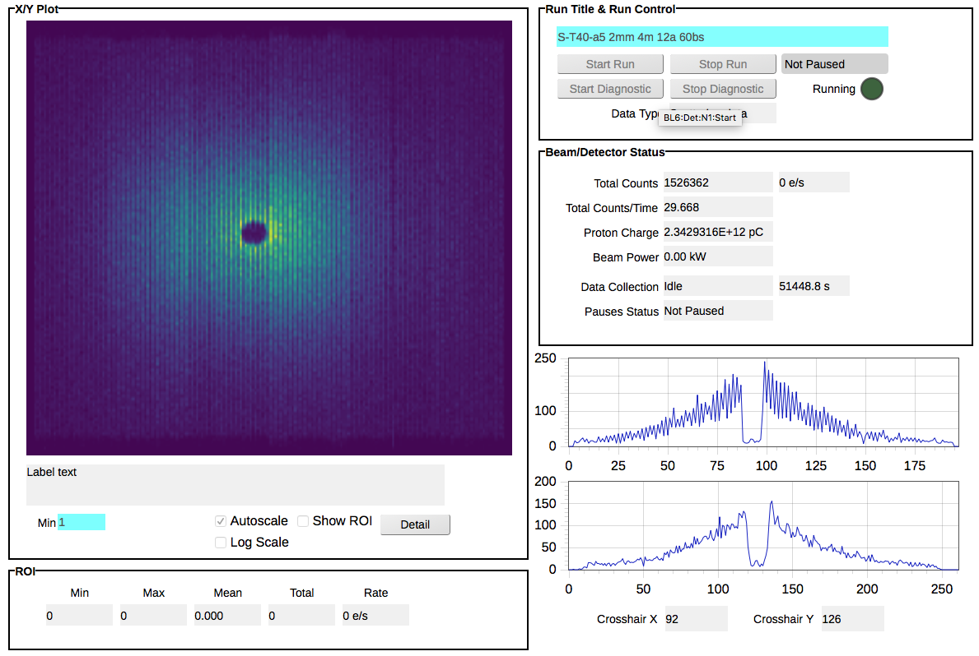
Line and Detector plots

Slide 11
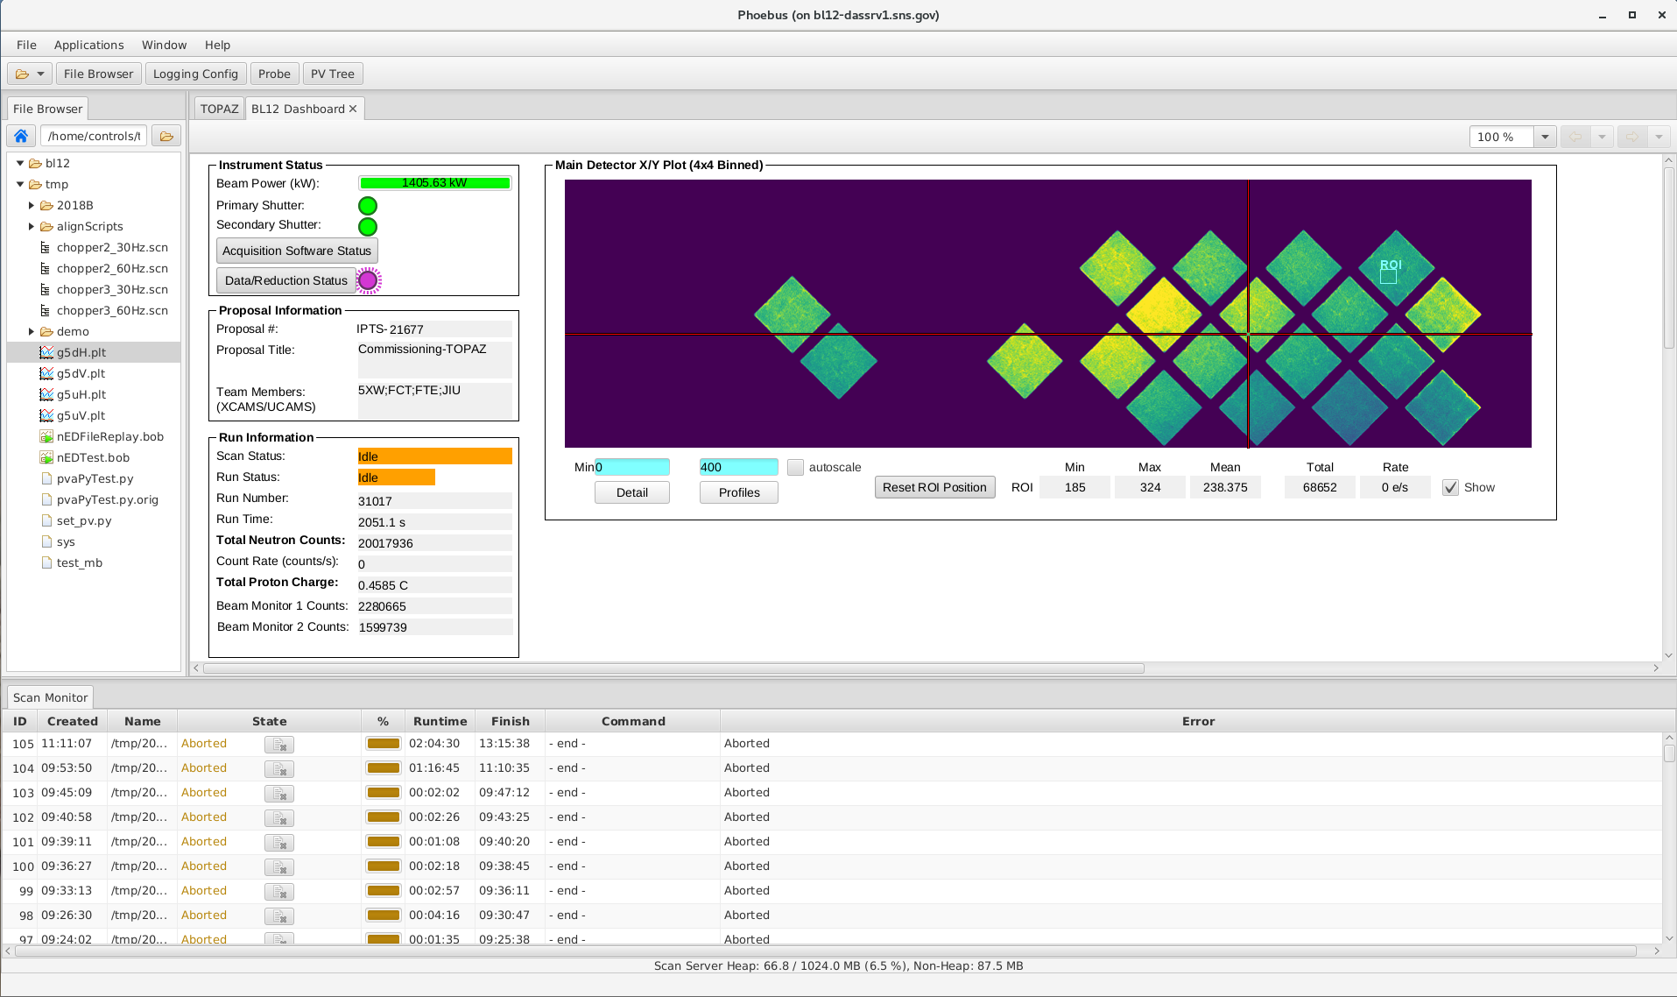
CS-Studio on Desktop vs. Web Runtime
Integrated Product w/ Editor
Robust Development
  Type checking
  Single-Language
Just Display Runtime
Fragile Development
  No type checking
  Client: HTML, CSS, JS
  Server: Java, Python, …
  Different Web Browsers
Still:
Web view of control system is extremely convenient and useful!

Slide 12
Status: Ongoing Project, but already very useful
Label
Rectangle
Ellipse
Arc
Polyline
Polygon
Text Update
Text Input
Text formatting (precision, units, enum labels)
LED
Multi-State LED
Action Button to open display or web link
Combo
Group with group border
Embedded Displays
Tabs
XYPlot
Image
Macro support
Alarm-sensitive border based on PV
Limited Rule support:
Color of rect/circle/label, visibility
Caching

Slide 13
Summary
Display Builder Web Runtime offers web access to much of the
Desktop version
https://github.com/kasemir/pvws
https://github.com/kasemir/dbwr
git clone
ant
copy *.war to Tomcat
Set environment:
EPICS_CA_ADDR_LIST, ..
➔ http://your_tomcat/dbwr

Slide 15
EPICS Operator Interfaces
198x edd/dm X11, Xt
199x medm, dm2k Motif
200x edm Motif
2010 CS-Studio BOY SWT
2017 CS-Studio Display Builder JavaFX
Also: tcl/tk/ca, TK
python/qt/ca, .. Qt
UI libs change with technology and fashion

Slide 16
Limited Compatibility
MEDM
Text
{
object
{
x= 265
y= 440
width=155
height=20
}
"basic attribute”
{
clr=54
}
textix=”Hello"
}
EDM
object activeXTextClass
beginObjectProperties
x 265
y 440
w 155
h 20
font "arial-bold-r-10.0"
fgColor index 5
value {
”Hello"
}
endObjectProperties
Qt Designer
<widget class="caLabel" name="caLabel_0">
<property name="foreground">
<color alpha="255">
<red>10</red>
<green>0</green>
<blue>184</blue>
</color>
</property>
<property name="text">
<string>Hello</string>
</property>
<property name="geometry">
<rect>
<x>265</x>
<y>440</y>
<width>155</width>
<height>20</height>
</rect>
</property>
</widget>
Why not just
<text>Hello?
Dump of tool’s in-memory “model”.

Slide 17
Simple, General Format
<widget type="label">
<x>268</x>
<y>440</y>
<width>155</width>
<height>20</height>
<text>Hello<text>
<foreground_color>
<color red="0" green="0" blue="0”/>
</foreground_color>
</widget>
XML
  Somewhat human-readable
  Parsers for every programming language
“label”, “text_update”
  Not hinting at specific implementation
Display Builder

