Slide 1
CS-Studio & Phoebus
Developers Meeting Report

Slide 2
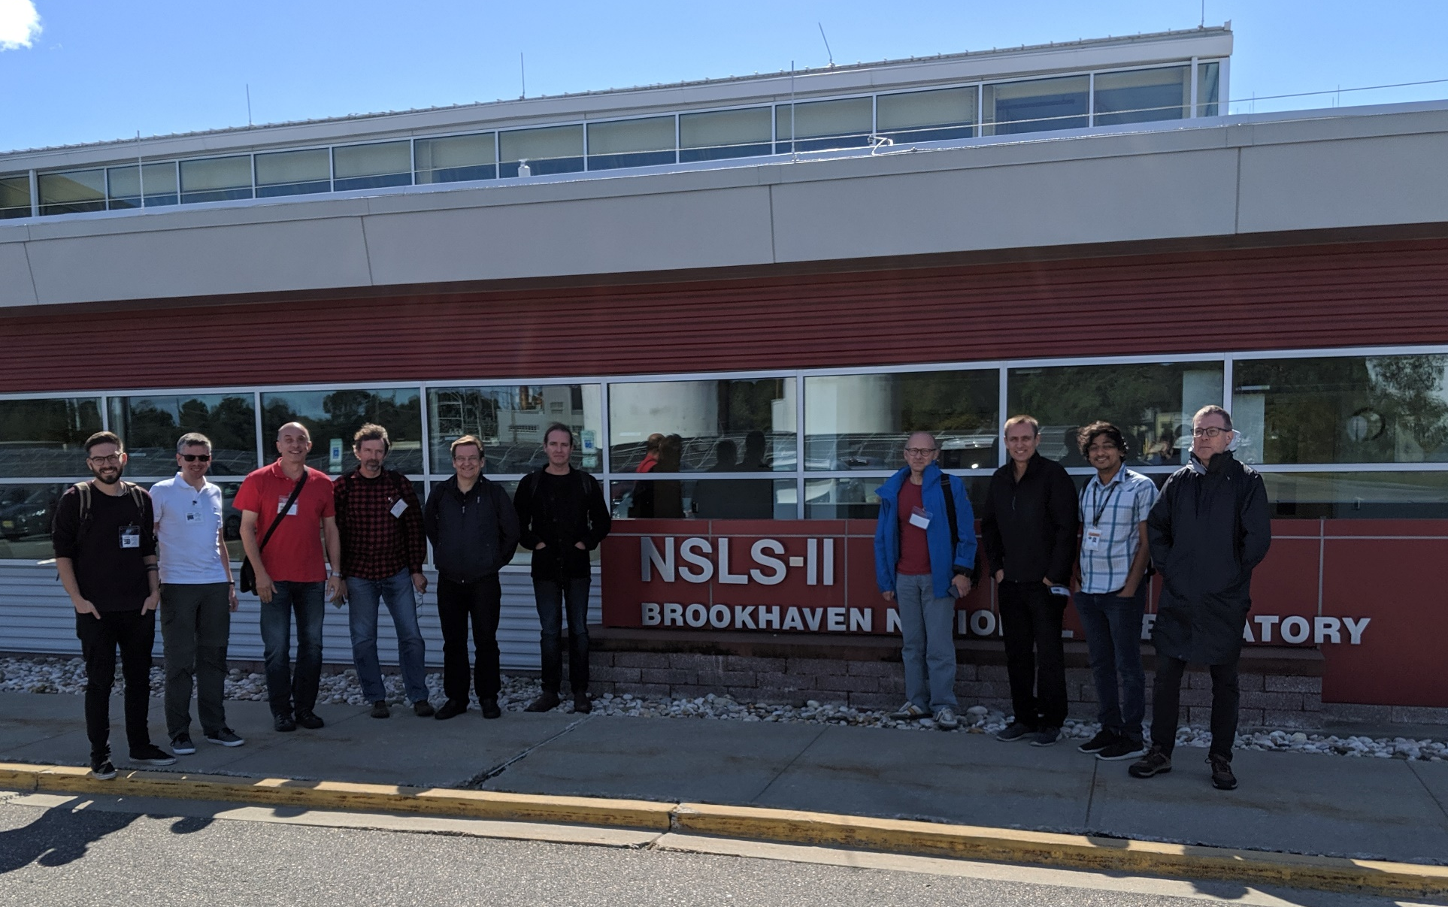

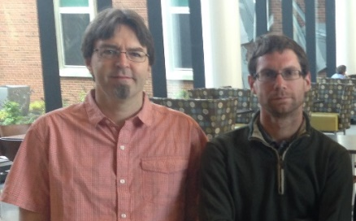
CS-Studio Developers meeting
NSLS2 2019
Meeting Highlights
  CS-Studio Roadmap
  CS-Studio 4.6 release
  Scripting
  Documentation
  Review of Core modules
CS-Studio Meeting Minutes - minutes

Slide 3
CS-Studio Roadmap
JavaFX
SWT
BOY
Display Builder
Display Builder
Display Builder
Data Browser
Data Browser
Data Browser
Data Browser
PV Tree
PV Tree
PV Tree
PV Tree
Probe
Probe
Probe
Probe
PV Table
PV Table
PV Table
PV Table
Alarms
Alarms
Alarms
Alarms
Channels
Channels
Channels
Channels
Scan
Scan
Scan
Scan
… more …
… more …
BOY
… more …
Eclipse
Eclipse
Eclipse
Phoebus
Java 11
Java 8
Java 9,10
Java 11
CS-Studio, 2010
Since ~2016
2019

Slide 4
“Phoebus”
Phoebus (Greek for “bright”)
As we step out of the shadow of
To improve user experience
A framework for well integrated control system tools and software
To reduce the barrier of entry for new developers
A simple Build
A development environment that is easy to setup and use
Use generic tools and technologies available as part of the java ecosystem

Slide 5
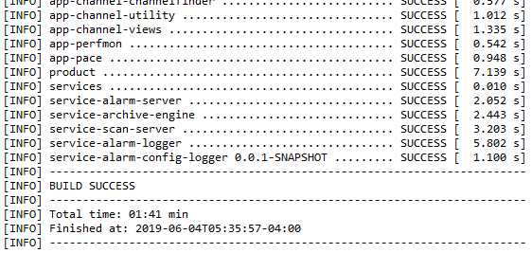
Fast & Simple Build
# clone the sources
git clone https://github.com/shroffk/phoebus.git
# build using maven
mvn clean install
# or build using ant
ant clean run
Eclipse build: 30+ mins
Phoebus build: ~3 mins

Slide 6
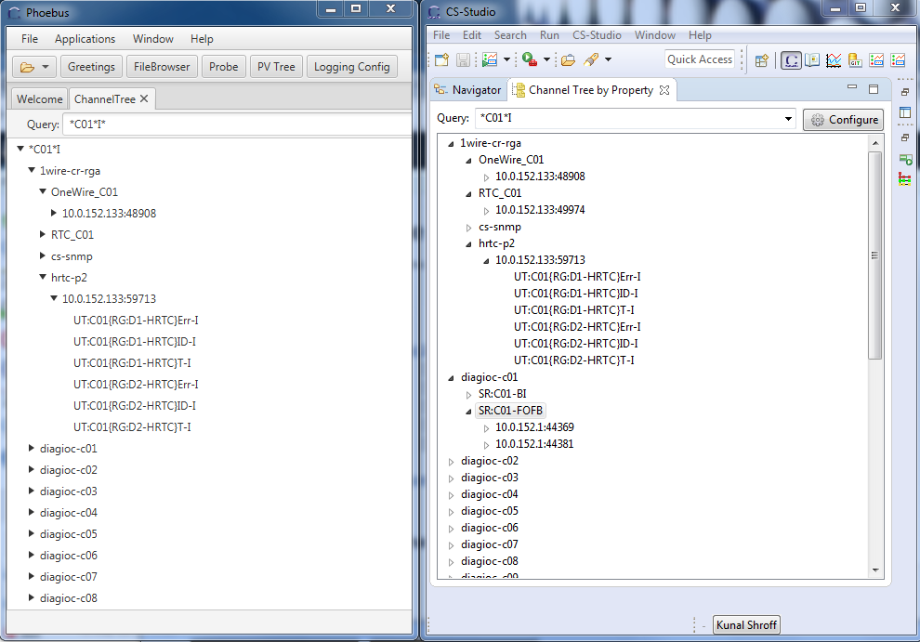
Less code
Eclipse based
Channel Finder Tree w/t
Lazy loading
11.2k Loc
Phoebus based
Channel Finder Tree w/t
Lazy loading
4.5k Loc

Slide 7
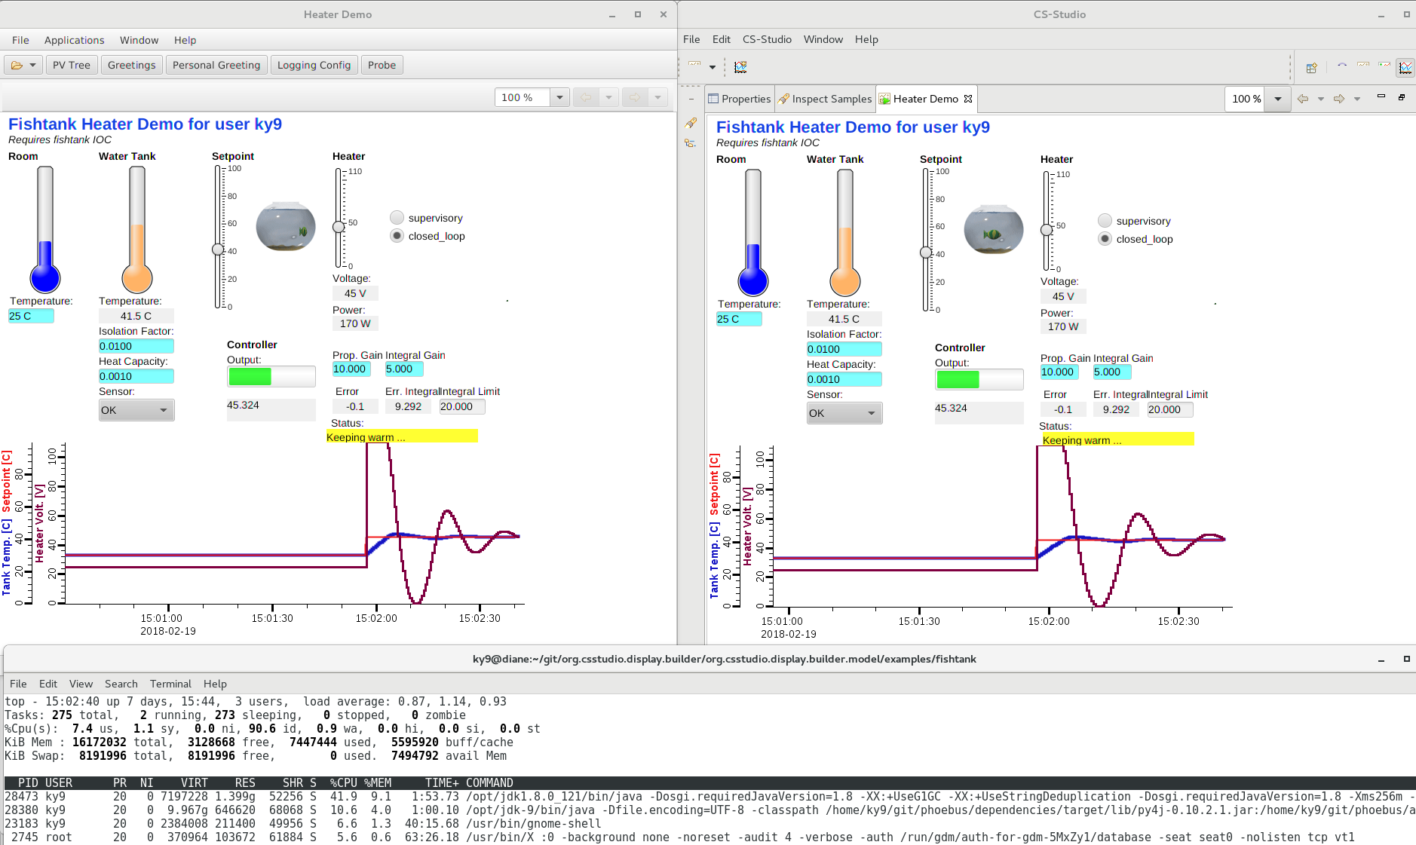
Better Performance
Phoebus:
¼ CPU,
½ Memory
CS-Studio with Eclipse

Slide 8
CS-Studio using Eclipse & Phoebus
Minimize the disruption
The migration from eclipse to Phoebus will be a multi year process
  Each application will be migrated individually.
  Both the eclipse and Phoebus based applications will be supported by the cs-studio community.
  Each site will have the flexibility to define their timelines
Notes:
The migration from eclipse to Phoebus will be a multi year process
Each application will be migrated individually.
Both the eclipse and phoebus based applications will be supported by the cs-studio community.
Each site will have the flexibility to define their time lines

Slide 9
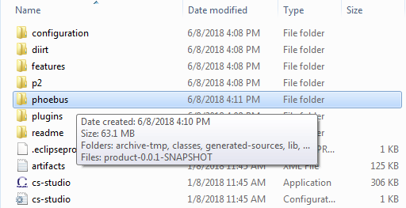
Moving from Eclipse to Phoebus
A easy transition
JavaFX
SWT
Display Builder
Display Builder
Data Browser
Data Browser
PV Tree
PV Tree
Probe
Probe
PV Table
PV Table
The Phoebus applications can be packaged with the existing eclipse applications into a single CS-Studio product
Developers can package the appropriate versions of each application to satisfy their site needs
Under the hood
org.csstudio.phoebus.integration
A plugin which provides a service with methods for launching CS-Studio phoebus applications from inside existing CS-Studio/eclipse products
Alarms
Alarms
Channels
Channels
Scan
Scan
BOY
… more …
… more …
Eclipse
Phoebus
Java 11
Java 11
Composite Product CS-Studio 4.6

Slide 10
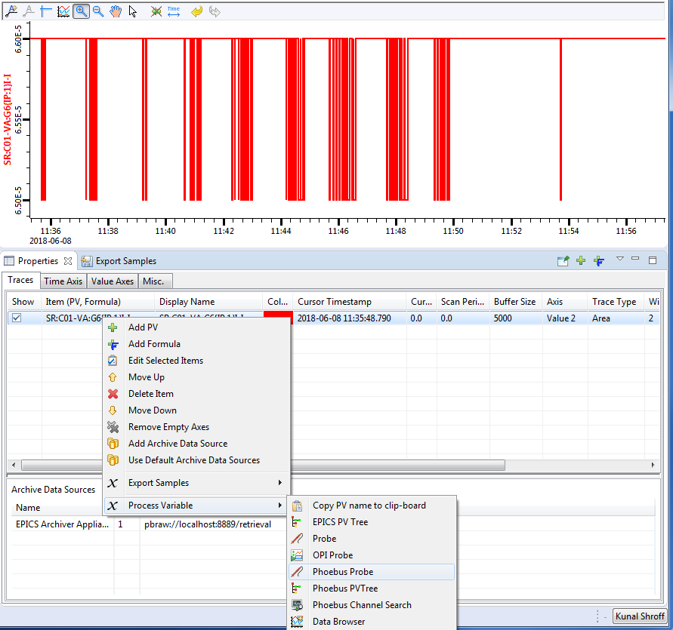
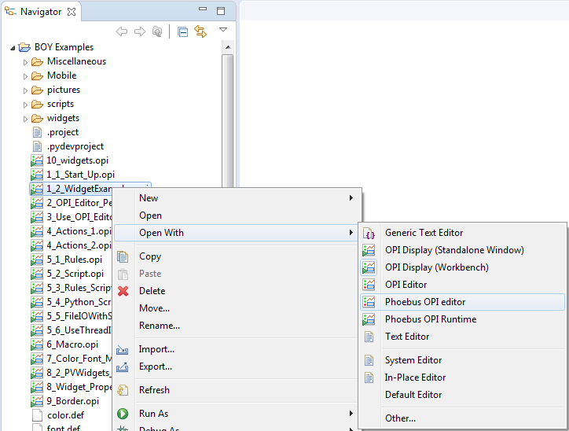
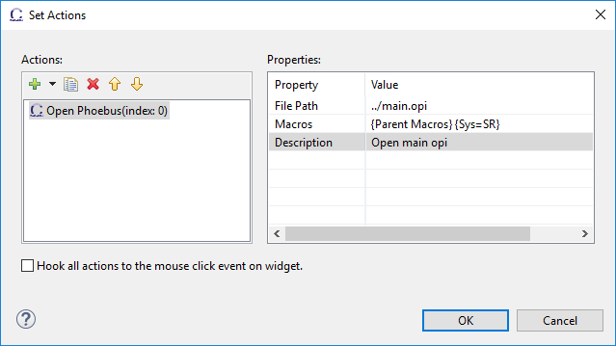
Phoebus Integration in
Existing eclipse products
Launch various Phoebus applications via
Menu bar actions
Toolbar actions
Context menu
The phoebus application is launched with the selection data.
Phoebus applications can be registered as the editors for cs-studio configuration files like .opi, .bob, .plt
“Open Phoebus” action
BOY actions buttons, menu buttons, other widgets can open resources in cs-studio phoebus applications.
Notes:
org.csstudio.phoebus.integration
A plugin which provides a service with methods for launching CS-Studio phoebus applications from inside existing CS-Studio/eclipse products
Launch various phoebus applications via
CS-Studio menu or toolbar actions
CS-Studio context menu actions using the selection
When a users launches an application or a tool, the details of weather it a swt/javafx based eclipse application or a javafx based phoebus applications are transparent to the user.
e.g. The “send an email” or “create a log entry” will open the associated phoebus apps in a new window instead of the eclipse based ones.

Slide 11
CS-Studio 4.6 release
Upgrades to the underlying infrastructure
  OpenJDK 11.0.2
  OpenJfx 11.0.2
  Eclipse 2018-12
Building CS-Studio
  Jenkins pipeline ( https://github.com/cs-studio-nsls2/build )
Phoebus framework
  Development of Phoebus services and new core modules
  Phoebus & eclipse integrations
New Application features and Bug fixes
Notes:
Significant improvement in performance on linux GTK 3
Renders well…
BOY intensity graph interpolation
Databrowser Axis
Bug fixes for multi state leds
Bug fixes for edm and medm converters

Slide 12
Scripting support
JavaScript support in OPIs depend on the Nashorn interpreter, which will be removed in future Java releases. Graal (supported by Oracle) seems to be a good – and faster – replacement.
Jython still on version 2.7, development is slow and there is no clear roadmap for version 3.
Rules are converted to Jython scripts, implementing them in Java
  eliminates the script engine initialization overhead resulting in faster OPI loading.
  less error prone
  better performance
Script support in OPIs is to some extent abused. Logic may in many cases be expressed through formula functions.

Slide 13

Documentations
User Documentation
Read-The-Docs (https://github.com/kasemir/phoebus-doc)
Phoebus repository is parsed for .rst, preferences.ini, and html files which are used to create documentation in html and/or download formats hosted at
http://phoebus-doc.readthedocs.io/en/latest/
Developers Documentation
In github readme.md and Javadoc’s

Slide 14
Design Patterns & Best Practices
Review of the Core Modules
SelectionService & AdapterService
Context Menu Helper
Security
  AuthorizationService
  SecureStore
  An encrypted store for saving user credential
Notes:
ecureStore mechanism could prompt user for the secure-store-password instead of using Integer.toString(secure_file.getAbsolutePath().hashCode()).toCharArray()

Slide 15
How to Contribute
(and get free Beer)
Fork us on Github
  https://github.com/ControlSystemStudio/cs-studio
Create Issue tickets for feature request / bugs
Point out missing documentation
Pick an issue/feature or make one
  https://github.com/ControlSystemStudio/cs-studio/issues
Create a branch in your fork with the fix or feature
Make a Pull Request with the issue number in the title
Attend meetings, know the release schedule, subscribe to mailing list

Slide 16
Meetings
We use Google Hangouts to share our progress and discuss issues
  Meetings are posted (viewable after being added to group)
  First Wednesday of the month (9am EST)
  Project groups meet once a week when actively developing

Slide 17
Useful links
CS-Studio
https://github.com/ControlSystemStudio/cs-studio
https://github.com/shroffk/phoebus
http://phoebus-doc.readthedocs.io/en/latest/
CS-Studio Phoebus Integration
https://github.com/ControlSystemStudio/cs-studio/issues/2437

Slide 18
Questions?

