Slide 1
Systems Delivery And What Lurks Below: Legacy, Support, Users
EPICS Collaboration Meeting, ICALEPCS 2019
Anton A. Derbenev, 5 October 2019

Slide 2
Plan
Scope
What we do now
What we tried
What we discovered
What we plan to do
Conclusion

Slide 3
Scope
A comprehensive approach to Controls software delivery
Not only about the software itself:
  Version control for code (e.g. EPICS drivers) and configurations (e.g. st.cmd)
  Development and production environments (base, modules…)
  Testing setups, build environments
  Means of deployment and update
  …
Now have to consider delivery of the delivery

Slide 4
What we do now
EPICS base, modules available as Debian packages from NSLS-II repo
  Debian 8, 9, and 10 in the works
  “Debianized” source comes from epicsdeb on GitHub, no EPICS 7 packaging
  Delivered to IOC systems by puppet
Manual builds to get “newer” stuff (EPICS 7, AreaDetector 3.7…)
Using GitLab and Mercurial for code and configurations
IOCs deployed manually, sysv-rc-softioc for running
Services deployed manually, configurations are centralized
Central repository for OPIs, automatically synced to workstations

Slide 5





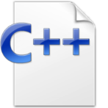




EPICS delivery
Debian repository
Repository owner
Maintainer
Code
“Debianized” code
Tester
System owner
Developer
Production
Binaries
Many tasks should be handled for code to become available on production system, and coordination is required to ensure that environment is both stable and up to date

Slide 6



What we tried
SNACK, an Ansible-based toolkit for building, deployment, and configuration management [App delivery]
  Good amount of stable IOCs was converted
  Currently in use by inclined developers
  Not a “standard” solution
Binary “bundles” made available via NFS [Environment delivery]
  Currently used for newer AreaDetector deployments
  Comes with tools to upgrade IOCs and create new bundles as updates come
GitLab CI/CD for IOCs, Jenkins for services [App delivery]
  Easy to use, not easy to set up (runners, keys, proxies…)
  In simplistic proof-of-concept stage for IOCs, limited usage for services
Docker etc. [Environment + App delivery]
  “Environment” image with base, modules, etc. available in volume
  “Application” image, per IOC/app, on host network stack using “environment”
  In simplistic proof-of-concept stage

Slide 7
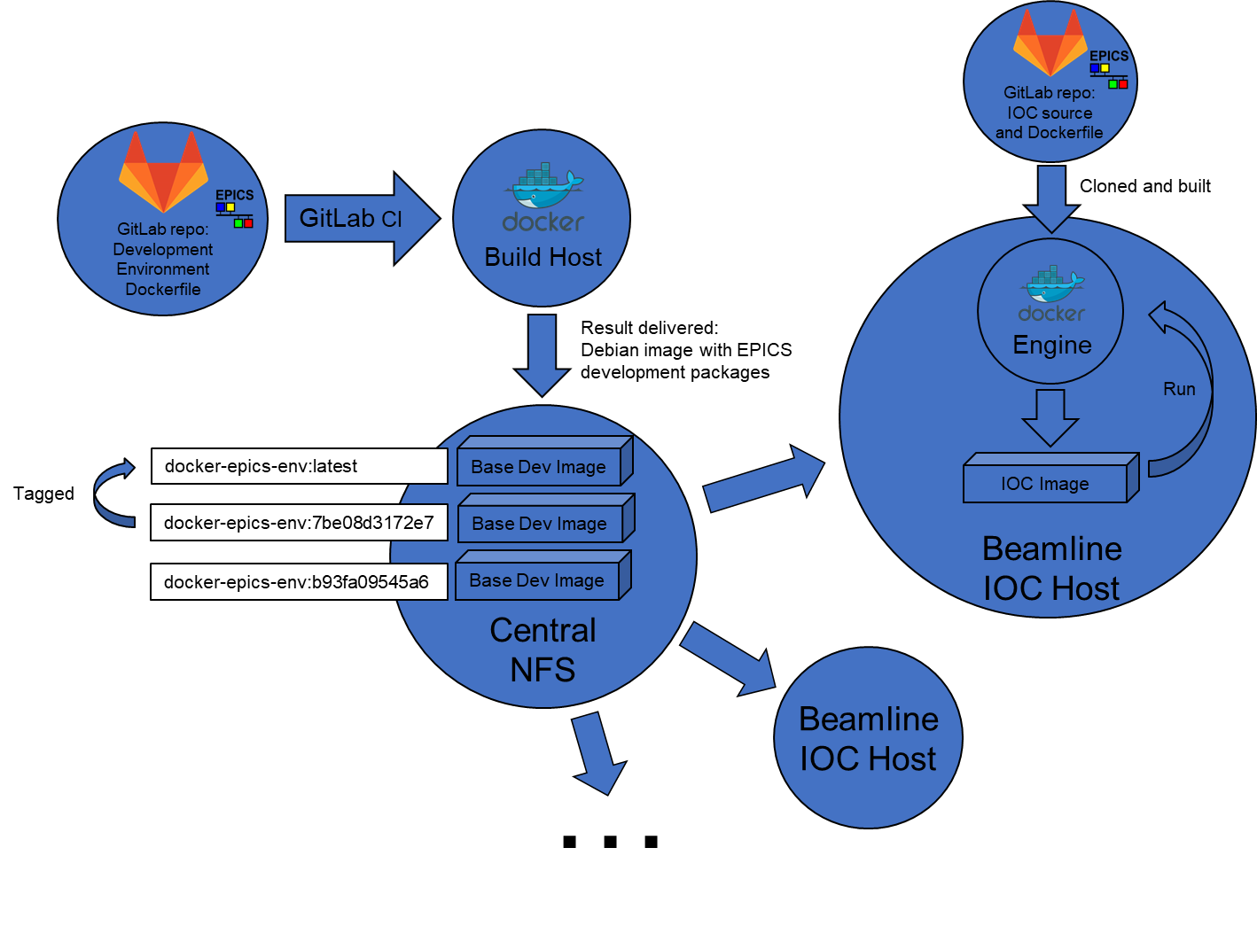
Sample – EPICS + App delivery
One image with EPICS
One image per IOC
Use volumes, host networking
Capitalize on Docker for features (tagging, logs, run control…)
Good: it works
Bad: so what?

Slide 8
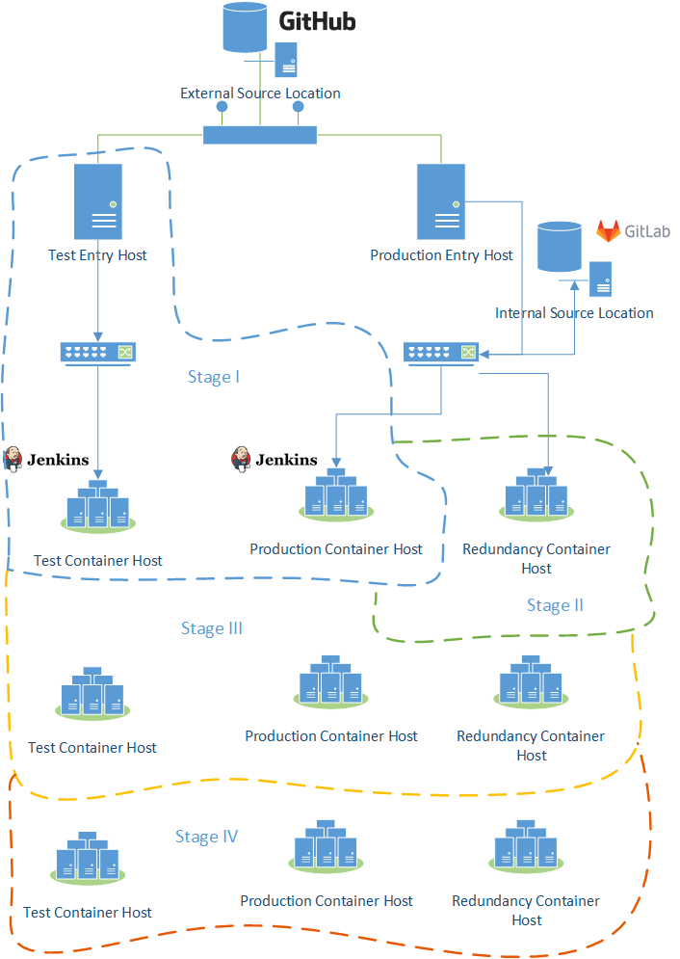
Going virtual
Switch to containers with known and exact configuration
  Leave Legacy behind
  Easy to re-deploy and recover
  Perform testing in isolation from production
Use modern CI/CD tools
  Actual solutions are easier in Support
  Users get a well-defined toolkit
  Capitalize on benefits and tools
De-couple from other system considerations
  Not influenced by external changes, e.g. dependencies, OS, and environment configuration
  Agnostic to hardware

Slide 9
What we discovered
No solution is comprehensive
  Approaches usually target a specific need (see custom build scripts, packaging, SNACK, SUMO, rsync-dist, CI/CD – great materials from 2019 France meeting)
  Lots of questions appear from “how do we make it standard, facility-wide?”
Legacy
  Many apps exist “the old way” (in-place, HG…). Are we upgrading? How?
  Old dependencies are everywhere, incompatible with new solutions
Support
  No solution comes for free – maintenance and upgrade are liability
  There is a reason why DevOps are often considered separately
Users
  Whatever tool or approach, there should be buy-in and adoption
  Documentation and training cannot be waived

Slide 10
What we plan to do
Target specific needs instead of “all-problems-solutions”
Procure and deploy hardware, software, and support for general CI/CD
  “Container host” machines are standing by for Docker etc. experiments
  Planning to use Jenkins or GitLab or something “properly” with builds and testing
Enable a consistent route for services deployment and update – Phoebus
  Deliver CS-Studio, Olog, Alarm, Phoebus…
  Take dependencies under control
Converge on a “standard” approach for detector software – AD update venue
  Specifically, AreaDetector binaries and IOCs deployment
  Try to keep it abstract enough to apply to IOCs in general
Decide on future delivery of development/production setups – EPICS [7]
  Put more effort and pressure to Debian packaging?
  Abstract from beamline environments via virtualization?
  Use different OS or delivery mechanism?

Slide 11
Conclusion
The “legacy pillow” is worn out
Refreshments are needed to keep up with systems evolution
There are plans to increase investments in delivery

Slide 12
Thanks for your attention!
Questions?

