Slide 1

Enhanced Support for GenICam Cameras and Detectors
Mark Rivers
GeoSoilEnviroCARS, Advanced Photon Source
University of Chicago

Slide 2
GenICam Overview
Generic Interface for Cameras standard is the base for plug & play handling of cameras and devices.
From European Machine Vision Association (EMVA)
“The goal of GenICamTM (Generic Interface for Cameras) is to provide a generic programming interface for all kinds of devices (mainly cameras), no matter what interface technology (GigE Vision, USB3 Vision, CoaXPress, Camera Link HS, Camera Link etc.) they are using or what features they are implementing. The result is that the application programming interface (API) will be identical regardless of interface technology.”

Slide 3
GenICam Overview
GenApi
  Defines the mechanism used to provide the generic API via a self-describing XML file in the device. Part of GenApi is the Schema, which defines the format of the XML file.
SFNC (Standard Features Naming Convention)
  Standardizes the name, type, meaning and use of device features, so that devices from different vendors always use the same names for the same functionality.
GenTL (Transport Layer)
  Standardizes the transport layer programming interface. It is a low-level API to provide a standard interface to a device regardless of the transport layer It allows enumerating devices, accessing device registers, streaming data and delivering asynchronous events. GenTL also has its own SFNC.

Slide 4
Interface Standards used by GenICam
GigE Vision
USB3 Vision
Camera Link
Camera Link HS
IIDC2 (Firewire)

Slide 5
GenICam XML Files
Every GenICam camera has an XML file inside it that can be accessed to determine the cameras available “features”.
By reading and parsing this XML file one can automatically generate the EPICS database and OPI screens based on the specific features available in that camera. Small snippet for PixelFormat:
<Enumeration Name="PixelFormat" NameSpace="Standard">
<ToolTip>Format of the pixel data.</ToolTip>
<Description>Format of the pixel data.</Description>
<DisplayName>Pixel Format</DisplayName>
<Visibility> Beginner</Visibility>
<pIsLocked>TLParamsLocked</pIsLocked>
<ImposedAccessMode>RW</ImposedAccessMode>
<EnumEntry Name="Mono8" NameSpace="Standard">
<ToolTip>Pixel format set to Mono 8.</ToolTip>
<Description>Pixel format set to Mono 8.</Description>
<DisplayName>Mono 8</DisplayName>
<pIsImplemented>Mono8Inq_Reg</pIsImplemented>
<Value>0x01080001</Value>
</EnumEntry>

Slide 6
GenICam and aravis
GenICam is not open source
There is a reference implementation of the GenICam API, but it cannot be released publicly
  This is a pain, but we need to live with it
aravis is an open-source toolkit based on reverse-engineering the GenICam specifications and protocols.
  Linux-only, based on glib
There is an older areaDetector driver, aravisGigE based on aravis
  https://github.com/AravisProject/aravis
aravis previously supported only GigE, but now also supports USB3
  I have modified areaDetector/aravisGigE to also support USB3

Slide 7
ADGenICam
Vendor APIs for GenICam cameras are very similar, and programming straight to them results in lots of redundant code.
Instead create a new areaDetector base class to support any GenICam camera
Much of the generic code is in this layer
  Implements code to get and set GenICam features
Creates the areaDetector parameter library dynamically at iocInit from the drvUser fields passed by each record.

Slide 8
ADGenICam
Derived classes for real drivers
  Implement the code to read and write features to the device
  Implement the code to stream the images from the device
ADAravis
  Uses aravis library
  Replaces aravisGigE with much of the code moved to the base class
  Linux only (most versions, e.g. RHEL 7)
ADSpinnaker
  New version of driver for FLIR/Point Grey cameras using their Spinnaker SDK
  The old FlyCap2 SDK used by ADPointGrey is not supported for their newer cameras (e.g. BlackFlyS and Oryx 10Gbit)
  Windows and new versions of Linux (e.g. Ubuntu 18, not RHEL 7)
ADVimba
  New driver for AVT/Prosilica cameras using their Vimba SDK
  The old pvAPI SDK used by ADProsilica is obsolete and no longer supported
  Windows and Linux (most versions, e.g. RHEL 7)

Slide 9
arv-tool (from aravis package)
Find the cameras
corvette: ADAravis>bin/linux-x86_64/arv-tool-0.6
Allied Vision Technologies-02-2142A-06178 (164.54.160.58)
Allied Vision Technologies-02-2604A-07008 (164.54.160.104)
Allied Vision Technologies-50-0503317598 (164.54.160.62)
Allied Vision Technologies-50-0503419258 (164.54.160.21)
PointGrey-13481965 (164.54.160.114)
Prosilica-02-2142A-06110 (164.54.160.57)
Extract the XML file
>arv-tool-0.6 -n PointGrey-13481965 genicam > BFly-20E4C.xml
Look at the XML file
>more BFly-20E4C.xml
PointGrey-13481965 (164.54.160.114)
<?xml version="1.0" encoding="UTF-8"?>
<!—
<RegisterDescription
xmlns:xi="http://www.w3.org/2003/XInclude"
…
Must run this once on Linux for each new camera type toc reate XML file.

Slide 10
Python tool to create template file from XML file
Create the database with makeDb.py
>scripts/makeDb.py BFly-20E4C.xml BFly-20E4C.template
Snippet of the template file
record(ai, "$(P)$(R)GC_ExposureTime_RBV") {
field(DTYP, "asynFloat64")
field(INP, "@asyn($(PORT),$(ADDR=0),$(TIMEOUT=1))GC_D_ExposureTime")
field(PREC, "3")
field(SCAN, "I/O Intr")
field(DISA, "0")
}
record(ao, "$(P)$(R)GC_ExposureTime") {
field(DTYP, "asynFloat64")
field(OUT, "@asyn($(PORT),$(ADDR=0),$(TIMEOUT=1))GC_D_ExposureTime")
field(PREC, "3")
field(DISA, "0")
}
Creates output and readback record for each feature that the camera supports.

Slide 11
Python tool to create medm files from XML file
Create the medm files with makeAdl.py
>scripts/makeAdl.py BFly-20E4C.xml BFly-20E4C
>ls -l *.adl
-rw-rw-r-- 1 epics domain users 54593 Apr 17 16:53 BFly-20E4C-features_1.adl
-rw-rw-r-- 1 epics domain users 48936 Apr 17 16:53 BFly-20E4C-features_2.adl
-rw-rw-r-- 1 epics domain users 21322 Apr 17 16:53 BFly-20E4C-features_3.adl
Snippet of the adl file
# (Menu Button)
menu {
object {
x=235
y=520
width=150
height=20
}
control {
chan="$(P)$(R)GC_SaturationAuto"
clr=14
bclr=51
}
}

Slide 12
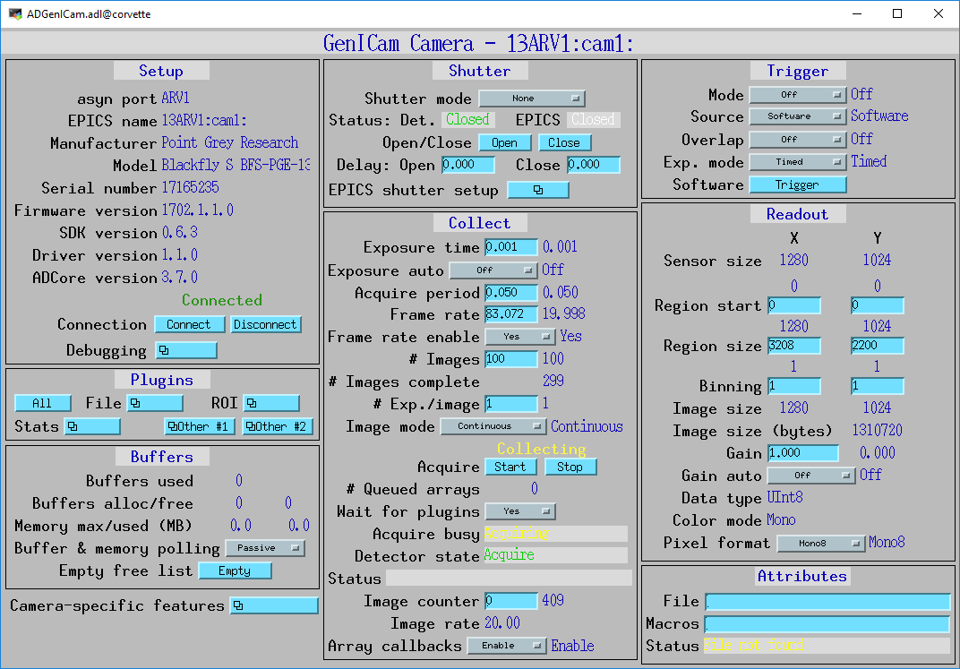
Main medm screen for ADGenICam
Identical screens are provided for EDM, CSS/BOY, and caQtDM via auto-convert

Slide 13
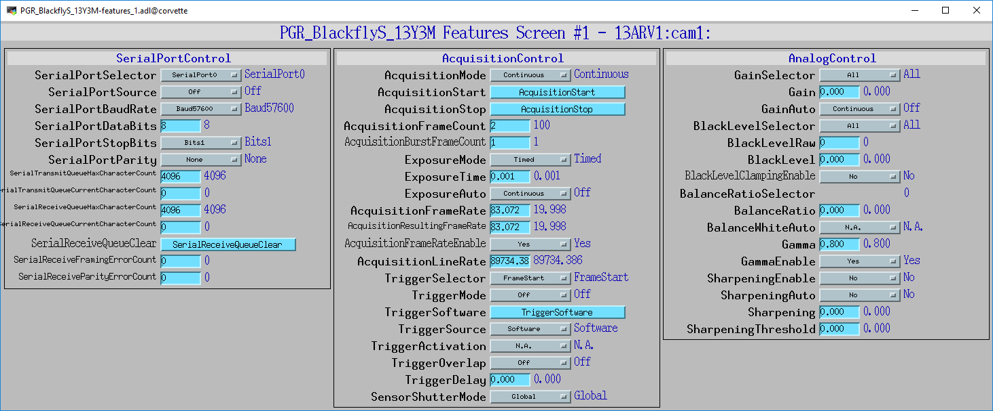
Auto-generated medm screens for PGR BlackflyS 13Y3M
Screen #1

Slide 14
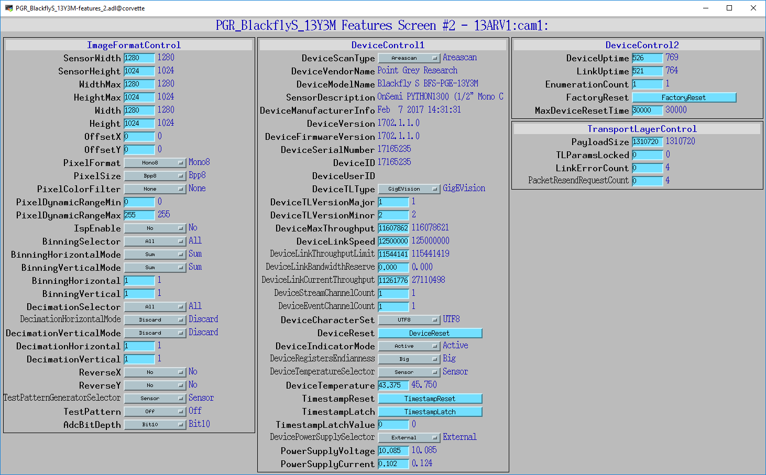
Auto-generated medm screens for PGR BlackflyS 13Y3M
Screen #2

Slide 15
ADGenICam Status
Good framework, lots is done automatically
ADAravis will support any GenICam camera on Linux (GigE, USB3, possibly Camera Link)
ADSpinnaker and ADVimba work on Windows and may have higher performance because vendor-optimized transport layer
ADSpinnaker is released and working well.
ADAravis is released
  Performance issues for some cameras due to bug in aravis library.
  It does not correctly implement “register caching”.
  ADGenICam reads back all features when any one is changed, since there can be side-effects.
  aravis developer is actively working on a fix.
ADVimba still needs work

