Slide 1
Just-in-time EDM converter
Kay Kasemir, October 2019

Slide 2
Display Tools Evolve …
*.edl
*.opi
*.bob
EDM
~2000
Linux (X11, Motif)
CS-Studio ‘BOY’
~2006
Linux/Win/Mac (SWT)
CS-St. ‘Display Builder’
~2018
Linux/Win/Mac (JFX)
Web EDM
~2017
Fast!
No plots; only CA
WebOPI
~2007
RAP = Same code
Slow!
D.B. Web Runtime
~2019
CA, PVA, Plots, …
No Scripts

Slide 3
EDM
Compiles, runs fine
WebEDM now allows viewing most displays remotely
→ No need to panic right now.
But technology moves on.
Good to have upgrade path

Slide 4
Converters…
Original CS-Studio EDM Converter
Display Builder reads *.opi
*.edl
*.opi
*.bob
Direct EDM-to-Display Builder Converter
For the record, there’s also an MEDM *.adl to *.bob converter

Slide 5
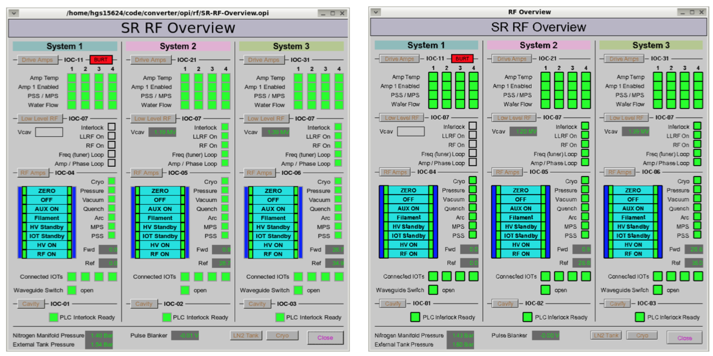
CS-Studio EDM converter
Started by SNS, Cosylab contract
Finessed by DLS when replacing EDM with CS-Studio
Creates BOY *.opi files
Will Rogers, Spring 2015 EPICS Meeting

Slide 6
Meanwhile, CS-Studio moves on
Eclipse → Phoebus
SWT → JavaFX
BOY *.opi → Display Builder *.bob
RAP OPI (slow) → Display Builder Web Runtime (very decent)
Porting EDM converter to CS-Studio/Phoebus
Same EDM parser
Now creates *.bob files

Slide 7
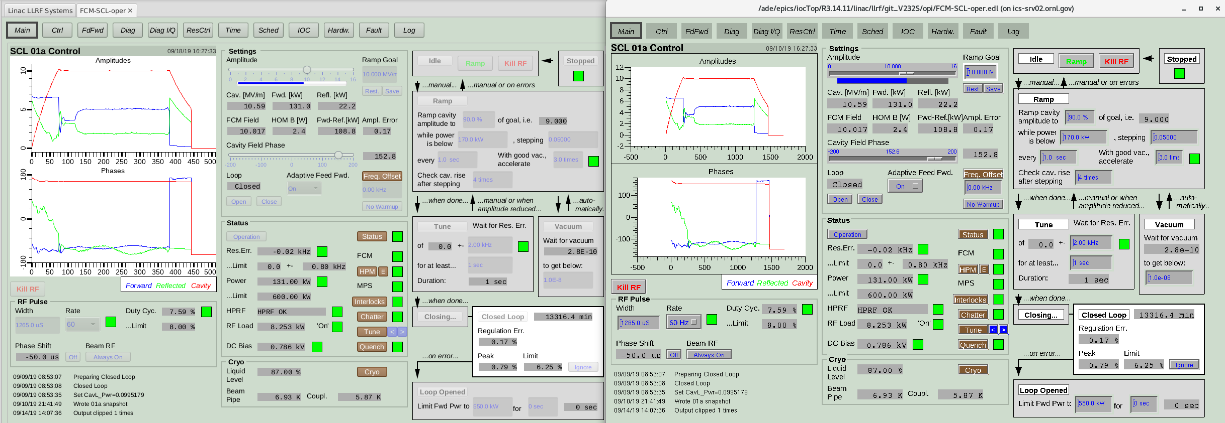
Converted vs. EDM

Slide 8
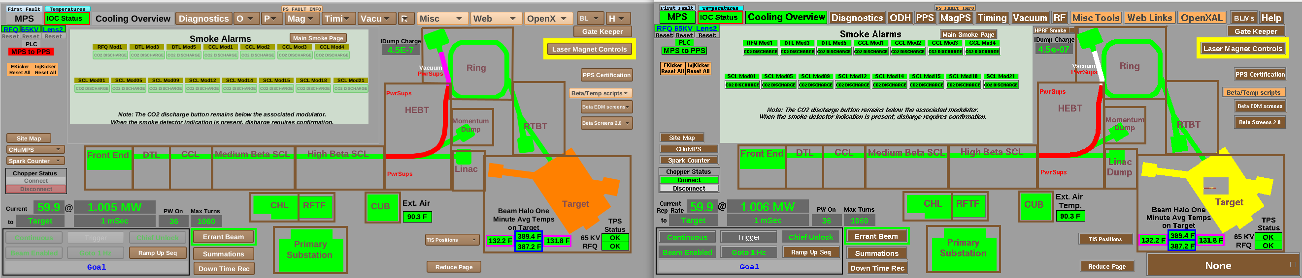
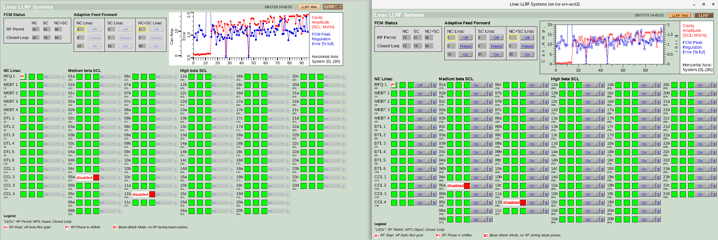

Slide 9
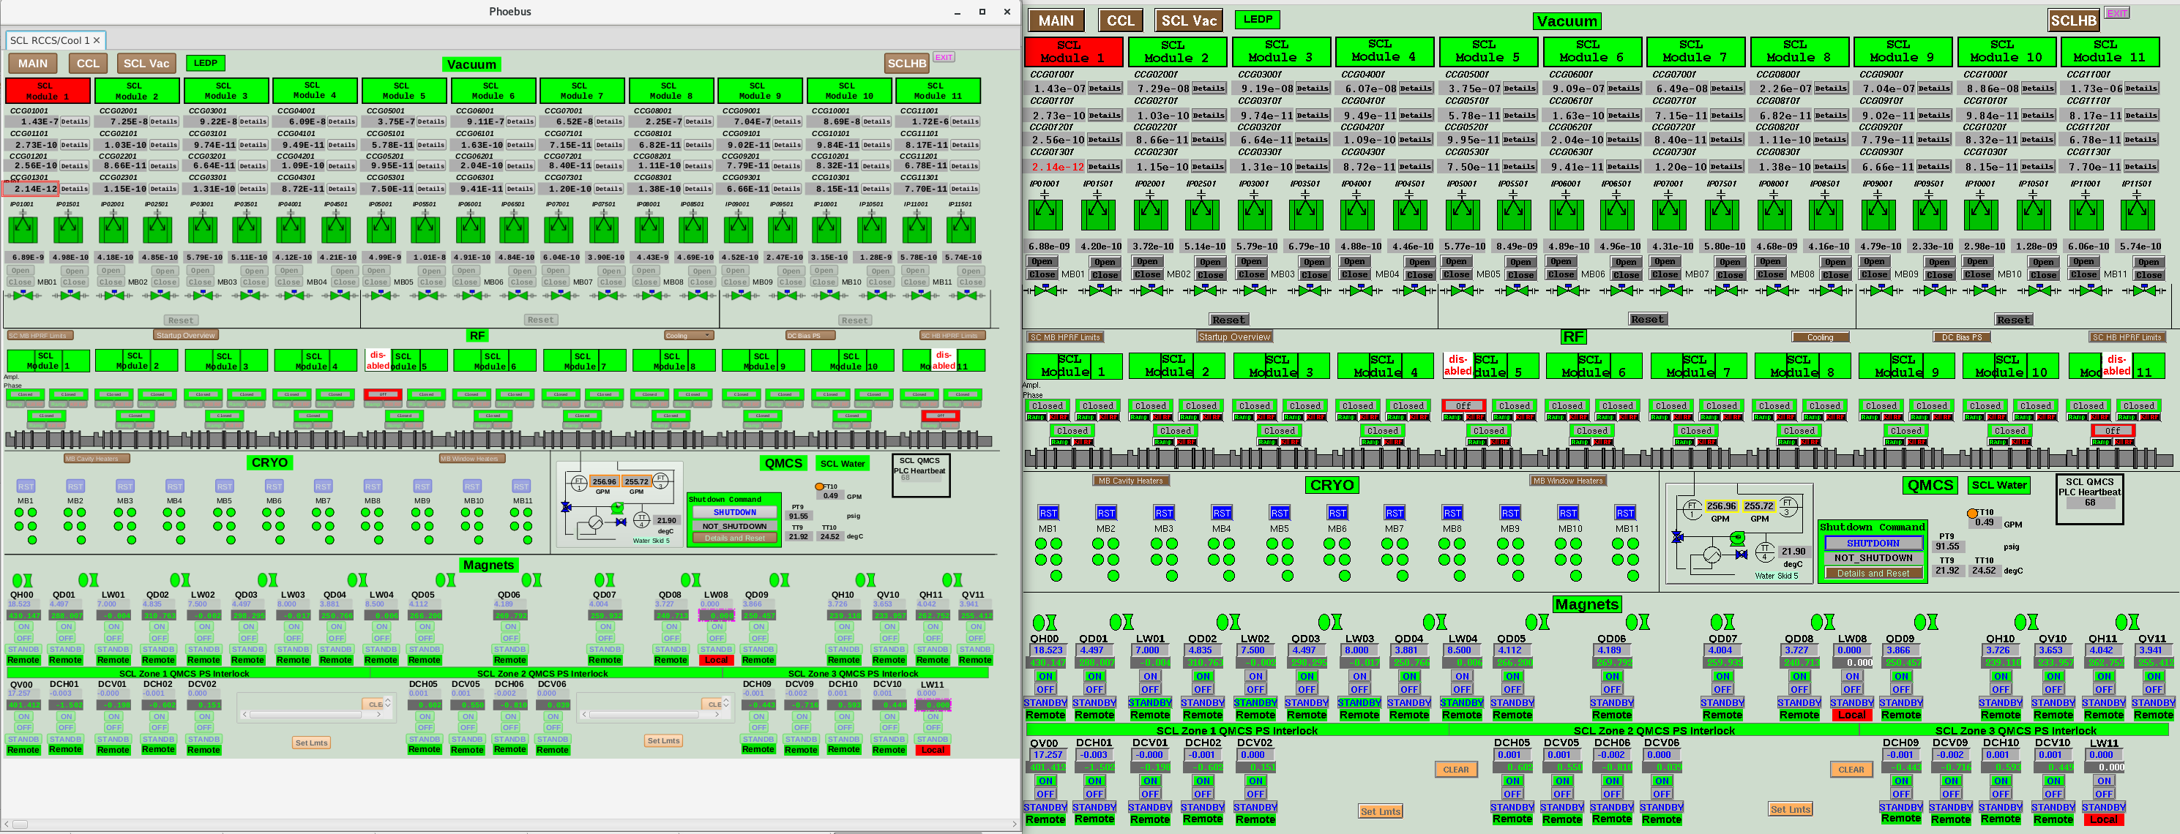

Slide 10
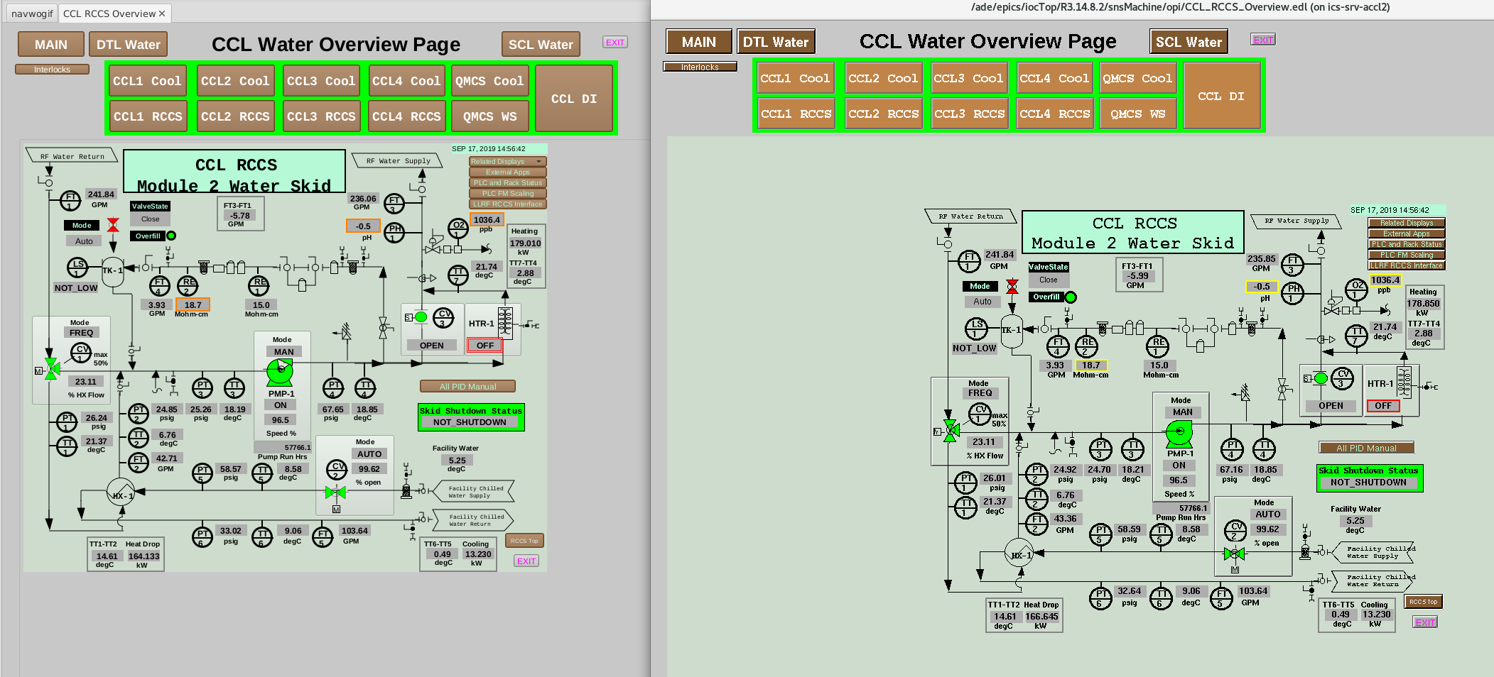

Slide 11
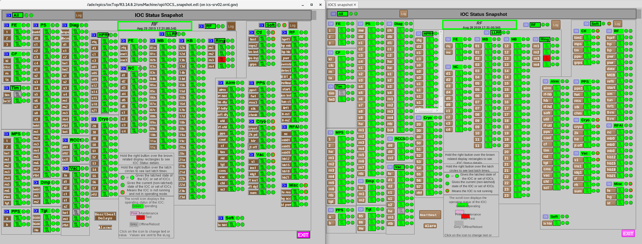
Now: EDM vs. Converted

Slide 12
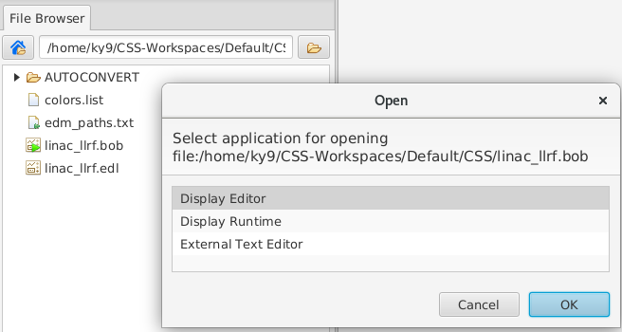
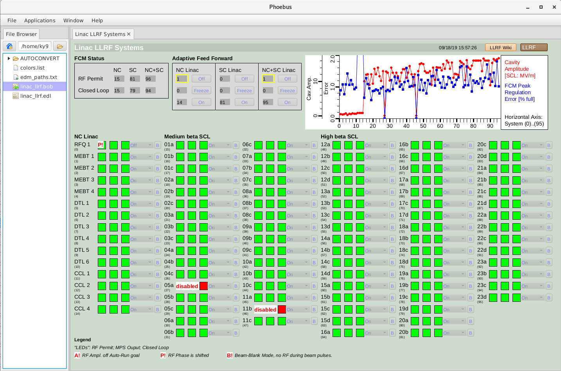
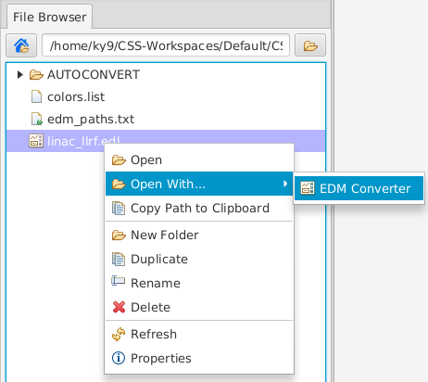
How to convert EDM files? 1) Interactively
Open *.edl file in CS-Studio/Phoebus

Slide 13
2) Command line
Convert individual files or complete folders
Can use EDM search path
Can convert ‘embedded’ or ‘linked’ files,
configurable recursion depth
Still, SNS has ~8000 files on search path.
Blindly convert all?

Slide 14
3) Auto-Converter
Configure EDM search path (may be http:/…)
and auto-convert target folder (local)
Whenever XYZ.bob is missing, auto-converted from XYZ.edl
EDM Search Path
Auto-converted Files
*.edl
*.bob
Display Accessed?

Slide 15
EDM Converter Highs/Lows
Converts “CALC” PVs into formulas
Combines overlapping related display buttons
Works surprisingly well
Can only convert EDM 4
  “edm –convert ..” older files
You’ll always find something

Slide 16
EDM Converter in Phoebus
Similar to previous *.edl → *.opi, now → *.bob
Never perfect, but already quite good
Can be used ‘just-in-time’ to convert files as needed

